Slide 1
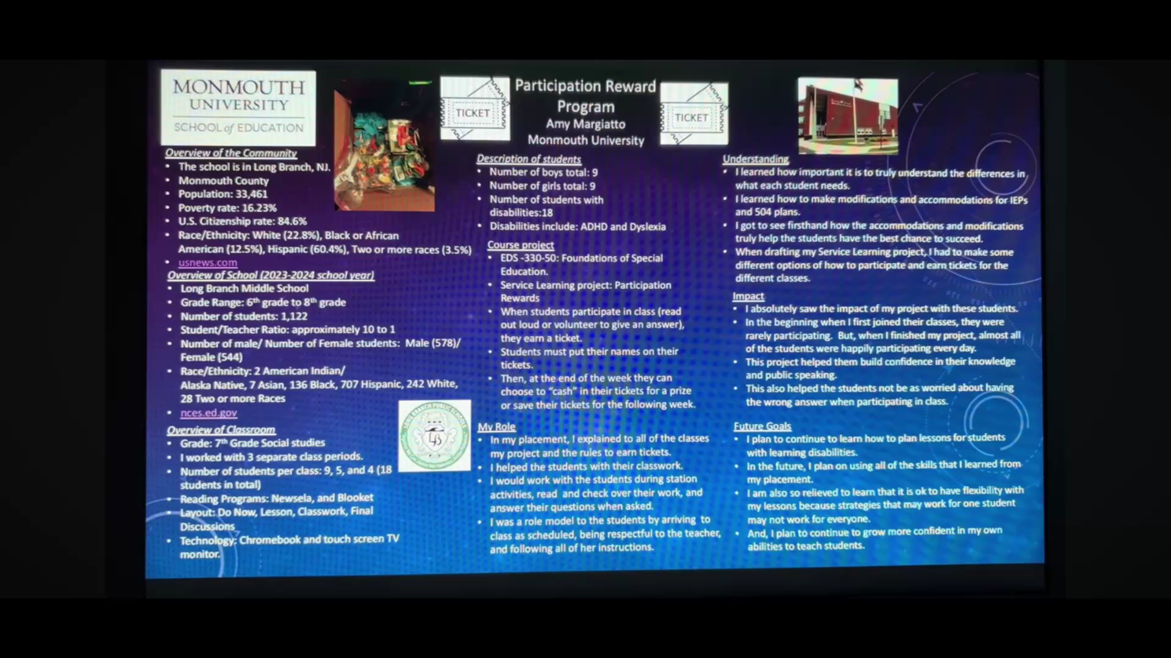
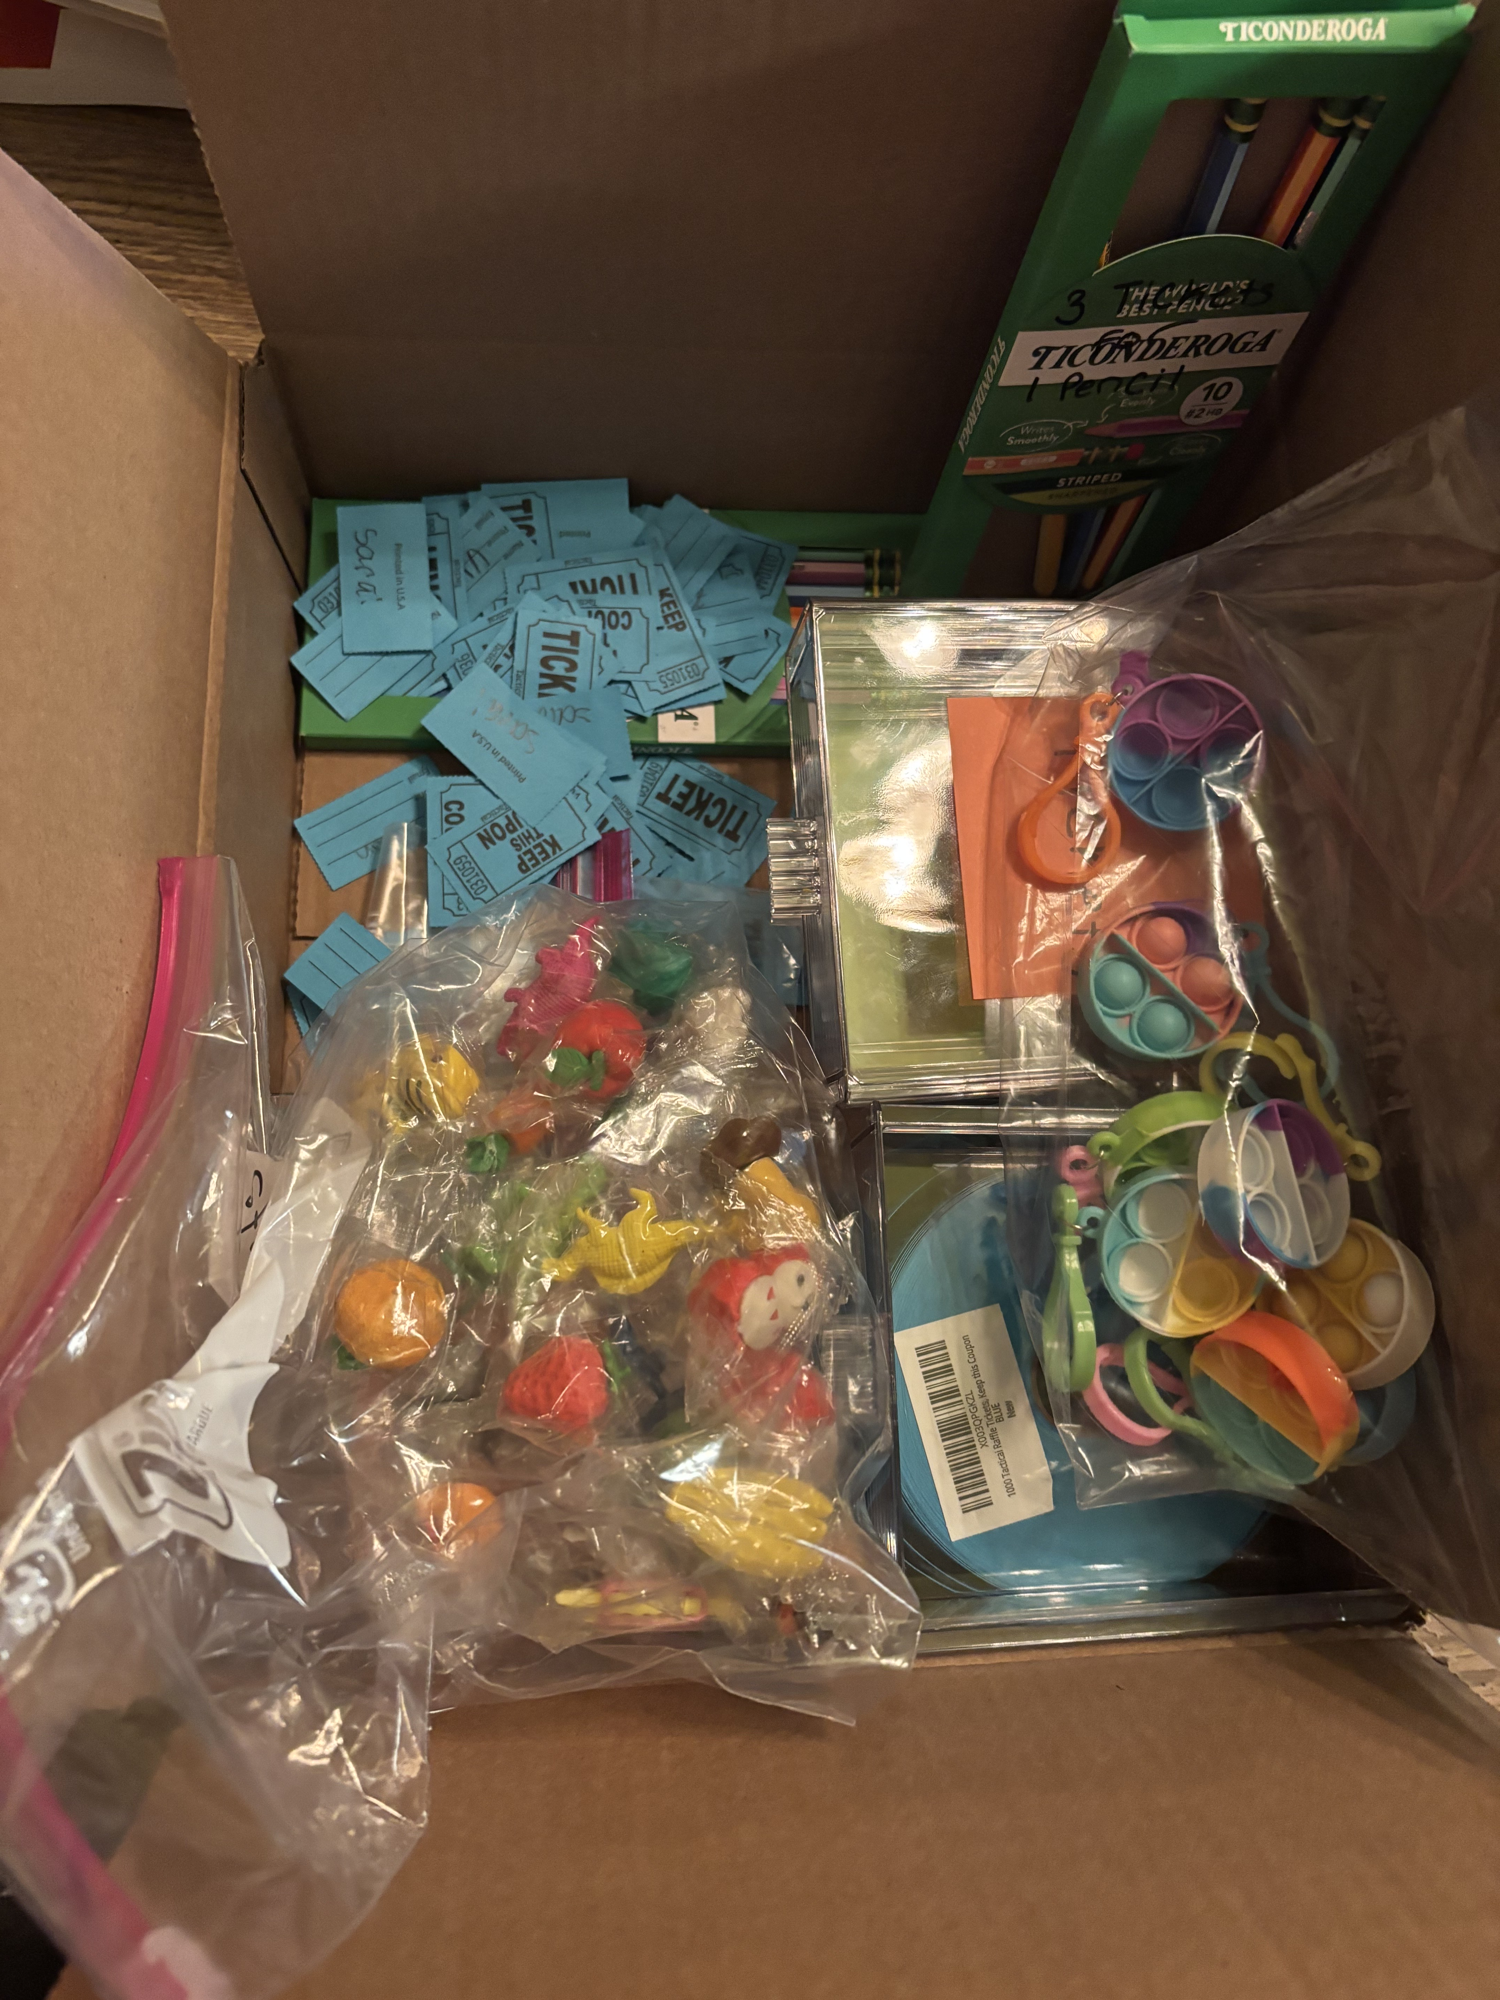
Participation Reward Program
Amy Margiatto
Monmouth University
Setting
Overview of the Community
The school is in Long Branch, NJ.
Monmouth County
Population: 33,461
Poverty rate: 16.23%
U.S. Citizenship rate: 84.6%
Race/Ethnicity: White (22.8%), Black or African American (12.5%), Hispanic (60.4%), Two or more races (3.5%)
usnews.com
Description of students
Number of boys total: 9
Number of girls total: 9
Number of students with disabilities:18
Disabilities include: ADHD and Dyslexia
Understanding
I learned how important it is to truly understand the differences in what each student needs.
I learned how to make modifications and accommodations for IEPs and 504 plans.
I got to see firsthand how the accommodations and modifications truly help the students have the best chance to succeed.
When drafting my Service Learning project, I had to make some different options of how to participate and earn tickets for the different classes.
Course project
EDS -330-50: Foundations of Special Education.
Service Learning project: Participation Rewards
When students participate in class (read out loud or volunteer to give an answer), they earn a ticket.
Students must put their names on their tickets.
Then, at the end of the week they can choose to “cash” in their tickets for a prize or save their tickets for the following week.
Overview of School (2023-2024 school year)
Long Branch Middle School
Grade Range: 6th grade to 8th grade
Number of students: 1,122
Student/Teacher Ratio: approximately 10 to 1
Number of male/ Number of Female students: Male (578)/ Female (544)
Race/Ethnicity: 2 American Indian/ Alaska Native, 7 Asian, 136 Black, 707 Hispanic, 242 White, 28 Two or more Races
nces.ed.gov
Impact
I absolutely saw the impact of my project with these students.
In the beginning when I first joined their classes, they were rarely participating. But, when I finished my project, almost all of the students were happily participating every day.
This project helped them build confidence in their knowledge and public speaking.
This also helped the students not be as worried about having the wrong answer when participating in class.
Overview of Classroom
Grade: 7th Grade Social studies
I worked with 3 separate class periods.
Number of students per class: 9, 5, and 4 (18 students in total)
Reading Programs: Newsela, and Blooket
Layout: Do Now, Lesson, Classwork, Final Discussions
Technology: Chromebook and touch screen TV monitor.
My Role
In my placement, I explained to all of the classes my project and the rules to earn tickets.
I helped the students with their classwork.
I would work with the students during station activities, read and check over their work, and answer their questions when asked.
I was a role model to the students by arriving to class as scheduled, being respectful to the teacher, and following all of her instructions.
Future Goals
I plan to continue to learn how to plan lessons for students with learning disabilities.
In the future, I plan on using all of the skills that I learned from my placement.
I am also so relieved to learn that it is ok to have flexibility with my lessons because strategies that may work for one student may not work for everyone.
And, I plan to continue to grow more confident in my own abilities to teach students.

