Slide 1







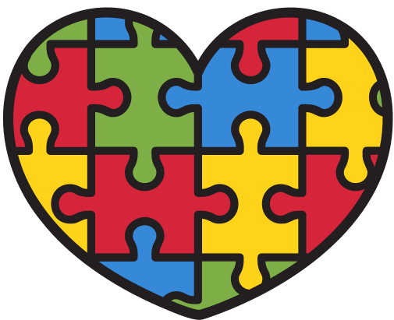










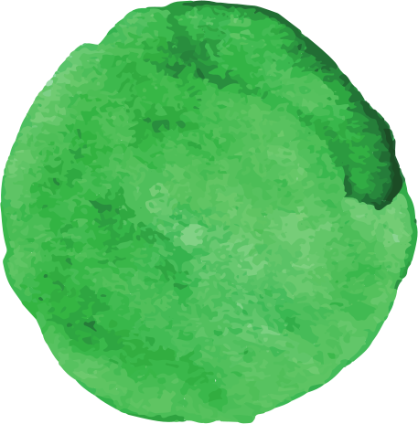

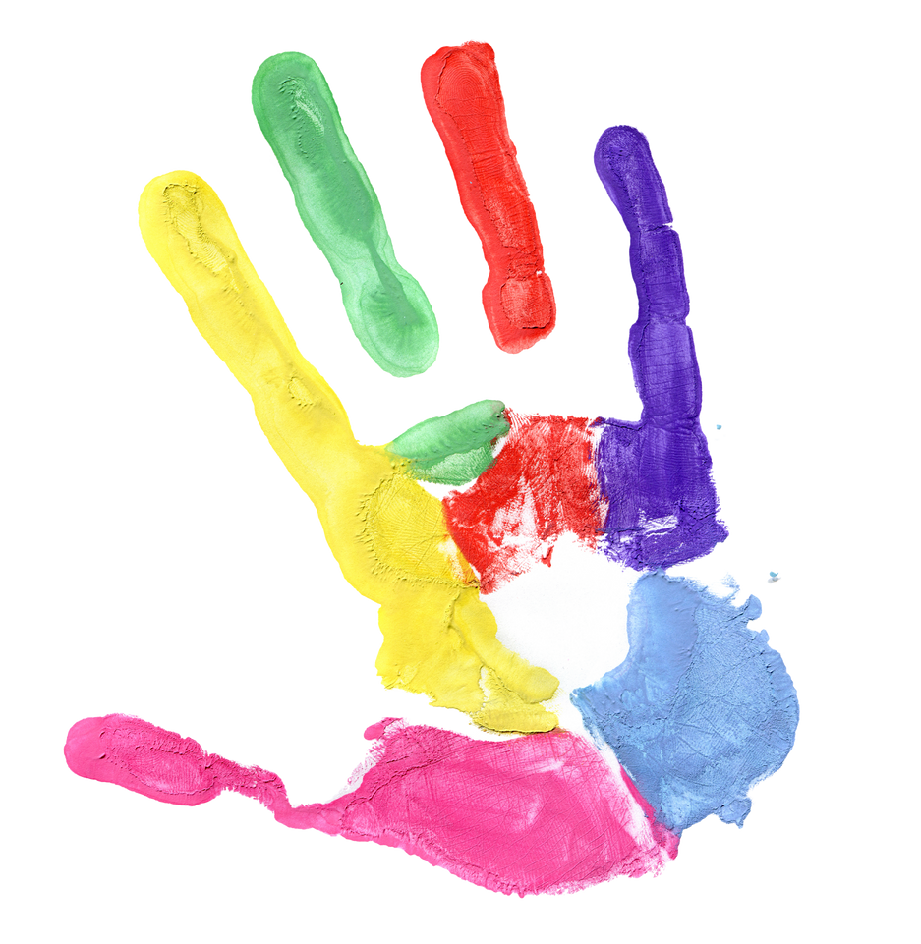

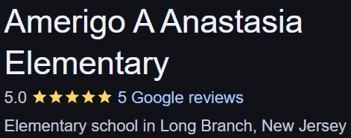


Sophia Valente
“These experiences not only shaped my teaching skills but also my heart.”
EDS330
In a classroom supporting students with disabilities, I observed whole-class learning, guided independent reading, checked in with students, and provided help and support to all.
I worked with children in 5th grade, aged 10-11, in a small classroom setting. Each child had unique strengths and weaknesses.
What I Learned
Students thrive when we adapt to their unique learning styles
Teamwork with staff creates stronger support for children
Meet the need, change the outcome.
“Even in a short time, I made students feel seen, supported, and safe.”

