Slide 1


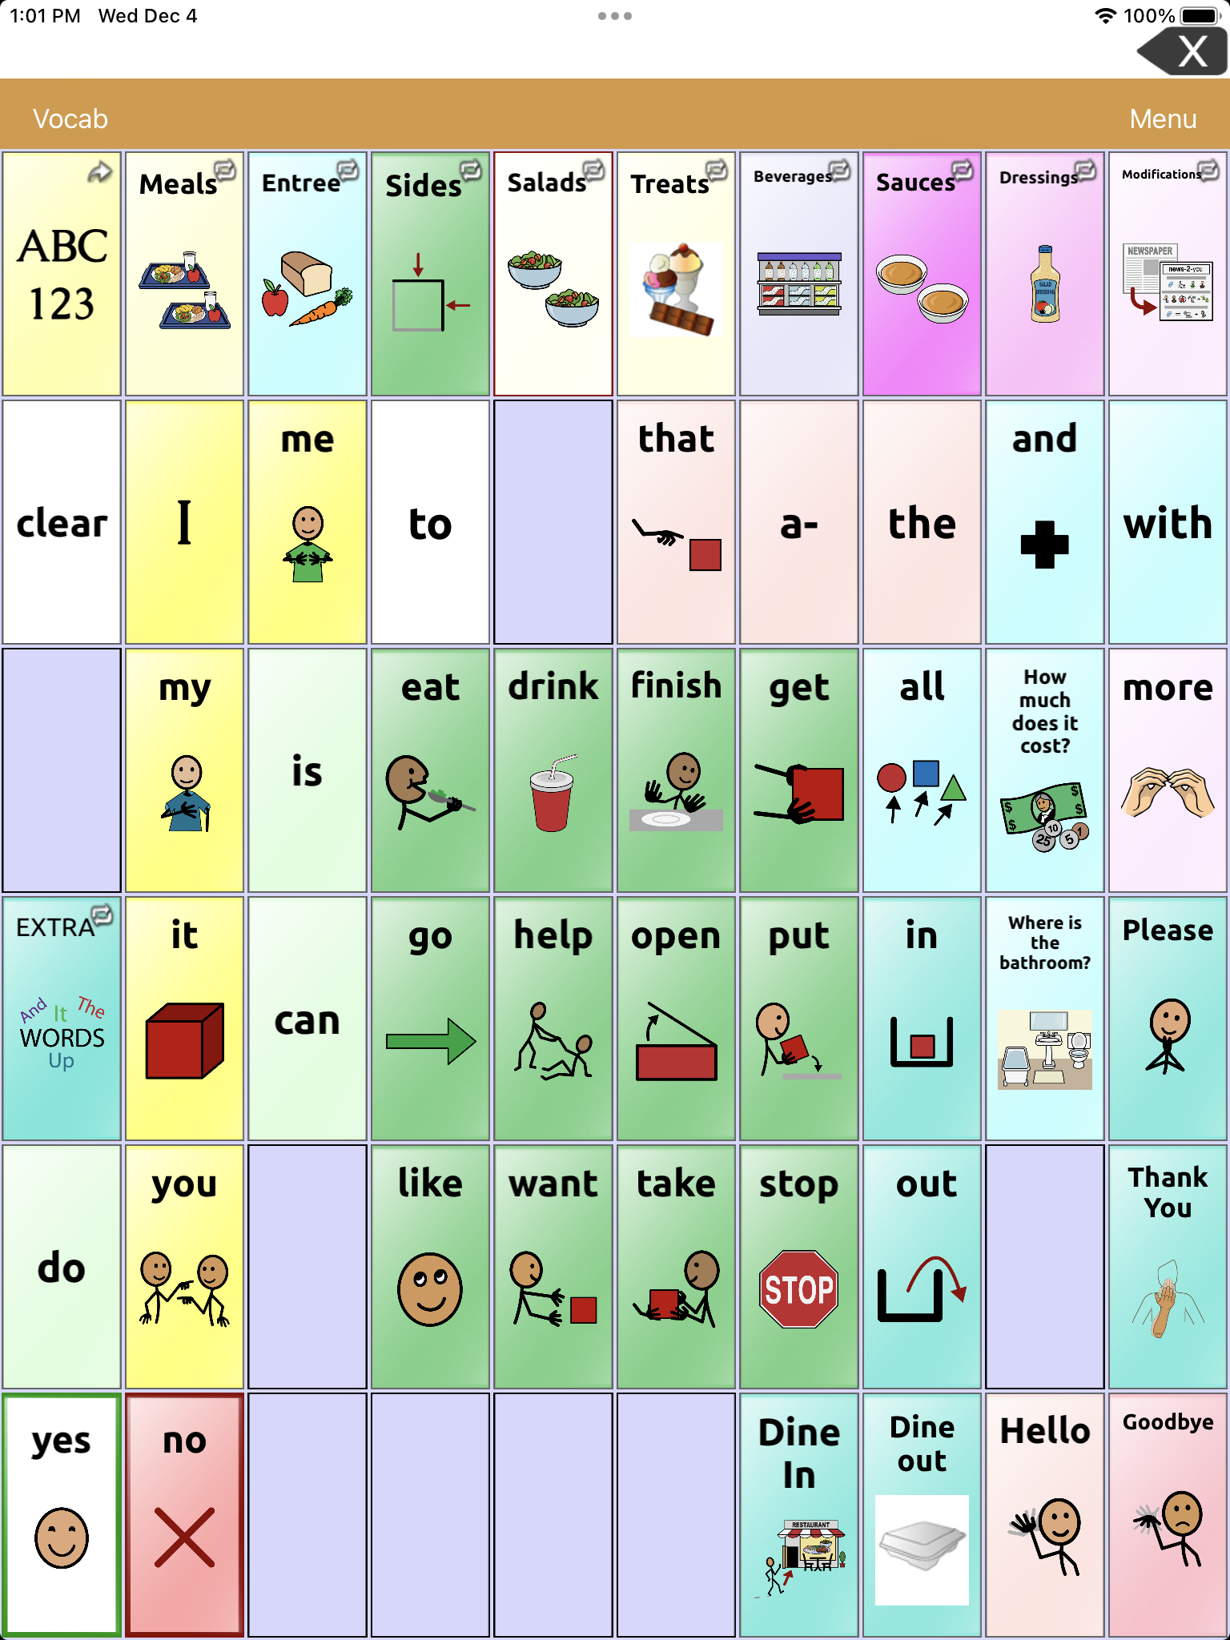
Empowering Our Community: The Role of Speech-Language Pathologists in Fostering Communication Inclusivity
Brittany Bascone, Casandra Barroqueiro, Skylar Espinos, Sarah Toth, Ashley McCarthy, M.S. CCC-SLP, Brittany Khan, M.S. CCC-SLP
Monmouth University, West Long Branch, 07764
Abstract
Why should speech language pathologists foster community engagement?
Framework for Starting an AAC Community Project
How does this align with your mission?
This presentation focused on highlighting the importance of accessibility within the community and the need for collaboration between Speech-Language Pathologists (SLPs) and other professionals. We discovered a need for greater accessibility at a restaurant to promote inclusion for those with communication disorders. Through a local community partner, we created a menu to promote social participation for these individuals. The design of the presentation involved the work of SLP students, SLP graduate professors, and professionals to create low-tech and high-tech augmentative and alternative communication (AAC) boards tailored to the restaurant, via the application TouchChat. This partnership cultivated an opportunity to create an AAC board that focused on functionality with the aim of increasing social communication. The design of our AAC boards included visual aids such as images of menu items, icons for common requests, and a variety of core words. The vocabulary and icons were carefully selected to create the opportunity to customize the wants and needs of the individual. Furthermore, it was essential to consider the appropriate AAC program to create greater usability while navigating the device. Community engagement will help promote awareness of communication accessibility and encourage inclusive social interactions among individuals with communication disorders. This project serves as a model to identify community needs and create similar resources for public spaces through multidisciplinary collaboration. Advocacy is at the core of the field of Speech-Language Pathology. Likewise, it is essential to explore challenges for those with communication disorders in our community and determine how these challenges can be addressed.
Establish a need to support individuals with communication impairments through a connection with a local community partner.
Collaborate as a group to discuss an action plan.
Generate a list of Core Vocabulary Words that coincide with the needs an individual may use at this local community partner.
Compile a list of items on the menu including sizes, modifications, and other accommodations.
Select a program and design a system for organization of the language and vocabulary necessary to complete these social interactions (consider field size and navigation abilities of users).
Program device including appropriate images and vocabulary.
Evaluate the quality of the AAC system created by trialing as a group to ensure that the icons activate appropriately.
Submit static boards to the owner of the establishment for corporate review and approval.
Have static and high-tech boards available for customer use at the register.
Check in with the facility owner periodically to discuss function and potential revisions.
Monmouth University’s School of Education's mission statement describes the importance of commitment to social justice initiatives, linking theory with practice, ensuring clinical competence, and promoting continued education. Improving accessibility for individuals with communication impairments aligns with the mission to foster inclusivity for people from diverse backgrounds in terms of abilities, age, gender, culture, race, ethnicity, family, and socioeconomic status. This project supports the idea of access to communication through daily activities, learning opportunities, and employment. It allowed us to highlight the importance of linking theory with practice by providing opportunities to apply theoretical knowledge on social communication, AAC, and accessibility in a meaningful way to improve the quality of life for those we serve through an innovative initiative in our community. This mission statement also demonstrates the importance of practicing clinical skills in a wide range of settings. Through projects like this, there is a greater opportunity to practice these skills and extend our expertise into the community to better serve others. SLPs can identify where their skills can be further utilized to continue applying these skills in new environments. Additionally, the field of speech-language pathology is rooted in a commitment to lifelong learning. Through the creation of this project, there was an opportunity to utilize practical skills and theory as well as reflect on their application, highlighting how our ability to reflect is essential to grow and adapt as practitioners, while providing the most competent level of care.
Wickenden (2013) highlights how Community-Based Rehabilitation (CBR) promotes the active involvement of people with disabilities in making choices and participating meaningfully within their communities. The article emphasizes that clinicians are no longer limited to working exclusively within the health sector; instead, they can engage in community outreach and contribute to a broader interpretation of rehabilitation. When individuals with disabilities were asked what would improve their lives, many expressed a preference for activities and opportunities that enable and empower their participation, rather than focusing solely on addressing impairments.
Batorowicz et al. (2006) discussed how collaborations between AAC specialists and community organizations can integrate AAC strategies into existing programs, making communication more accessible. The authors emphasize the importance of inclusivity, highlighting the Life Needs Model, which underscores the critical role of community participation. This model advocates for intertwining community engagement with clinical intervention to achieve long-term goals of fostering participation and improving the quality of life for individuals with disabilities.
Carroll et al., (2018) spoke about a practical project called Hear Me! This initiative emphasized the influential role SLPs play in making communication more accessible within the community. Through this project, SLPs were given opportunities to deliver presentations aimed at improving social participation and accessibility for individuals with communication difficulties. The Hear Me! project demonstrates how SLPs can foster community engagement by collaborating with individuals with communication disabilities, training local businesses, and promoting accessible and inclusive environments.
References
Batorowicz, B., Mcdougall, S., & Shepherd, T. A. (2006). AAC and community partnerships: The participation path to community inclusion. Augmentative and Alternative Communication, 22(3), 178 195. https://doi.org/10.1080/07434610500468498
Carroll, C., Guinan, N., Kinneen, L., Mulheir, D., Loughnane, H., Joyce, O., Higgins, E., Boyle, E., Mullarney, M., & Lyons, R. (2017). Social participation for people with communication disability in coffee shops and restaurants is a human right. International Journal of Speech-Language Pathology, 20(1), 59–62. https://doi.org/10.1080/17549507.2018.1397748
Wickenden, M. (2013). Widening the SLP lens: How can we improve the wellbeing of people with communication disabilities globally. International Journal of Speech Language Pathology, 15(1), 14-20. https://doi.org/10.3109/17549507.2012.726276
Learner Outcomes
The reader will learn how the menu communication boards were developed and the plan to implement them at the store.
The reader will explore how community engagement promotes inclusive communication and social interaction in public spaces.
The reader will explore ways to replicate the project in their town.
Suggestions for Future Projects
SLP’s can develop community-based projects to support communication skills through real-world activities. Potential ideas include experiences such as grocery shopping, park and recreation programs, classroom activities, and other functional outings like using public transportation. These activities provide meaningful opportunities to increase communication inclusivity.

