Slide 1
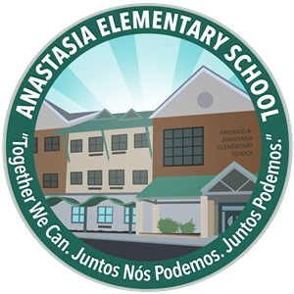


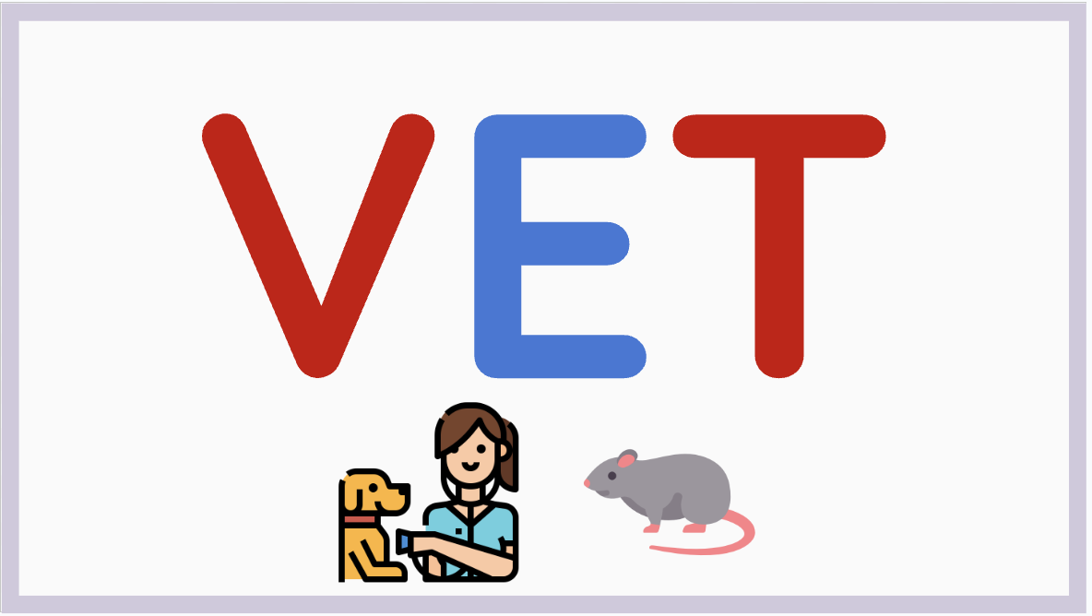
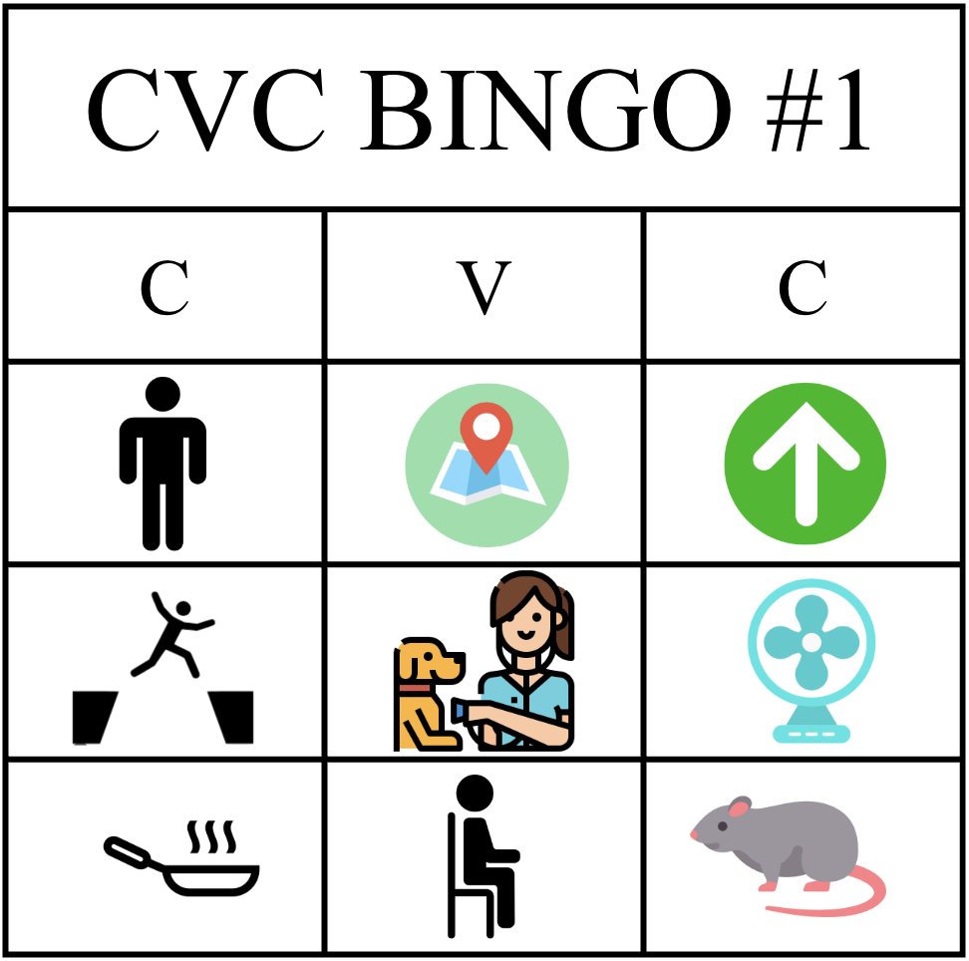

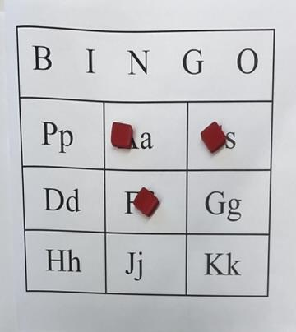

Differentiated Instruction Through Sight Word and Letter Bingo: A Plan to Improve Literacy
Ava Bamonte
EDS 330 - Foundations of Special Education Development Across the Lifespan
Setting
School: Amerigo A. Anastasia Elementary School
Location: Long Branch, New Jersey
School Demographics
Student/Teacher Ratio: 9:1
Grades: K - 5
Total Students: 587
White: 24.5%
Hispanic/Latino: 58.9%
African American: 10.9%
Asian/Pacific Islander: 0.3%
(usnews.com)
Classroom
Grade: 3rd - 5th
Type: Special Education Moderate Cognitive Impairment (MCI)
Students
Total: 8 (2 girls + 6 boys)
Disabilities: Williams Syndrome, Cerebral Palsy, Non-Verbal Autism, ADHD, and Aphasia
Related Services Used: Speech Therapy and Occupational Therapy
My Project
Goal: Task students with an alternative method to learning literacy; Use bingo boards as an evolving plan. Update plan weekly with students’ progressed levels of proficiency in literacy. Each week, I altered them to align with their current learning standards.
Modifications Made: (3 total games)
Game #1 - Students presented with visual of written sight/cvc word on slide. After sounding it out, students found the picture that matched on their bingo board
Game #2 - Students presented with visual of written sight/cvc word on slide alongside two picture options. After sounding it out, students selected the correct picture out of the two and then matched it to their board.
Game #3 - Bingo board has capital and lowercase letters. After I verbally said the letter and phoneme, student found it on bingo board. Student that used iPad for augmentative and alternative communication (AAC) found the letter on their iPad and then circled on board. Students with dysgraphia were able to use counters rather than a pencil (seen in Figure 4).
Figure 1: (Game #1)
Figure 2: (Game #2)
Staff
1 - Special Education Teacher
1 - Classroom Paraprofessional
1 - One-on-one aide
My Role
Monmouth Learning Partner
Create connections with students in local community
Make a positive impact on students’ personal and academic lives.
Monmouth University School of Education Student
Acquire knowledge to better myself as a future educator
Figure 3: (Board for Games #1+2)
Impact + Outcome
Personal:
Inspiring to see students’ progress
Instructional skills development
Confidence in the classroom
Students:
Literacy proficiency increased
Peer to peer interaction (taking turns) strengthened
Increased motivation to do new assignments
Figure 4: (Board for Game #3 w/ counters)

