Slide 1

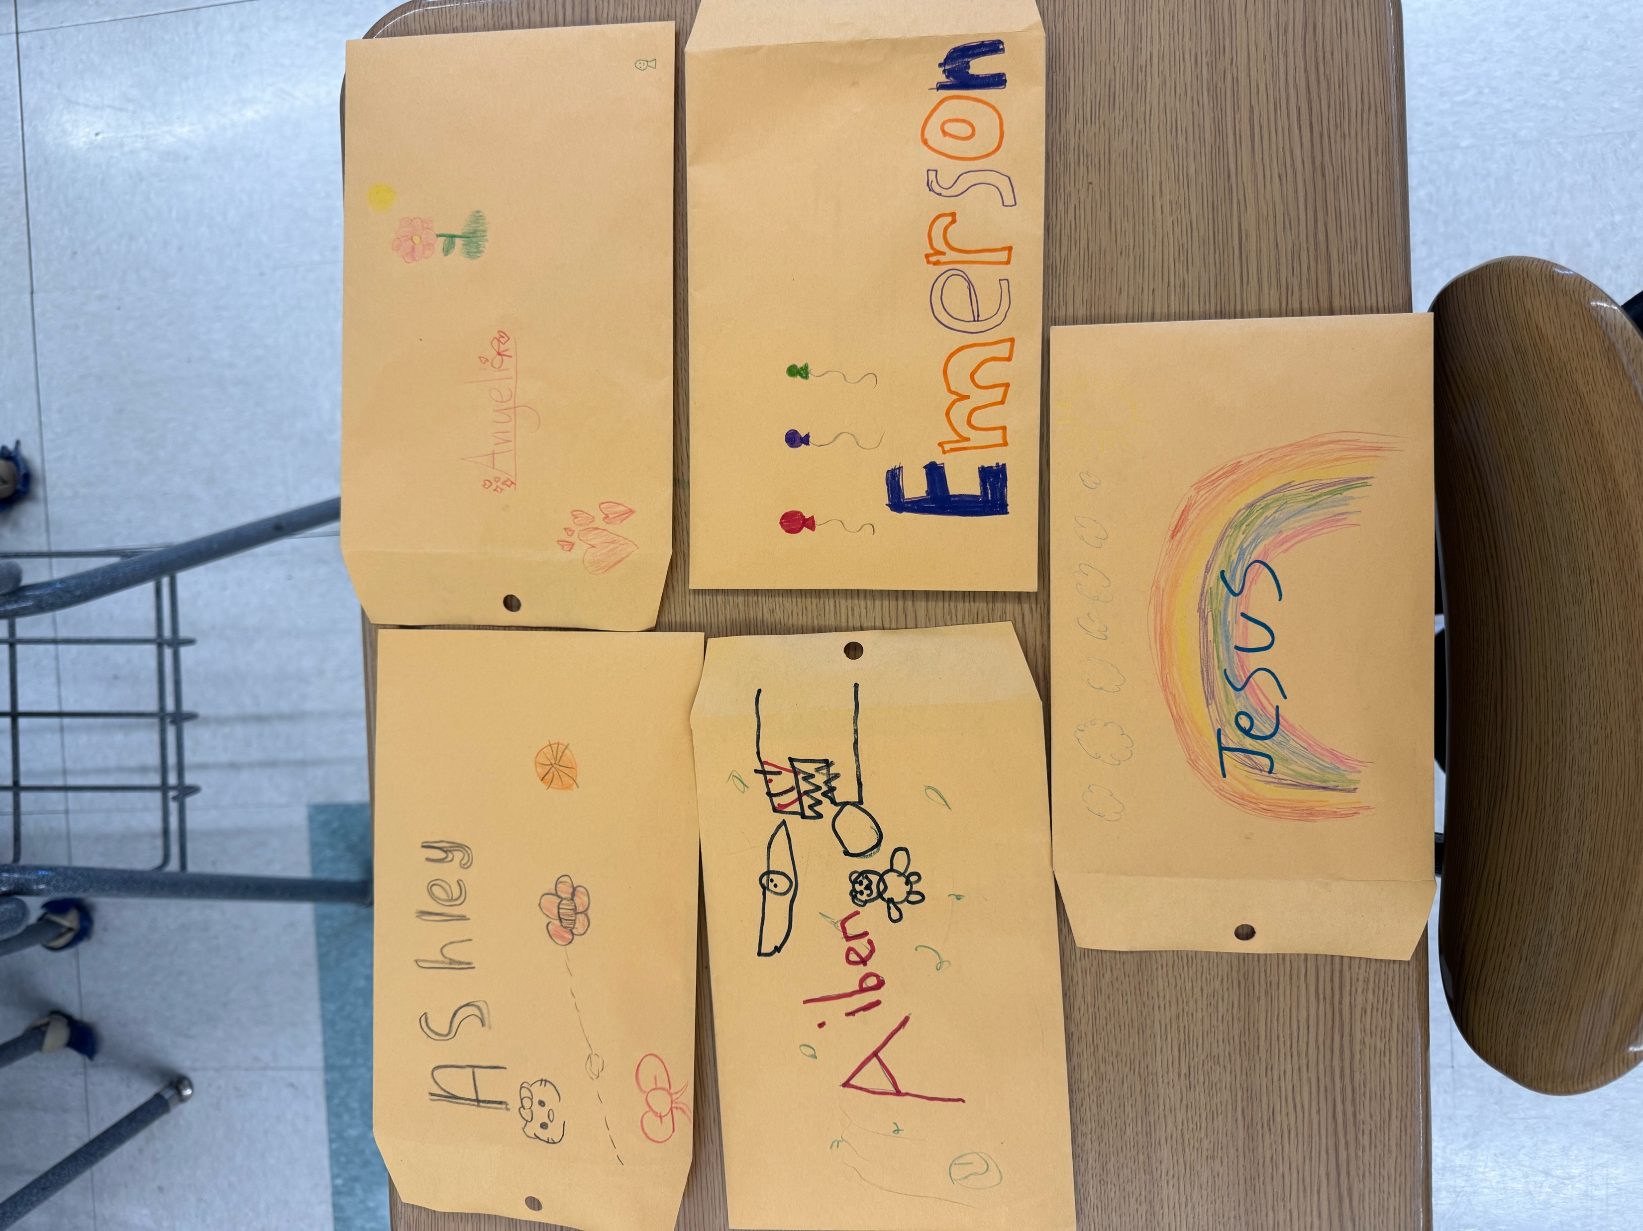
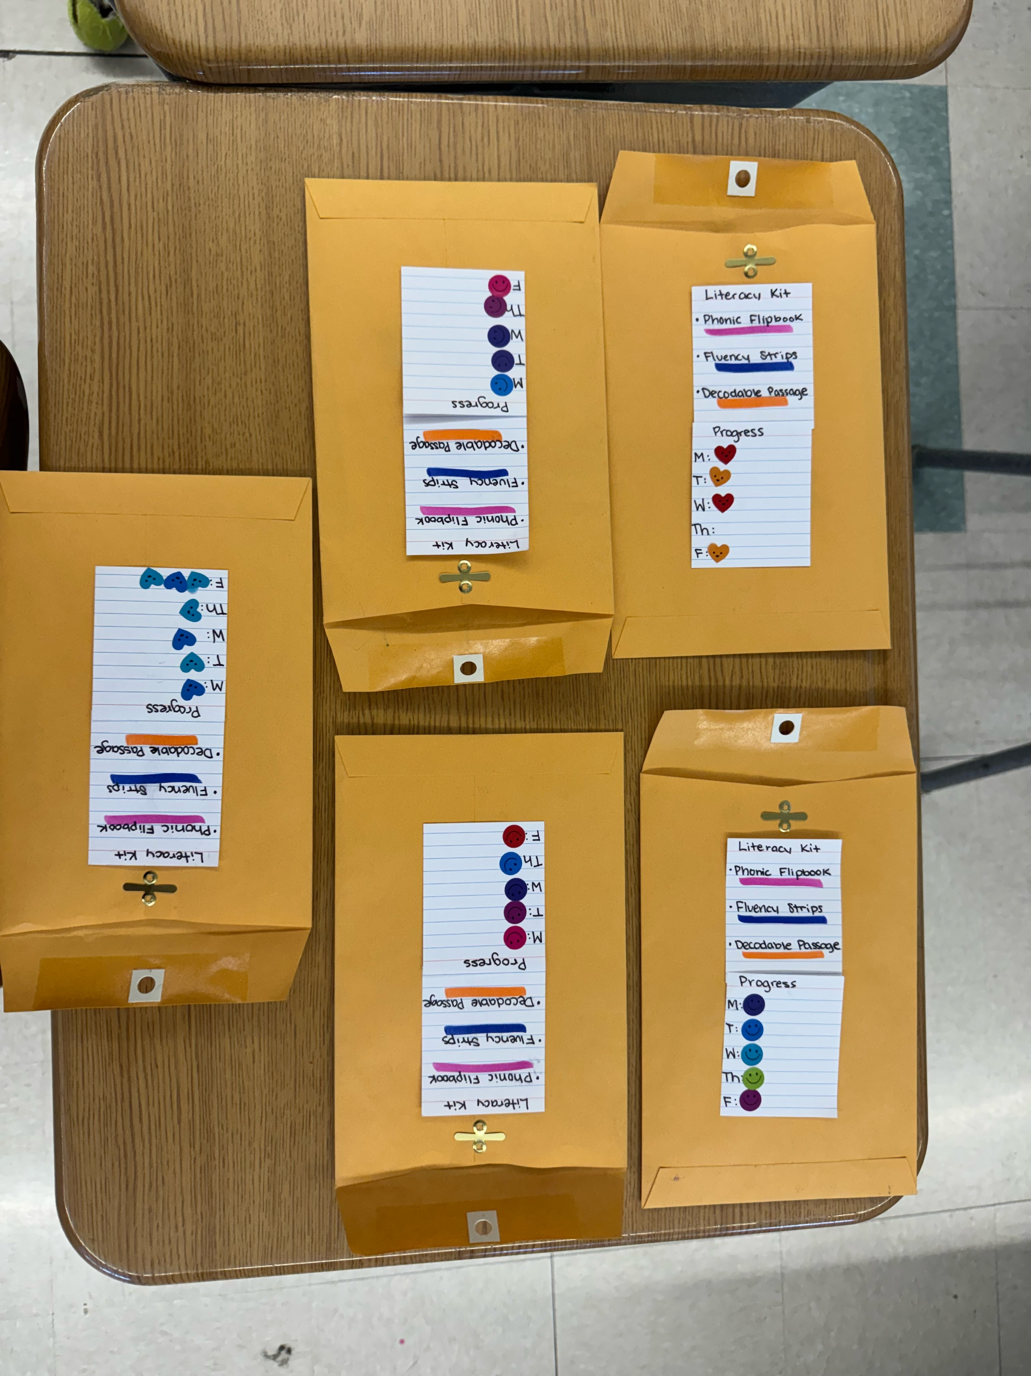

NAME Monmouth University
Fluency in Action: A Literacy Kit & Readers Theater Journey
Description of Students
Roughly equal between male and female students
All students in the classroom have disabilities
Types of disabilities: Mild learning disabilities, ADHD, Speech or language delays
Course & Project
Course Title: EDL 326 / EDL 503
Project: Literacy Fluency Action Plan
Overview:
Created take-home literacy kits with a reading log, stickers, and parent guides
Introduced Reader’s Theater using The Cat in the Hat and a fluency checklist
Implemented in two 5th grade homerooms (Mrs. H’s and Mrs. C’s)
Role
Supported classroom instruction
Designed and introduced two-week literacy kits
Checked and tracked student participation
Led fluency-building Reader’s Theater activity
Collaborated with teachers and adjusted based on feedback
Co-modeled reading fluency with students
Understandings
Fluency improves when reading is fun and purposeful
Visuals and structure (like logs & stickers) help with motivation
Reader’s Theater supported both expression and engagement
Connected to coursework on differentiated instruction, ELL strategies, and fluency research
Impacts
Increased student interest in reading
Several students noted fluency progress (“I’m not a robot voice anymore!”)
Helped students feel ownership through personalizing folders
Encouraged reading with family or siblings
Teachers reported students reminded them to check the kits
Future Goals
Learn more about fluency support in special education
Try new reader’s theater scripts at different grade levels
Build stronger home-school reading connections
Develop more visual, engaging tools for all learners
Continue making reading a positive and shared experience
Setting
Overview of Community
Long Branch, NJ
Monmouth County
Population: Approx. 31,000
Poverty rate: 15.3%
Citizenship: 78.1 % U.S. citizens
Race/ethnicity: Hispanic/Latino: 40.1%, White: 36.4%, Black/African American: 16.6%, Two or more races: 5.1%
Sources: U.S. Census Bureau (2023)
Overview of School
Anastasia Elementary School
Pre-K-5
Approx. 400 students
Student/Teacher Ratio: ~11:1
Nearly even male/female
Race/ethnicity: Primarily Hispanic/Latino, Followed by Black, White, and Multiracial students
Source: NJ School Performance Reports (2023)
Overview of Classroom
5th Grade Special Education
7 students in each homeroom
Reading: Fundations, Leveled Readers, Fluency activities-Math: EnVision
Lines of desks, visual schedule, carpet space for group activities
Smartboard, student Chromebooks, visual timers
Notes:
Hi. My name is Kaitlyn Delatush, and for my service-learning project, I was placed in a 5th grade special education classroom at Anastasia Elementary School in Long Branch, New Jersey.
The classroom had two homerooms with 7 students in each. All the students had mild disabilities—nothing severe—and most were diagnosed with learning disabilities or ADHD. I worked under the guidance of Miss Hochstaedter, and also collaborated with Miss Carrié’s class.
My project was focused on building fluency and encouraging students to feel more confident and excited about reading. So I created take-home literacy kits, which included small activitues, stickers, a parent guide, and some fun options for personalization. I launched it on March 13 and checked in weekly to see how it was going.
I introduced the kits in both classes and the response was really positive! The students were engaged right away, especially when I showed them my own example that I had decorated. They asked questions about how many nights to do and what to do if they forgot. I kept things flexible and focused on encouragement.
One thing I noticed early on was how much the kids enjoyed decorating their folders and using the stickers. Many did the activities with their siblings, and some did it independently. A few had trouble remembering, but the Mrs. H helped by checking in mid-week. One of the biggest wins was how excited they were when I came in to check them—it was a moment I was proud of.
After that, I wanted to build on the fluency piece with a Reader’s Theater activity. We used The Cat in the Hat, and I taught them how to use a fluency checklist first so they could reflect on how they were reading—things like volume, expression, and not reading like a robot. One girl literally said, “At first I was a robot but then I wasn’t!” and that was so awesome to hear.
We picked parts by pulling sticks, which made it feel like a fun game. Even though some students struggled with rhyming words, they followed along well, especially since I highlighted their parts. The whole experience made them more expressive readers, and it turned reading into something joyful—not just another assignment.
This project really helped me connect theory to practice. In class, we talk a lot about fluency, engagement, and scaffolding, but seeing it in real life made it real. It also reminded me how much small details—like stickers, visuals, and fun voices—can go a long way.
Moving forward, I want to keep learning how to support fluency in creative ways, especially for students with learning differences. I’d love to explore more scripts for Reader’s Theater and keep finding fun ways to involve families in the process too.
Thanks for listening!

