Slide 1
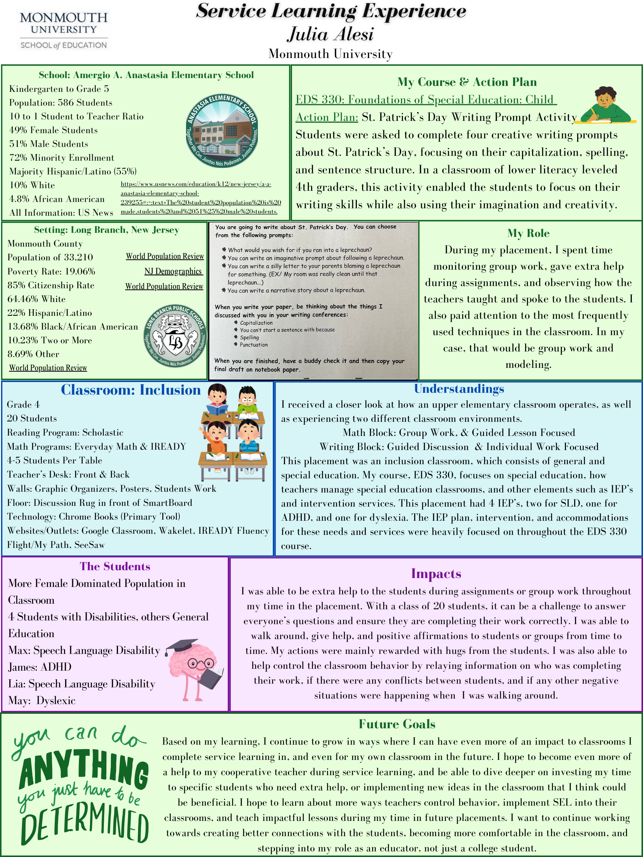
Service-Learning Experience Poster
Julia Alesi
Virtual Presentation Link:
https://www.canva.com/design/DAGBZhNXHoU/WZM67PgtReiIwk46um3vzw/view?utm_content=DAGBZhNXHoU&utm_campaign=designshare&utm_medium=link&utm_source=recording_view

