Slide 1
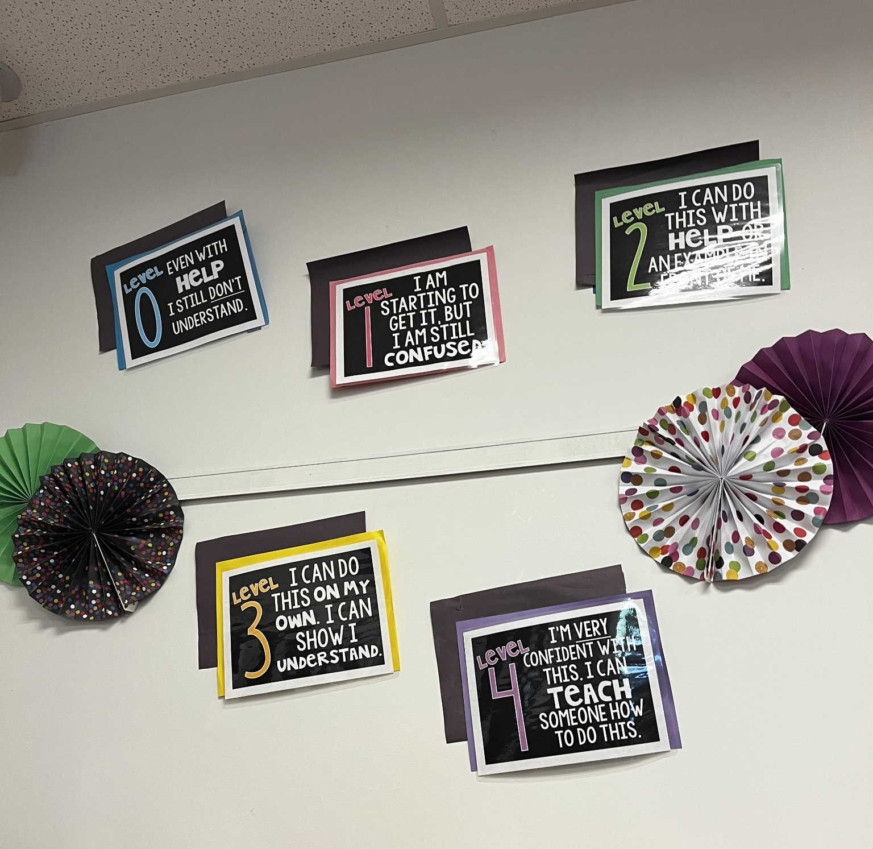
Samantha Schmidt Monmouth University
Poster Presentation
Setting
Overview of Community
Long Branch
Monmouth County
Around 33,210 people
Poverty rate-19.06%
Citizenship %- 83%
Race/ethnicity White-56.8% African American-12% Hispanic- 17.16%
Overview of School
Long Branch Middle School
6th-8th grade
1,028 students
10:1 student to teacher ratio
576 male students and 532 female students
25% Hispanic 14% white and 3% African American
Overview of Classroom
6th grade
6 students
Science class
One desk and desks in groups
Chromebooks used
Description of Students
5 male students 1 female student
2 students have disabilities
Both students have ADHD
Both students sit at their own desks to stay focused
Course & Project
EDS 330- Fondation of Special Education: Child
Created cards with personal questions ex. What is your favorite childhood memory?
Encourages students to talk and feel like they are being listened to
Role
Helped students with independent work
Encouraged students to solve problems on their own
Understandings
I learned how important patience and understand is with students with disabilities
This connects to what we learned in the class about understand the differences in your students
This connects to what I saw in the classroom because I was able to see how no student is the same.
Impacts
I encouraged students to find answers on their own and not always ask a teacher
Students had to list 3 states but one student didn’t know any so I told her to use her resources (chromebook) to find some
Future Goals
I plan to continue my growth based on jmy learning by learning new and fun ways to make special education more fun for both the teachers and the students
The areas I plan to work towards the most is communication with anyone involved in the students education and creativity.

