Slide 1
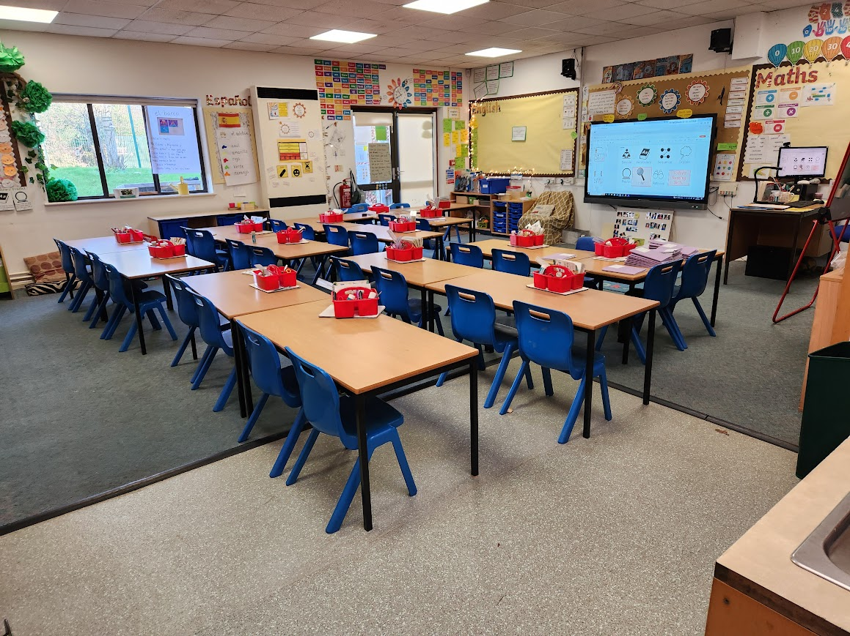
Our Understandings:
Learned:
Culture heavily influences what students are taught, academically and socially.
Despite the differences, there are similarities between American and British classrooms.
Connection to ED-300:
First hand experience seeing a different countries educational system.
Deeper awareness how culture affects education.
Connection to field of education:
Demonstrates the importance of understanding an area’s culture and social norms.
Exposure to other methods of special education.
Winchcombe, England
5,121 total people
93.8% White British
57.6% Christian
16% of children are in low-income families
26% 16-74 yr olds have full-time jobs
(Wind, Green, Shifflet, & Scarbrough, n.d.)
Assignment/Role:
Teacher Candidate
Observed the difference between American and England's Education System
Instructed individual and small group interventions
Taught lessons on American Culture and History
Assisted the teacher in making classroom material
Graded student work
Interacted with students, teachers and other faculty
Winchcombe Abbey Primary School
Christian School under the Church of England
303 Students
Reception to Year 6 (PK-5)
18.5% receive daily free meals
Teacher to Students: 1:30
(Winchcombe Abbey Church of England Primary School - GOV.UK, n.d.).
Sofia’s Classroom/Students:
General Education, including Students with Disabilities
Year 4 (3rd grade) - the Badgers
29 Students - 17 male; 12 female
1 General Education Teacher & 1 Teacher Assistant
1 Student With Autism, 1 Student with ADHD, 8 Students with Learning Disabilities
Our Impacts:
Students received extra support that allowed them to be successful in lessons.
Students and faculty learned more about America’s culture.
Teachers were provided with additional support
Kailyn’s Classroom/Students:
General Education including Students with Disabilities
Year 2 (1st grade) - the Kingfishers
30 Students - 17 female, 13 males
1 General Education Teacher & 1 Teacher Assistant
1 Student with Autism, 1 Student with Dyslexia, and 9 students with Learning Disabilities
Future Goals:
Learn more about other culture’s educational system to allows us in improve our teaching styles.
Ensure all students have interventions and services they need to be successful.
Have students in America learn how education is a privilege.

