Slide 1



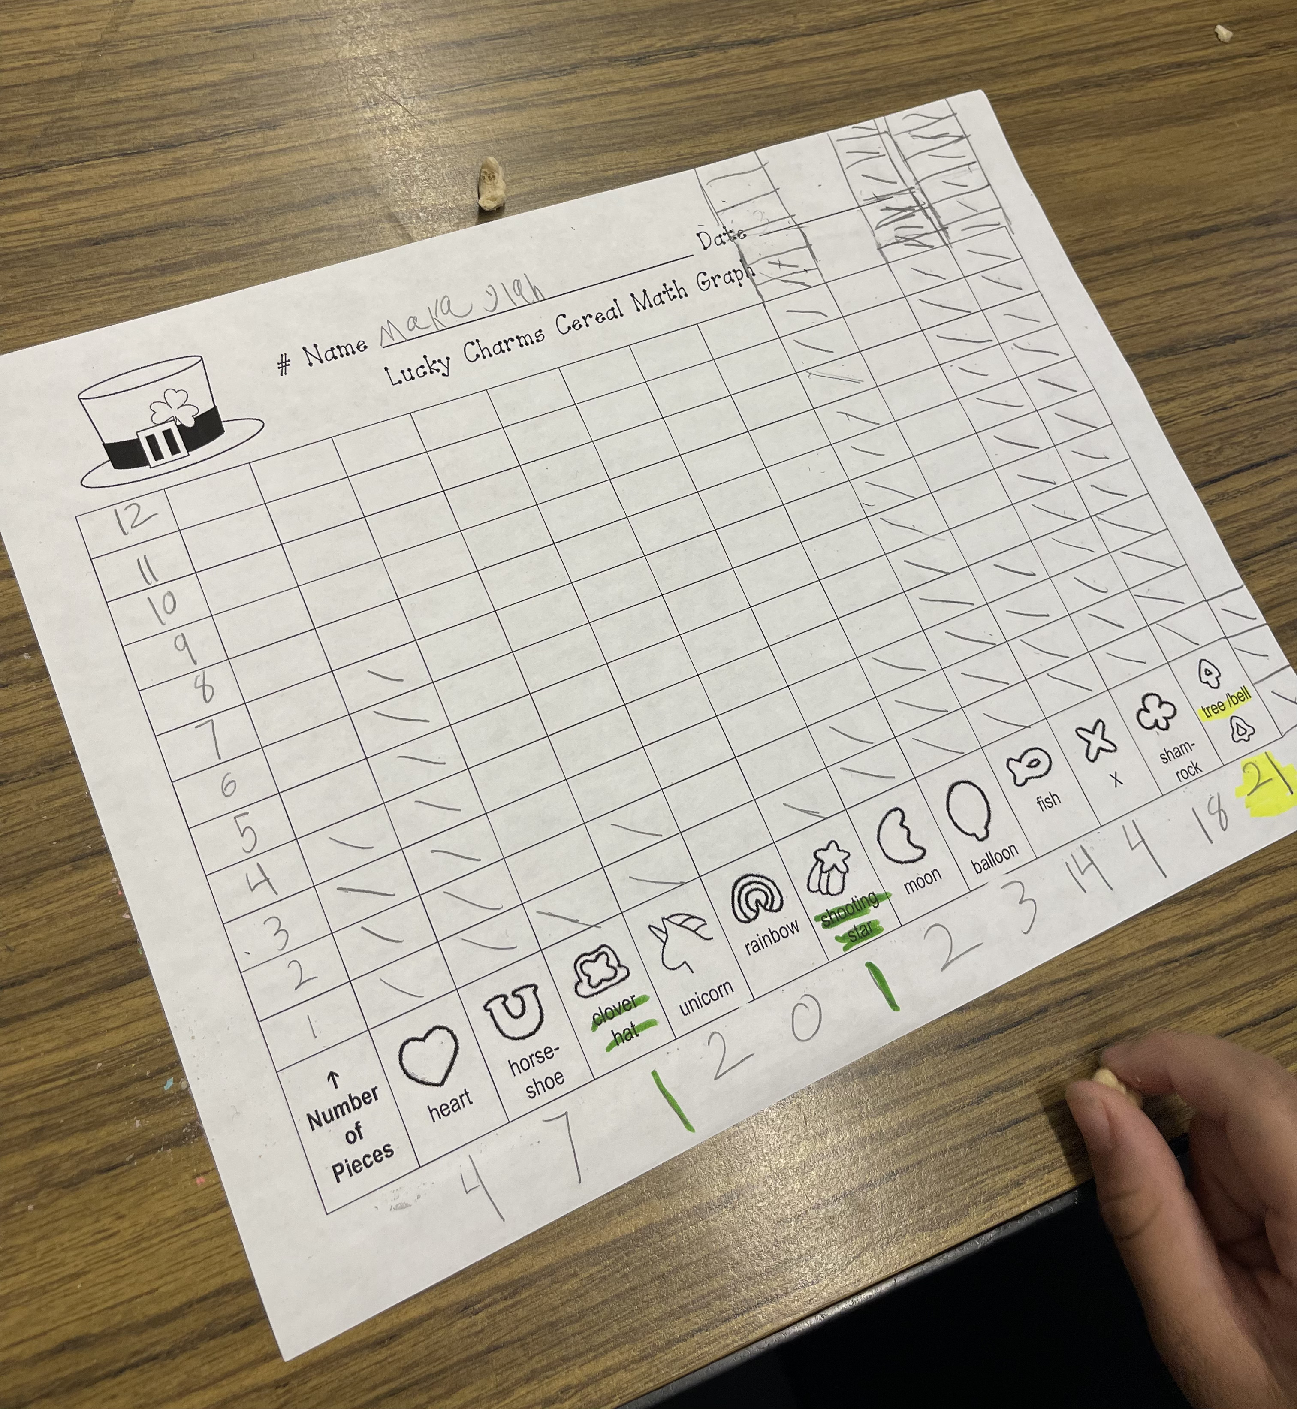
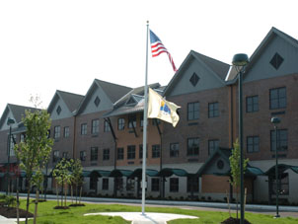
Understandings
Each student is different and has unique learning abilities and needs
Need multiple methods of instruction and unique activities to serve all special education students
Flexibility, patience, compassion
EDS 330 placement corelates to concepts learned in the classroom
Firsthand experience - equal education and a fair education are not the same
  Not equal to general education peers, but need fair education
Not everything goes as planned
  Must be flexible with lessons and activities
  Field placement – things change, students need more/less help, teacher is flexible and quick to change to serve needs of students
Impacts
Extra set of hands and eyes in the classroom
  Observe students and make note of their needs and progress
Answered students' questions while circulating the room
  Teachers did not need to stop lessons or activities
Advanced math skills
Future Goals
Put in a genuine effort into learning the needs and abilities of each student I work with
  More motivated to learn if they feel accepted and comfortable
Become a guide and mentor
Continue to work on flexibility and patience
  It is okay for things to not go as planned
Maintain structure, organization, and a calm environment
"Lucky Charms" Sorting, Counting, & Graphing Activity
Course & Project
Foundations of Special Education – EDS 330
"Lucky Charms" Sorting, Counting, Graphing Activity
  Spoke with cooperating teacher to see what the special education students needed practice in most.
  Conducted around Saint Patrick's Day
    Decided on a graphing and counting activity with the cereal, "Lucky Charms"
  Constructed a graph for my students to use in the activity
  purchased a box of "Lucky Charms
  Pulled my students to a separate table during "Writing" to complete their activity
  Students sorted and categorized the "Lucky Charms", counted them, and used their graphing skills to construct a bar graph
  Students were asked questions about their graphs after completion
Role
Moved with my cooperating teacher's homeroom class to their "Social Studies" and "Writing" Blocks
Circulated the classroom during lessons to assist and answer questions
Conversed with teachers to gain insight into each student
Assisted my cooperating teacher in serving the needs of special education students
Setting
Overview of Community
Long Branch
Monmouth County
332,383 people
19.06% poverty rate
83% citizenship rate
White: 64.46%, Black or African American: 13.68%, two or more races: 10.23%, other race: 8.69%
Overview of School
Amerigo A. Anastasia School
Kindergarten-Fifth Grade
586
10:1 student to teacher ratio
49% female students, 51% male students
55.6% Hispanic/Latino, 28.3% White, 10.9% Black/African American, 4.8% two or more races, 0.3% Asian or Asian/Pacific Islander
Overview of Classroom
Fourth Grade
20 Students
Reading: "Scholastic" Program
Math: "Everyday Math", "IREADY"
Inclusion Classroom
Technology Used: Google Classroom, Wakelet, IREADY Fluency Flight/My Path, SeeSaw
Description of Students
Female-heavy classroom
Four students with disabilities (2 boys, 2 girls)
Speech/Language Disorders, ADHD, Dyslexia
  One boy and one girl have a SLD Disorder, one girl has dyslexia, and one boy has ADHD
Amerigo A. Anastasia School

