Slide 1
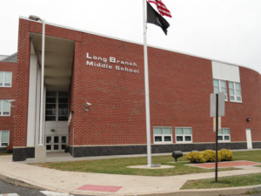
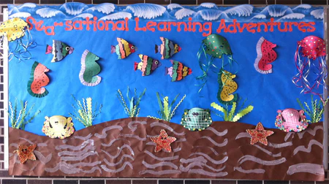
“Getting Hooked on iReady”
Ally Scott
Monmouth University
Long Branch , NJ
Monmouth County
33,210 people
19.06% poverty rate
83% citizenship
6th Grade
LD class
9 students
(6 females, 3 males)
K-3 performance level
ADD, ADHD, Autism, reading comprehension/fluency,
cognitive impairment
Layout- desk arrangement in 4 groups of 3
Technology- chromebooks, bytello board- interactive smart board
Math program- Big Ideas
Reading program- read 180 and read 360
Action Plan: Created a reward system to engage and encourage the students to stay on task and motivate them to do their work. There will be a competition each week to see who passes the most lessons and at the end of the week, they earn a reward of their choice out of the given options.
My cooperating teacher and I have designed a display with an ocean theme to keep visible track of the progress of each student. The students are represented as different sea creatures and the goal is to reach the top of the water where there is a boat that represents the prize. Each time a lesson is completed the student moves up.
I learned about engagement and motivation in the classroom and how to use a reward system as a way to get students excited. This is an interactive way to incorporate into a classroom that also allows the students to look forward to something beneficial. This connects to my research in the field because I hope for my future classroom to be a comforting and effective learning environment that inspires each individual to try their best in everything they do. I plan on growing based on my learning by expanding my ideas and implement different strategies to lead to the most successful classroom as possible.
Long Branch Middle School
6-8 Grade
1,108 students
9.85 student/teacher ratio
Figure 1: DataUSA
Figure 2: National Center for Educational Statistics

