Slide 1
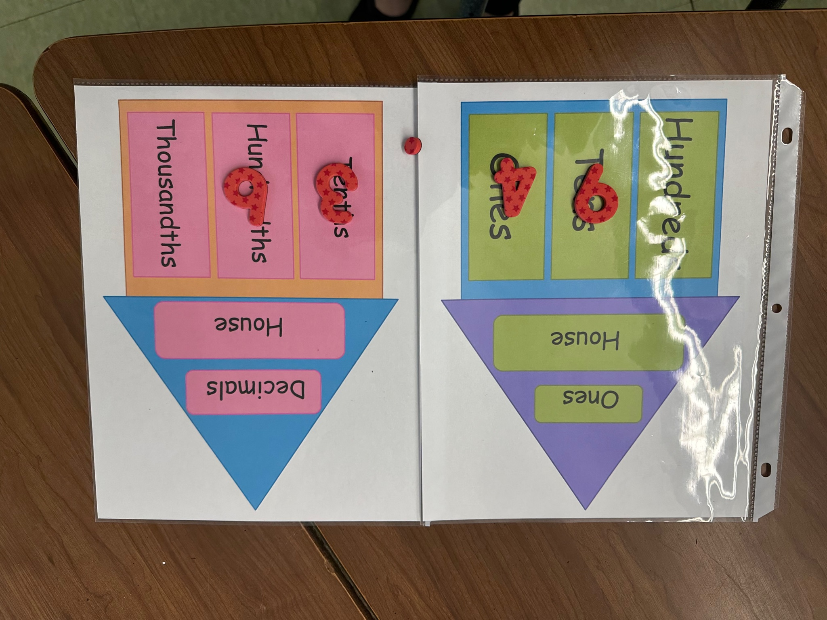
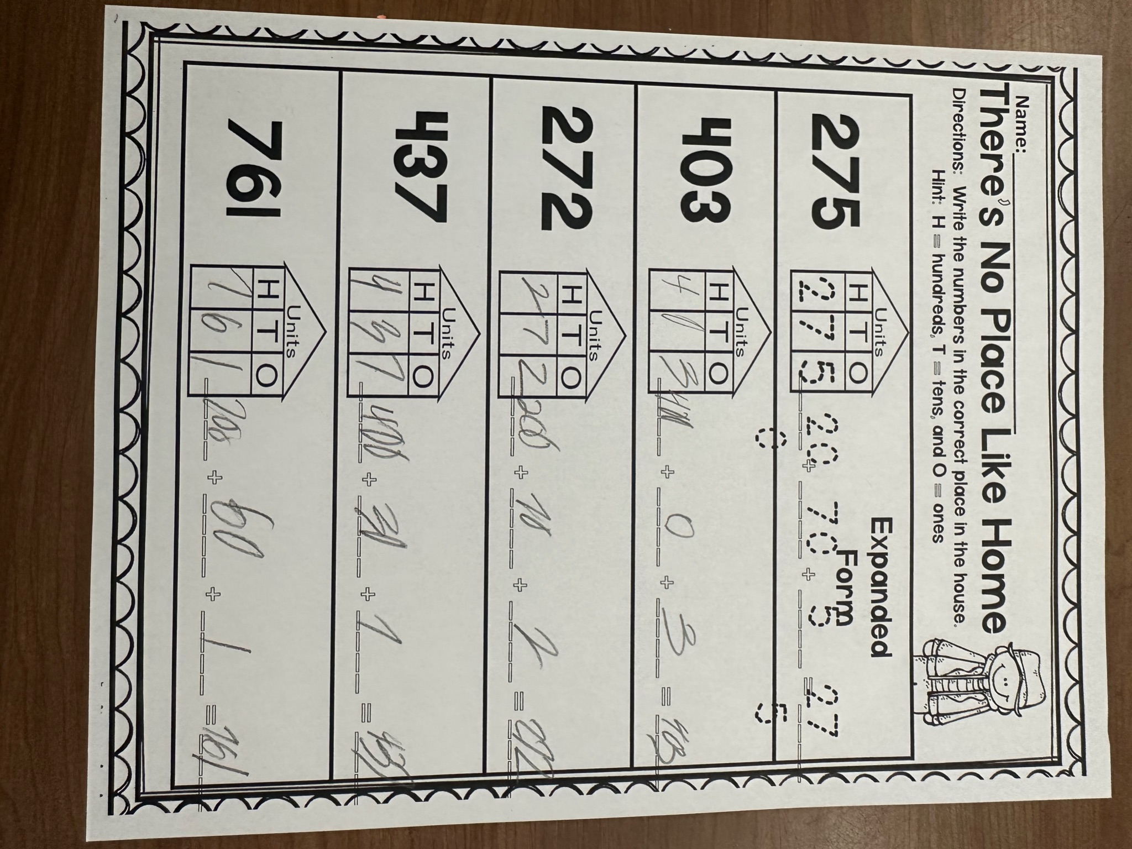
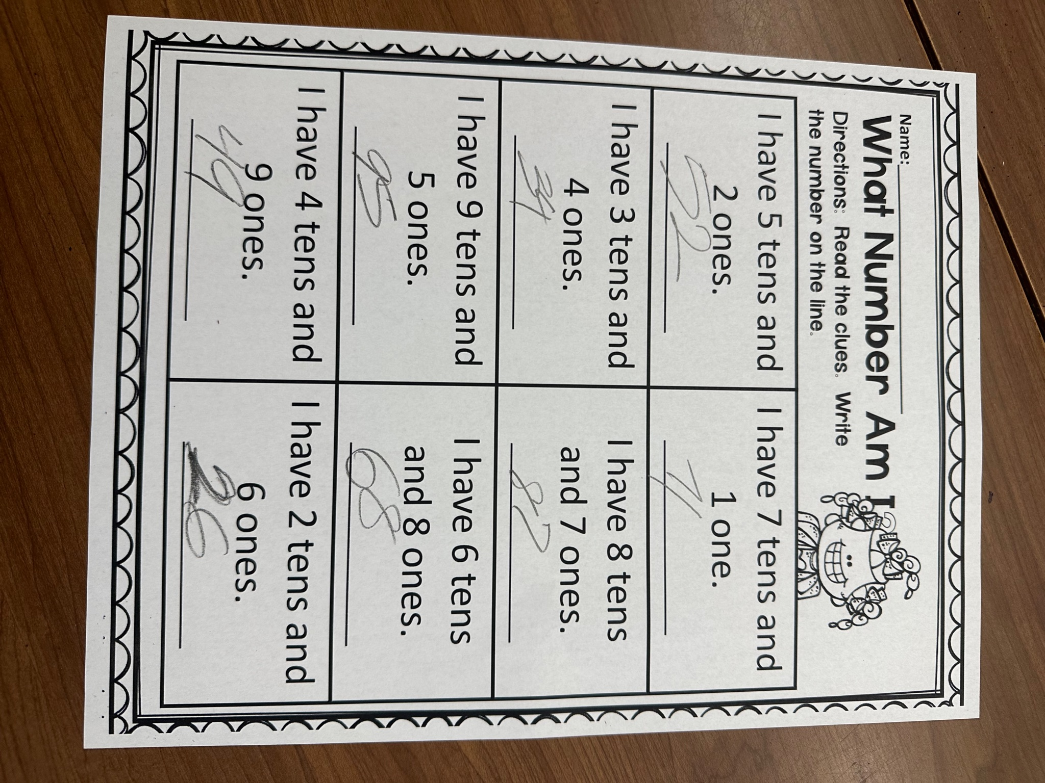
Fostering Confidence with Learned Skills: An Interactive Place Value Activity for Students with Learning Disabilities at Amerigo A. Anastasia Elementary School
Isabella Ficili
Monmouth University
Overview of Community
Long Branch, New Jersey located in Monmouth County has a population of 32,383.
The poverty rate is 19.06%
Citizenship rate is 83%
The racial/ethnic composition is 55.5% White, 21.5% Hispanic, 12.1% black, and other ethnicities
Description of Students
5 females, 3 males
All 8 students Identified with Learning Disabilities
Referred to here as
Cayla, Beth, Dani, Ally, Gail, Jason, Dan, and Mike
Future Goals
Continuation of improving inclusive education skills
Further development of strategies that can help to assist students with diverse learning disabilities
Development of collaboration and communication with colleagues and families
Overview of School
Amerigo A. Anastasia Elementary School is located in Long Branch, New Jersey.
Grades K-5
Enrollment of 586 students with a student to teacher ratio of 10:1
Student population is 49% females and 50 % males
Racial/ethnic composition is 55.6% Hispanic/Latino, 28.3% White, 10.9% Black, and 4.8 % tow or more races, and 0.3% Asian
Course and Project
Title of the Class
Mrs. Carey and Mrs. Tatum’s class
SL Project
“Place Value Houses”: Designed to help students practice place value interactively. Incorporates sensory movement and allows students to be hands on while practicing this skill. Enhances knowledge on this skill to be applied in classroom activities.
Concrete Examples of Impact on Field Site
Increased engagement when practicing the skill of place value
Increased confidence of students when practicing this skill
Creation of a more inclusive environment with the betterment of this skill
Understandings
Adaptability is important for teaching students with learning disabilities
Interactive elements boost student engagement and retainability
An inclusive environment for students is crucial to effective teaching and learning
Role at the Field Site
Collaborated with classroom teacher to plan and implement the place value house activity
Worked closely with student needs to ensure that the project was being tailored to all the needs of the student as listed in their IEP
Utilized effective communication to adapt an activity that will accurately help the students gain more knowledge on the skill
Plan to continue growth as a future educator by incorporating feedback by cooperating teachers and seeking ways that can help with the education of students in an inclusive environment.
Overview of Classroom
Self Contained Learning Disability Classroom (SCLD)
Two special education teachers in the classroom
The students are all in 5th grade and have a type of learning disability
Cooperating teacher teaches math and social studies/science

