Slide 1
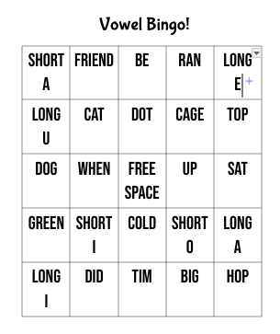
Experience and Vowel Bingo
Hanna MacDonald Monmouth University
Impacts and understanding
I learned that students are not the same even if they have the same “disability”
Teaching content is important but differentiate for other students
Students enjoy collaboration and games - no stress or grades
My students feel connected to me and draw me pictures and tell me about their lives
Working in education is hard but worth it
Amerigo A. Anastasia Elementary
1st - 5th grade
586 students enrolled
10 to 1 student-teacher ratio
Over 70% of students come from minority groups
78% economically disadvantaged students
From US News
Community
Long Branch in Monmouth county
32,383 (2021)
21.4% poverty rate (2021)
Majority of people are White, African American, Hispanic origins
29.4% of people were born outside the US (2020)
83% of long branch were US citizens (2021)
From DATA USA
Classroom and demographics
2nd grade self-contained
9 students total
7 boys 2 girl s
Struggling to read - 1st grade and lower reading level
Course and projects
EDS 330-50 Foundations of Special Education
Vowel bingo that focuses on long and short vowel sounds
Supporting the reading needs of the students through activity
Game play is an engaging way to learn
Students can remember and store information when it is presented in something they enjoy (Ferlazzo 2022)
potential to significantly enhance learning outcomes and educational achievements (International Journal of Technology in Education 2021)
My role in the classroom
One-on-one work with “john” and “tony”
Reading work and simple math
Communicating with the students about their goals and work
Observing actions, behaviors, friendships
Reacting to the students rather than their work
Notes:
Ferlazzo - The ESL/ELL Teacher's Survival Guide 2022
Games allow students to feel more motivated to participate
Adipat, S., Laksana, K., Busayanon, K., Asawasowan, A., & Adipat, B. (2021). Engaging students in the learning process with game-based learning: The fundamental concepts. International Journal of Technology in Education (IJTE), 4(3), 542-552. https://doi.org/10.46328/ijte.169
Initially, games serve as a catalyst for motivating students to integrate knowledge across different disciplines and apply it within decision-making contexts. Additionally, students can explore how game outcomes evolve in response to their choices and decisions. Moreover, engaging in discussions with fellow participants enables students to enhance their coordination skills, consequently fostering improved social interaction abilities.

