Slide 1
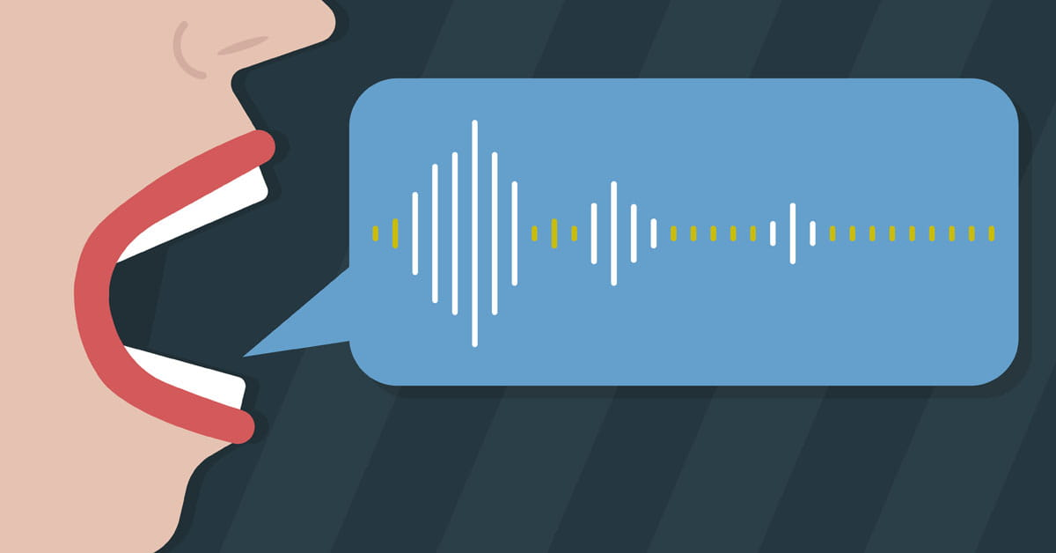
The Effect of Two Treatments on Loudness in Patients with Parkinson’s Disease
Kayla Ferreira, Taylor Lalevee, Phoebe Mervine, Madison Stout Monmouth University Graduate Students
School of Education
Parkinson’s Disease
Literature
Review
Findings
Proposed
Methodology
Proposed
Methodology
Proposed Methodology
Continued
Parkinson’s disease (PD) is a neurological disorder characterized by progressive degeneration of the nervous system. In the beginning of the diagnosis, symptoms can at times be barely noticeable, sometimes presenting with only a single tremor. Parkinson’s disease can cause deficits in a person’s motor, sensory, or communication abilities. A hallmark symptom of PD as it progresses is a decrease in vocal loudness. This often leads to PD patients to be unable to be heard by others when interacting in daily life activities. Lee Silverman Voice Therapy (LSVT) as well as SPEAK OUT! and the LOUD Crowd have become prominent methods of treatment to increase vocal loudness in those with Parkinson’s disease.
Participants: The study will include 40 participants from the Parkinson's Disease (PD) and Movement Disorders Center at the University of Pennsylvania. Twenty-six participants will be male and 14 will be female, according to the ratio of male to female patients with PD. All participants will be at least 5 years post-onset of their PD diagnosis. They will all be screened for cognitive deficits via the Montreal Cognitive Assessment (The MoCA Test). Any participants who do not score within functional limits on the MoCa will be ineligible to participate in the study. All participants must also have no other medical diagnoses or procedures that could affect their speech production, as well as display normal hearing limits on a hearing screening in order to participate in the study. Qualifying participants will give researchers informed consent and then be randomly assigned to receive LSVT LOUD ® or SPEAK OUT! ® and the LOUD Crowd ® treatment. ​​
Pre and Post Testing: During pretest and posttest conditions, acoustic measures of loudness of individuals’ production of the six sentences on the Consensus Auditory-Perceptual Evaluation of Voice (CAPE-V) will be recorded through Praat. All pre and posttest sessions will be recorded for future analysis.
Treatment: The treatment will be provided by licensed speech-language pathologists (SLP) blind to the study’s hypothesis with at least five years’ experience treating voice and motor speech disorders. These SLPs will also be trained and have their certification in LSVT LOUD ® and SPEAK OUT! ® and the LOUD Crowd ®. Treatment will be administered following proper treatment protocol. Both treatment groups will be intensive with the duration following protocol of both treatments. SPEAK OUT! ® and the LOUD Crowd ® will be administered 12 individual, 40- minute sessions, three times per week for four consecutive weeks. LSVT LOUD ® will be administered for 16 one-hour sessions for four weeks. Before administering treatment, the SLPs who are previously certified in LSVT® or SPEAK OUT! ® and the LOUD Crowd® will watch a training video to learn the study’s procedures. All treatment sessions will be recorded. The investigators will watch recordings of sessions throughout the study to ensure study treatment procedures are being followed (treatment fidelity). Feedback will be provided to SLPs to adjust treatment when needed. After treatment is completed, post test measures will be administered.
Data Analysis: Two trained researchers who are not involved in administering treatment and are blind to the study’s hypothesis will watch the videos of pre and post testing sessions. The researchers will collect data from the videos on the participants' change in vocal loudness of the six sentences on the Consensus Auditory-Perceptual Evaluation of Voice (CAPE-V) before and after treatment has been administered. Two weeks after initial data analysis, the two researchers will swap data and rescore 20% of each other’s data to check for inter-rater reliability. The two researchers will also rescore 20% of their own data to check for intra rater reliability. Pre and post-test scores between the treatment groups will be compared to measure changes in vocal loudness from pre to post treatment.
SPEAK OUT! and The LOUD Crowd and LSVT LOUD® both follow a similar course of treatment and both target increasing vocal loudness in patients with PD. Current research investigates the two treatments to see how their influence on increasing loudness in PD patients differs.
LSVT requires twice the amount of treatment minutes than SPEAK OUT! does. SPEAK OUT! includes 12 sessions for 40 minutes each while LSVT includes 16 sessions for 1 hour each (Behrman et al., 2020). SPEAK OUT! integrates a required weekly group session called The LOUD Crowd. Compared to SPEAKOUT!, LSVT does not require a group session after the completion of the program. However, the authors of the treatment added a group component called “LOUD for LIFE” but it is not integrated or required in the individual program (Behrman et al., 2020).
SPEAK OUT!® and LOUD Crowd® programs have been found to have statistically significant improvements in objective and perceptual measurements of vocal loudness in PD patients. After completion of the SPEAK OUT!® and LOUD Crowd® programs, an increase of vocal intensity from baseline was found on collaborated voice recording equipment. PD patients also reported having more positive feelings about their voice on the Voice Related Quality of Life (V-RQOL) after completion of the program when compared to their reported feelings at baseline (Levitt et al., 2015).
One of the main goals of LSVT LOUD® is to increase vocal loudness. Individuals who have been enrolled in the LSVT LOUD® program were significantly more likely to increase their sound pressure level and F0 inflection and maintain these effects 2 years post-treatment (Sapir et al., 2002). Not only does LSVT LOUD® increase vocal loudness through high phonatory effort, but also yields long-term improvement as well.
LSVT LOUD® has shown to provide lasting impacts on more than just vocal loudness. Individuals have shown gains post treatment over time for communicative effectiveness, voice handicap, and communication participation (Bryans et al., 2021). These measures have been well documented in short-term and long-term improvements as well as increased sense of control for those experiencing difficulties in communication due to Parkinson’s disease.
Purpose
References
The purpose of the proposed study is to examine which of two treatments would be more efficient in increasing and maintaining vocal loudness in individuals with Parkinson’s Disease.
Behrman, A., Cody, J., Elandary, S., Flom, P., & Chitnis, S. (2020). The effect
of speak out! And the loud crowd on dysarthria due to parkinson’s disease. American Journal of Speech-Language Pathology, 29(3), 1448–1465. https://doi.org/10.1044/2020_ajslp-19-00024
Bryans, L. A., Palmer, A. D., Anderson, S., Schindler, J., & Graville, D. J. (2021). The impact of Lee Silverman Voice treatment (LSVT LOUD®) on voice, communication, and participation: Findings from a prospective, Longitudinal Study. Journal of Communication Disorders, 89, 106031.
https://doi.org/10.1016/j.jcomdis.2020.106031
Levitt, J. S., Chitnis, S., & Walker-Batson, D. (2015). The Effects of the “SPEAK OUT! ®” andLOUD Crowd®” Voice Programs for Parkinson Disease. International Journal of Health Sciences, 3(2).
https://doi.org/10.15640/ijhs.v3n2a3
Sapir, S., Ramig, L. O., Hoyt, P., Countryman, S., O'Brien, C., & Hoehn, M.
(2002). Speech loudness and quality 12 months after intensive voice treatment (LSVT) for Parkinson's disease: a comparison with an alternative speech treatment. Folia phoniatrica et logopaedica : official organ of the International Association of
Logopedics and Phoniatrics (IALP), 54(6), 296–303. https://doi.org/10.1159/000066148
Research Question
Will Lee Silverman Voice Treatment (LSVT LOUD®) or SPEAK OUT!® and The LOUD Crowd® have a greater effect on increasing vocal loudness in patients with Parkinson's Disease?
Notes:
1
Talking Points:
-AAC: apps have increased from 3 apps in 2009 to over 110 in 2011. That is 6 years ago so we can infer that the amount of apps has only increased since then.

