Slide 1
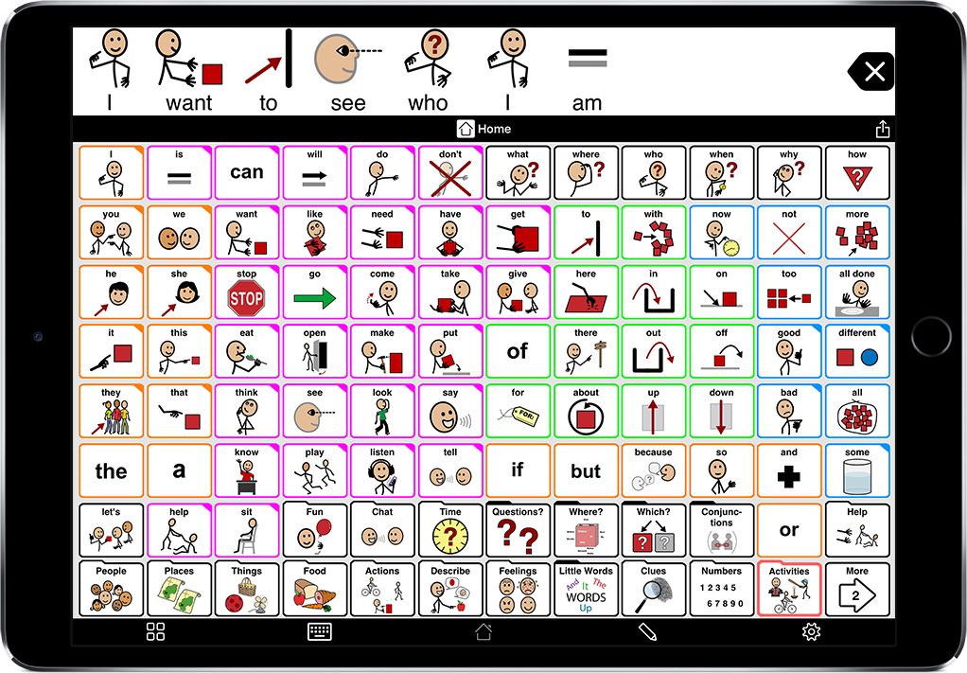
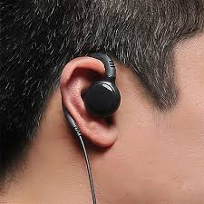
Teletherapy vs. In-person Cueing: A Comparison of Approaches for Working Adults with ASD
Emily Kania, Hallie Kocher, Gabriela Penagos, Erin Bayer
Monmouth University Graduate Students Speech-Language Pathology
School of Education
Augmentative and Alternative Communication (AAC)
Proposed Methodology
Proposed
Methodology
Description of Participants
Data Analysis
Participants: Four participants will participate in this study. Of these four participants, their ages will be 18, 21, 25, and 30. Each participant will be diagnosed with ASD, use AAC, and be currently employed.
Recruitment: A sample of convenience will be gathered from a local university clinic.
Administration: Licensed and certified SLPs with at least 5 years’ of experience working with adults who communicate with AAC devices administered treatment. The treating SLPs were unaware of the researcher’s hypothesis to prevent treatment bias.
Procedure:
The study will be conducted over a 4-month period.
Baseline:
During all baseline phases (A phases), the participants will attend work normally with no SLP assistance (virtually or in-person). The percentage of opportunities in a 60-minute time period when each participant successfully uses their device to communicate their needs (dependent variable) will be measured by a research assistant trained to record data for all phases of the study.
Sixty-minute baseline phases will be administered for a minimum of three sessions. Initial baseline sessions will continue until measurement of the dependent variable is stable across three consecutive sessions.
Treatment:
During the first treatment phase (Phase B), each participant will have an SLP on-site at their work to provide cueing for the participant to communicate their needs.
During the second treatment phase (Phase C), each participant, while at work, will have an SLP provide cueing and prompting virtually, via Zoom or an earpiece, to communicate their needs. All treatment phases will be 60 minutes in length.
The first participant of this study is an 18-year-old male. He currently works as an overnight stocker at a local grocery store, where he has worked for the past 18 months. He currently utilizes an app on his iPhone as an AAC device as well as short verbalizations for basic communication with his coworkers. His IQ is slightly below average and he requires additional instruction for certain tasks at his job. He was diagnosed with ASD at a young age and has been working with different professionals (e.g., job coaches, SLPs) for several years.
The second participant of this study is a 21-year-old male. He currently works as a cashier at a Shoprite. He has been at this location for just four months, after transferring from a smaller market near his house where he worked at for three years. He has participated in speech therapy for two years and utilizes a high-tech speech generating device to communicate with co-workers and customers. His IQ is average, and he is regarded as a reliable employee and a fast learner. He was diagnosed with ASD when he was in middle school and began working with SLPs and psychologists after his diagnosis.
The third participant of this study is a 25-year-old female. She is currently a bagger at Trader Joe’s where she has worked for 6 years. She was diagnosed with ASD as a child and utilizes a text-based AAC device to communicate with co-workers and customers. She works well with her co-workers and has the responsibility of assisting with training of new hires at the store. She has an IQ that is average, but still benefits from additional instruction. She has become more independent in her daily tasks at the store, but still shows some resistance to new tasks/change.
The final participant of this study is a 30-year-old female. She is currently a janitor at an ACME owned by her family, where she has been employed for the last 10 years. She was diagnosed with ASD as a child and is completely non-verbal. Her IQ was found to be below average. She utilizes a symbol based AAC device for basic communication with her coworkers. She avoids customers when working, as she doesn’t carry around her device. She has been working with a team of SLPs, occupational therapists (OTs), and psychologists since her early childhood.
Independent variable: Teletherapy vs In Person Therapy Dependent variable: How effective communication is when utilizing AAC (Percentage of opportunities in a 60-minute time period where participants will get their needs met appropriately utilizing AAC devices)
Data Collection: All treatment sessions will be recorded for future analysis. The treating SLP will not take data during sessions in order to avoid bias. Two trained researchers will view recordings of the sessions and measure the dependent variable from the recordings. The trained researchers will be different from the primary investigators and will be unaware of the researcher’s hypothesis to prevent measurement bias. Licensed and certified SLPs with at least five years of experience working with adults who communicate with AAC devices will administer treatment. The treating SLPs will be unaware of the researcher’s hypothesis to prevent treatment bias. Treating SLPs will watch training videos to learn study procedures. Investigators will watch recordings of sessions to check for treatment fidelity. Reliability: Two weeks after initial coding, two types of reliability will be conducted. Intra rater reliability: The same researcher will re-code 20% of their original data. They will then calculate the percentage of agreement vs. disagreement from the first to second coding. Inter rater reliability: Researchers will re-code 20% of original data that they did NOT originally code. They will then calculate the percentage of agreement vs. disagreement from the first to second coding
Augmentative and Alternative Communication
AAC is Augmentative and Alternative Communication. This includes anything that an individual uses to communicate other than their words, such as pictures, gestures, signs, objects, or speech-generating devices.
Autism Spectrum Disorder (ASD)
Autism Spectrum Disorder ASD is defined as a neurodevelopmental disorder in which the individual typically experiences impaired social skills and repetitive behaviors or restricted interests. Individuals with this diagnosis may also experience unusual reactions to sensory stimuli.
Purpose
Selected References
American Speech-Language-Hearing Association (n.d.). Autism Spectrum Disorder.Retrieved March 7th, 2023. https://www.asha.org/practice-portal/clinicaltopics/autism/
Biggs, E. E., Therrien, M. C. S., Douglas, S. N., & Snodgrass, M. R. (2022). Augmentative and alternative communication telepractice during the COVID-19 pandemic: A national survey of speech-language pathologists. American Journal of Speech - Language Pathology (Online), 31(1), 303 321. https://doi.org/10.1044/2021_AJSLP-21-00036
Curtis, R. T. (2014). Case studies for telepractice in AAC. Perspectives on Augmentative and Alternative Communication 23(1), 42- 54.https://doi.org/10.1044/aac23.1.42
Hines, M., Balandin, S., & Togher, L. (2011). Communication and AAC in the lives of adults with autism: the stories of their older parents. Augmentative and alternative communication (Baltimore, Md. : 1985), 27(4), 256–266. https://doi.org/10.3109/07434618.2011.587830
Richardson, L., McCoy, A., & McNaughton, D. (2019). "He's worth the extra work": The employment experiences of adults with ASD who use augmentative and alternative communication (AAC) as reported by adults with ASD, family members, and employers. Work (Reading, Mass.), 62(2), 205–219.https://doi.org/10.3233/WOR-192856
The purpose of the study is to investigate the effectiveness of in-person vs. teletherapy cueing in the workplace for users of Augmentative and Alternative Communication (AAC) diagnosed with Autism Spectrum Disorder (ASD).
Research Question
Which mode of cueing (in-person or via teletherapy) by a speech-language pathologist (SLP) is most effective in prompting clients with ASD who use AAC to communicate their needs in the workplace?
Notes:
1

