Slide 1
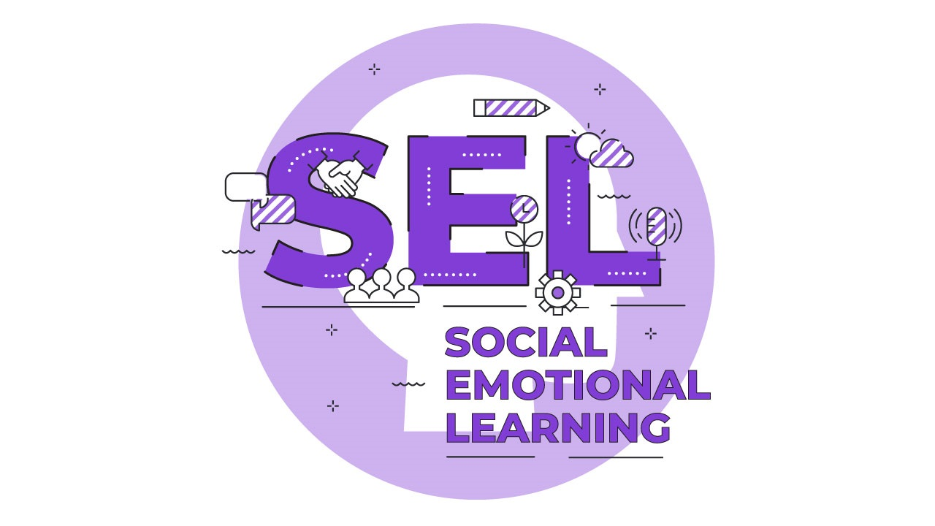
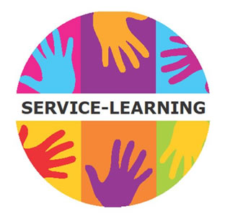
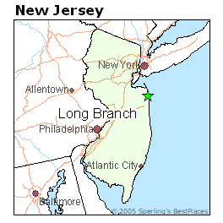
Service learning Project
By: Thomas Blaine
Monmouth University EDS-330
Impact:
-Improve emotional intelligence and awareness
-Allowing students to reflect and express on their perspectives
-Working towards improving their personal and collective goals
Description of classroom/students:
7th grade US history class
11 students
6 males, 5 females
2 students with disabilities
Learning disabled and ADHD
Understandings:
Learned:
-Classroom management
-Daily procedures
-Leadership in classroom
-Time management skills
Connections to class:
-Differentiation for students
Connection to the field:
-Differentiation and accommodations are necessary for success
Overview of community-
-Long Branch, NJ,
Monmouth County
-32,383 people
-Poverty Rate: 21.4%
Race and Ethnicity %:
-Hispanic: 58.1%
-White: 24.5%
-Black/ African American: 13.7%
(“U.S. Census Bureau QuickFacts: Long Branch City, New Jersey”)
Future Goals:
-Learn how to differentiate and accommodate for students
-Create and implement effective lesson plans to meet the needs of diverse learners
-Make strong connections with the students
Course + project-
Title of class: EDS 330
SL project: My service-learning project is a social emotional task card gallery walk. This involved students to walk around the classroom to different stations responding to certain scenarios. My project requires students to practice their emotional intelligence and awareness and apply it to several real life situations.
Overview of School-
Name: Long Branch Middle School
Grades: 6-8
Number of students: 1,121
Student to teacher ratio: 11:1
Roles:
-Observed teachers styles and behaviors
-Assisted students with help on assignments/readings
-Helped students with spelling or pronunciation

