Slide 1
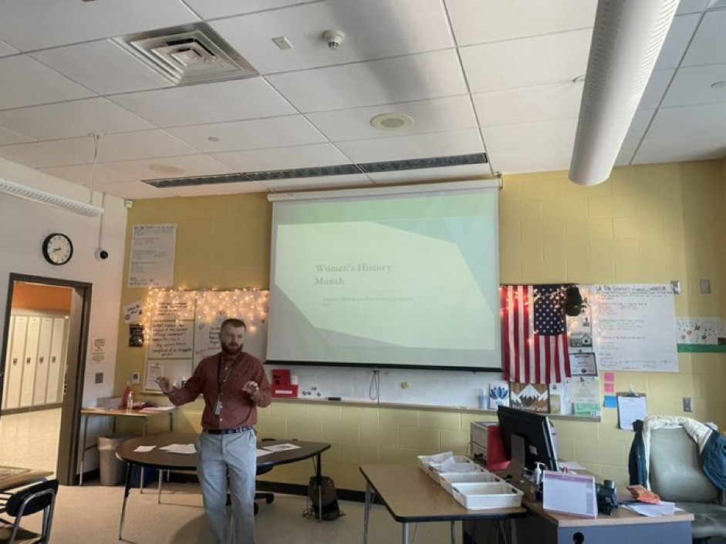
Service-Learning Presentation
Nicholas Bashore Monmouth University
Overview of Community
Long Branch
Monmouth County
32,383 Population
21.4% Poverty Rate
81.5 Citizenship%
56.8%W, 13.8 AA/B, 23.3% H, 6.1% O
(Census.gov, 2021)
https://www.census.gov/quickfacts/longbranchcitynewjersey?
My Role
Assist students with definitions
Add to lessons
Help groups understand questions
Add personal experiences to discussions
Understandings
Organization importance
Differentiate
Discussion
Creative and visually appealing methods
EDS 330 Connections?
Differentiation
Attention keeping methods
Overview of School
Long Branch Middle School
Grades 6-8
1,116 Total Students
11:1 Student to Teacher Ratio
52.2% Male/47.8% Female Students
W 21%, H 59% AA/B 15.3%, 0, 3%
(NJ School Performance Report, 2021)
https://rc.doe.state.nj.us/2020-2021/school/detail/25/2770/060/demographics?lang=EN
Service-Learning Project
EDS-330 Foundations of Special Education
Women's History Month
Background article
Lesson overviews
Video
Presentations
Impact
Community Engaging Project
Reading and memorization techniques
Teacher could focus more on specific students
Women's History Month and other recognitions
Overview of Classroom
Grade 7
Class of 7 and 5
Google Forms, Newsela, Gimkit, YouTube Videos,
Conversation and note based
Outlook with Special Education
Growth with the help of collaborating teachers
Find exceptional students early on in my lessons plans and differentiate
Conversation based learning
Students
7th grade Special Education class
Social studies
ADHD with various ranges
Students with IEPs

