Slide 1
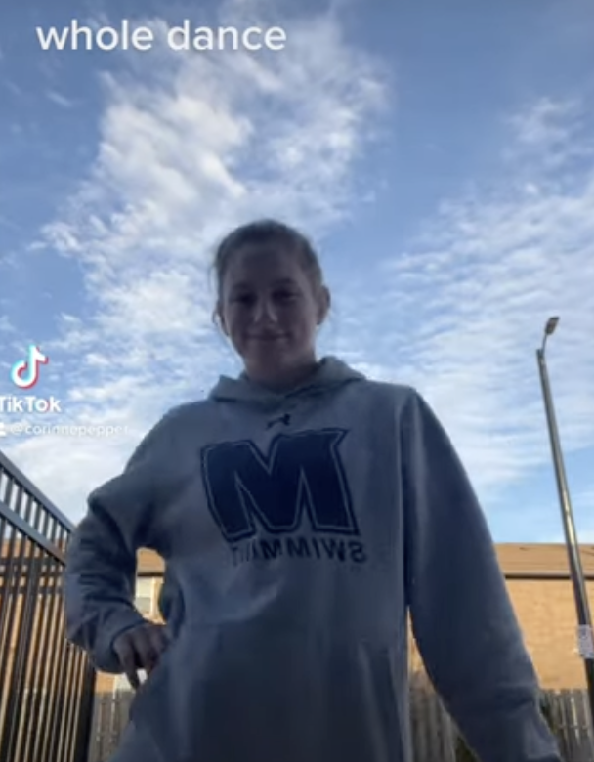
Corinne Pepper Monmouth University
Get Moving!
Setting
Overview of Community
Long Branch
3 Pre Schools, 6 Elementary schools, 1 Middle school and 1 High school
Approximately 5,5000 students
60.9% of students are economically disadvantaged
48% female, 52% male
54.9% Hispanic/Latino, 23.5% Caucasian, 13.2% African American
(“Long Branch Public School District”)
Overview of School
Anastasia Elementary School
K-5
Approx. 550 students
1:10 Student & teacher ratio
47% female, 53% male
69.8% minority students
54.4% Hispanic/Latino
(“Anastasia Elementary School”)
Overview of Classroom
4th Grade
Ten students
Use technology such as Read 180 and System 44
Students
Learning Disabilities Self-Contained Class
Six Girls and 4 boys
Disabilities include autism, SLD, ADHD, and communication-impaired
Course & Project
EDS 330
Learning a Tik Tok dance in four parts, one each week
Provides a break from learning to get any energy out and allows students to refocus afterward
Role
Helped with whatever cooperating teacher asked
Assisted students with writing and spelling
Show students the new portions of the dance
Break it down step by step
Lead the class through practicing as a class, and encouraging them
Understandings
Young students use lots of technology & know about all kinds of social media
In order to bring out a student’s personality, one should use techniques or things that they know and are comfortable with (in this case, Tik Tok)
Technology can be used to provide an alternate way of learning
Impacts
Students came to class excited to add to the dance
Some wanted to show me how they had been practicing at home
Let students show their personality
Personal- very happy that I was connecting and making the students happy
Future Goals
Plan to use technology and incorporate into lessons
Plan to provide breaks in learning in order to have higher-quality learning
Encourage students to want to be active and exercise
A A Anastasia Elementary School. (n.d.). US News and World Report. https://www.usnews.com/education/k12/new-jersey/a-a-anastasia-elementary-school-239255
Long Branch Public School District. (n.d.). US News and World Report. https://www.usnews.com/education/k12/new-jersey/districts/long-branch-public-school-district-105600

