Slide 1
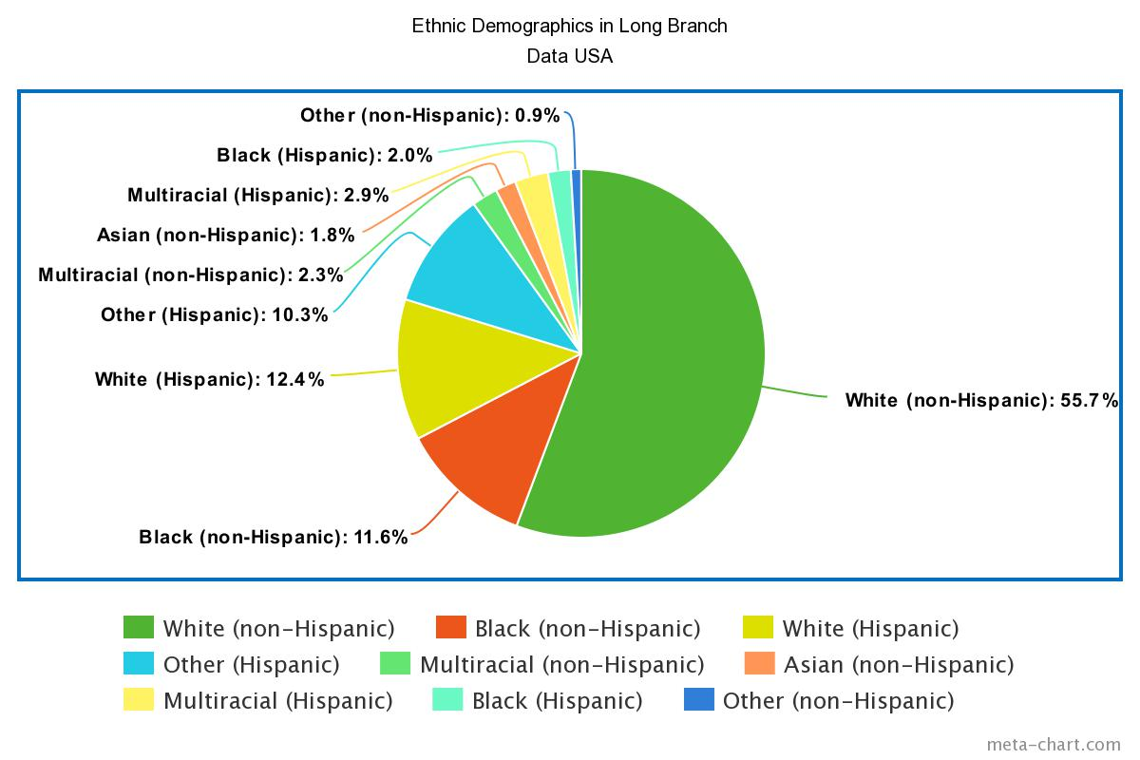
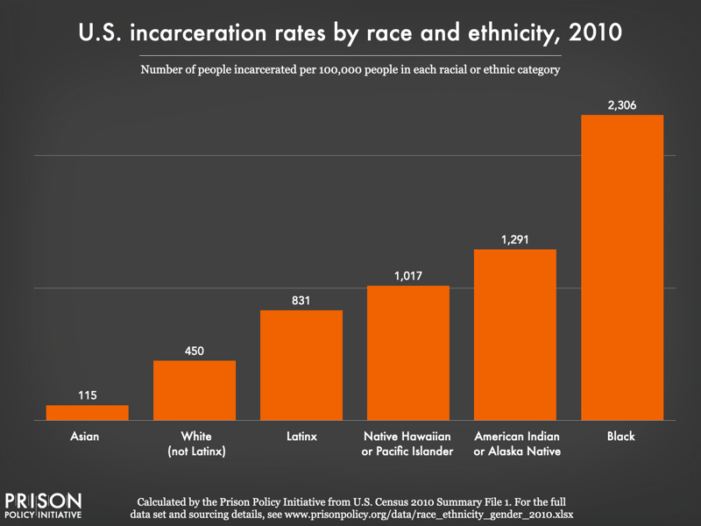
Racist Past, Racist Present
Holden Betz, Monmouth University: Lecturer & Classroom Assistant
Project for Course ED 330- Examined the link between the wording of the 13th Amendment and Incarceration rates today, done through brief lecture and timeline activity linking cause and effect.
Students- 7 males, 1 female. All have been diagnosed with ADHD, some have Intellectual Disabilities as well
Community- Long Branch ^{1, 2}
Monmouth County, NJ.
Pop. 32,383, poverty rate- 21.4%, citizenship rate- 81.5%, demographic data– see pie chart
School- Long Branch Middle School ³
1,121 students in Grades 6-8
11/1 student/teacher ratio
53% male, 47% female
58% Latino, 23% White, 15% Black
Classroom
7th grade Social Studies, 8 students (all with laptops), one professor, traditional desks
Understandings- As we covered in ED 330, I saw how much ADHD affects learning and attention span. I gained an appreciation for how much personal lives can affect learning. Both of these tie back to research advocating for more compassion in the classroom.
Impacts- I helped expose the students to a societal failing, making them more aware citizens in the process. I also made the students comfortable by being a different voice in the classroom
Future Goals- Take lessons learned about lecturing and how to simplify. I want to continue to learn how to manage unruly students.
Citations:
1. United States Census Bureau QuickFacts. (n.d.). U.S. Census Bureau QuickFacts: Long Branch city, New Jersey. Census Bureau QuickFacts. https://www.census.gov/quickfacts/longbranchcitynewjersey
2. Long Branch, NJ | Data USA. (n.d.). Data USA. https://datausa.io/profile/geo/long-branch-nj
3. Long Branch Middle School (2023 Ranking) - Long Branch, NJ. (2023, March 22). Public School Review. https://www.publicschoolreview.com/long-branch-middle-school profile#:~:text=58%25%20of%20Long%20Branch%20Middle,1%25%20of%20students%20are%20Asian.

