Slide 1
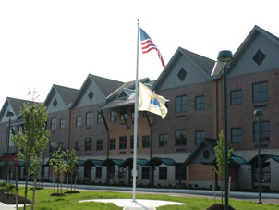
Cara Godschall Monmouth University
Prefixes and Suffixes Action Plan
Setting
Overview of Community
Long Branch
Monmouth
Population: 32, 383
Poverty rate: 18.2%
Citizenship: 81.5%
White: 68.1% Black or African American: 13.66% Other: 11.19%
Overview of School
Amerigo A Anastasia Elementary
Grade ranges: K-5
Number of students: 578
10:1 Student to Teacher Ratio
297 male/289 female students
55% Hispanic, 30% White, 10% Black, and 5% Two or more races
Overview of Classroom
Grade 5
11 Students
Reading Program: KidBiz – on the technology
Layout: Groups of 2 desks next to each other all facing the front
Technology: Everyone has a laptop
Description of Students
5 girls & 6 boys
Special Education Classroom – 11 students with learning disabilities
Course & Project
EDS 330 – Foundations of Special Education
Puzzle of prefixes and suffixes
Bingo Game
Role
Reviewed prefixes and suffixes with the students in small groups
Gave students a definition of a word, they had to find the puzzle pieces of the definition
Hosted a game of bingo where they had to find the word on the board when I called out a definition
Understandings
I learned that it takes a lot of patience to work with students with disabilities
That every student works differently, and it is your job to help everyone
This connects to my coursework because we learned all about working with students with disabilities
Working in the field helped me learn more about students with disabilities
Impacts
Learning prefixes helped with learning their vocabulary words.
Vocabulary word was unaware
The students enjoyed the puzzles
Future Goals
From my learning I plan to grow creatively
I want students to enjoy learning while understanding what is being taught
I plan to continue to learn about what works best in the classroom
Notes:
I am Cara Godschall and my action plan was about prefixes and suffixes. The town that I did my service learning was in Long Branch, in Monmouth county.
The school that I worked in was Amerigo A Anastasia Elementary school which ranges from kindergarten to 5th grade.

