Slide 1
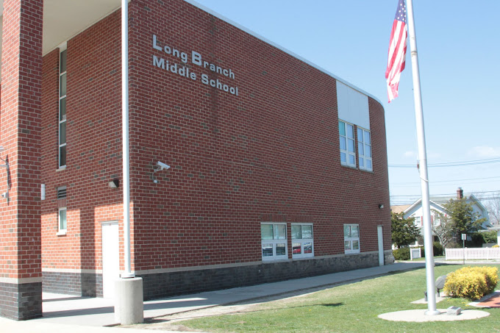
Monmouth University
Poster Project
By: Sabrina Burkhard
Understanding:
I learned leadership skills
Communication skills with students
Problem-solving tactics
Took information we learned in the course and implemented it in the classroom
Impact:
I feel I made students comfortable and excited to do SL project
I feel I made them become at ease when sharing or reading in a small group
Goals:
I plan on growing through continuing to practice the skills I learned
Taking advice from teachers/professors
Gaining a better understanding of what else can be done to make me a better teacher for my students
I want to learn more about specifically what to do if I feel a student isn’t listening to me or paying attention
About the Community:
Long Branch
Monmouth County
Population: 645,354
6.5% of population experience poverty (dataus.io)
95.2% of the residents are U.S Citizens (datausa.io)
Race % = white (84.7&) African American (7.3%) (census.gov)
About The School:
Long Branch Middle School
Students from grades 6th- 8th
1,121 students total (niche.com)
Student/Teacher ratio- 11:1 (niche.com)
47% female students 53% male (usnews.com)
58% of students are Hispanic, 23% of students are White,15% are Black (publicschoolreview.com)
About The Classroom:
Long Branch Middle School
6th grade students
4 students in classroom
2 teachers in classroom
All male students
Description of Students in Classroom:
4 male students
All with autism
2 students were nonverbal and communicated with a iPads
Their family members, teachers, classes, and common words/phrases were already put into the iPad
Course & Project:
EDS 330 02
Read a book each week and had students take turn reading and then answer questions based on what was read
Role: Guided Students Learning
Assisted in class assignments
Looked over homework
Helped understanding

