Slide 1
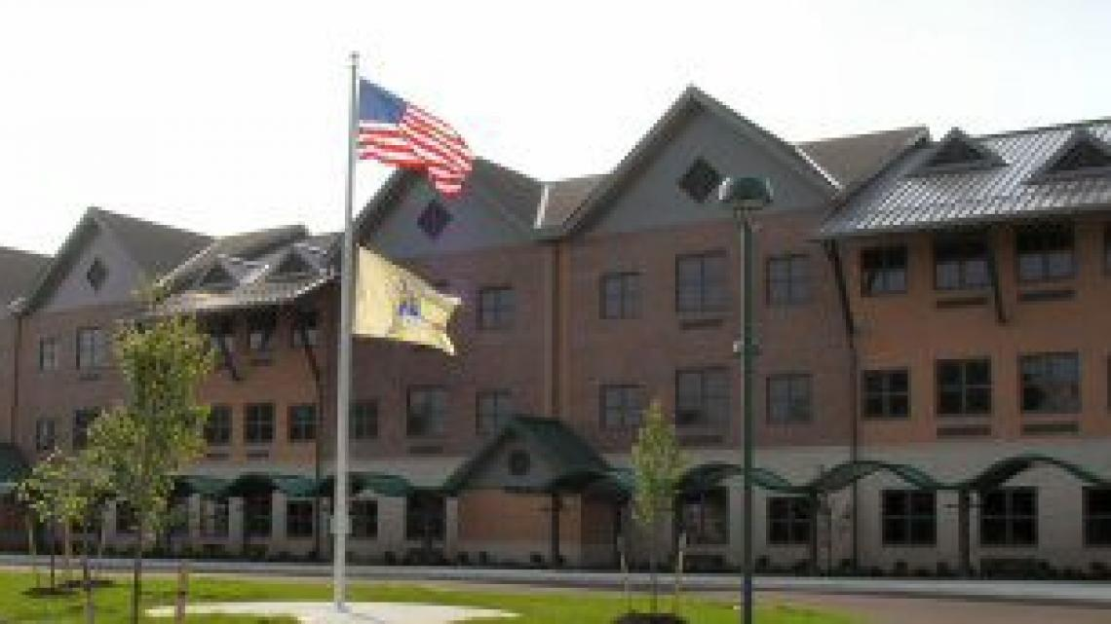
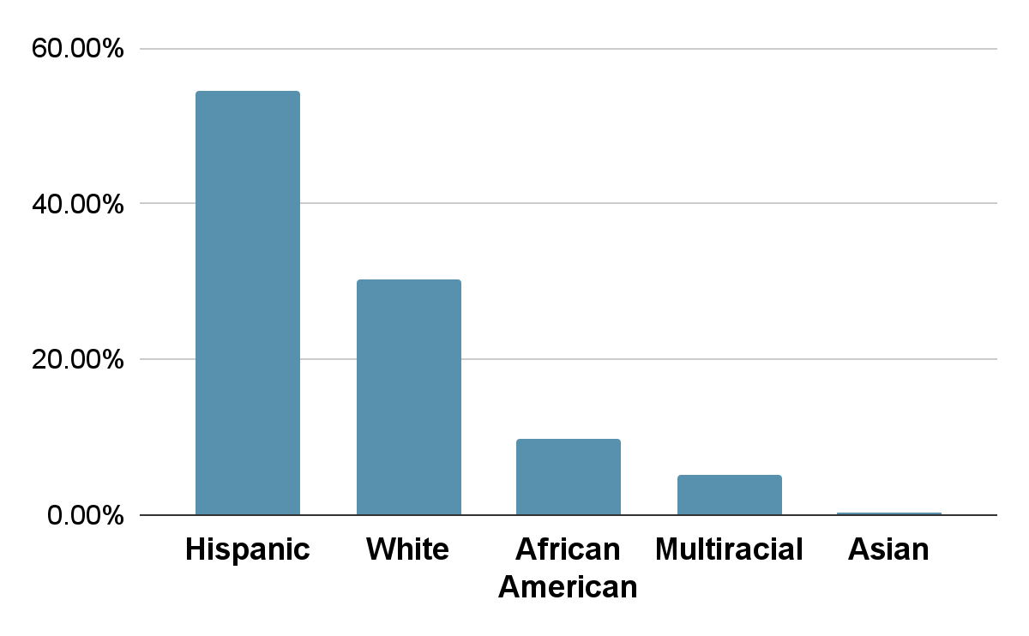
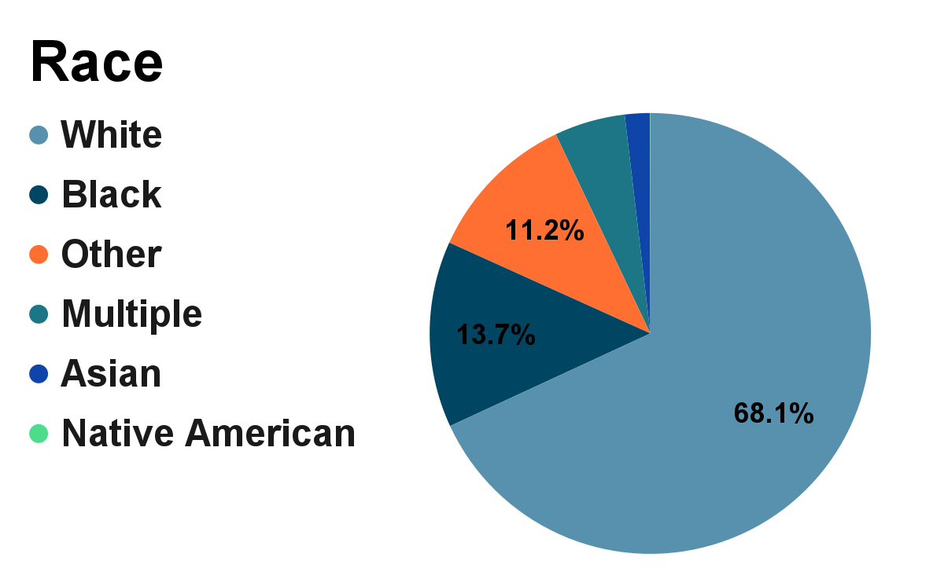
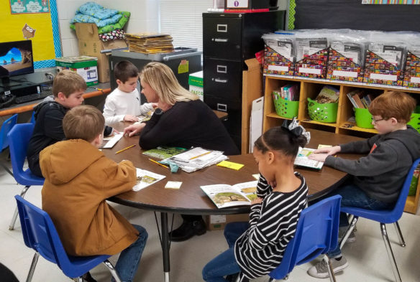
One World, Many Stories
Kourtney Schaffer
Monmouth University School of Education
INTRODUCTION
RESEARCH LEARNING
REFLECTION
CLASSROOM
ROLE
UNDERSTANDING
Fourth grade special education classroom. There are nine students. Websites they use on their chromebooks are, Class Dojo, Everyday Math, and Scholastic Word. The classroom is organized in rows facing the front of the classroom with a rug and flexible seating in the back and a center table to the side.
Helped with activities throughout small group work
Handed out papers
Morning greetings.
Hand out stickers for their reward charts
Small reading groups during centers
I learned how students can be at different reading levels, specifically lower grade levels
students are more engaged when it is material they like or know about.
I got to see different developments.
I got to see how students with different disabilities learn and interact.
I am continuously building more knowledge on different disabilities and key concepts to look for in a classroom to better educate my students.
SCHOOL
Amerigo A Anastasia Elementary is an elementary school in Long Branch, NJ which consist of grades Kindergarten to Fifth. It has roughly 560 students, 47% female and 53% male, with a student teacher ratio of 10: 1. (Niche 2023)
Race/ Ethnicity Percentage:
STUDENTS
GOAL OF PROJECT
There are nine students, four female and five male. Within the class, all students have a disability. These disabilities include Autism, Communication Impairment, Other Health Impairment, and Specific Learning Disability.
I chose this project because after communication with my cooperating teacher, we felt students would benefit best from working on reading and reading comprehension.
I wanted to gain insight on students with different reading levels and how to better accommodate and teach them.
I wanted students to gain more of a love for reading and more knowledge in literacy.
(Kentucky Teacher)
IMPACTS
More excitement in reading
Improved oral reading
Improved comprehension
Improved courage
Improved confidence
COMMUNITY
COURSE & PROJECT
FUTURE GOALS
The community is Long Branch, NJ in Monmouth County. The population is roughly 32 thousand people. 67.84% of Long Branch residents were born in the United States. 17.82% of residents are not US citizens. (World Population Review 2023)
Poverty %
My future goals are to get to know each student and understand what motivates them. To also continue building more knowledge to become a better teacher. To help achieve these goals, I can go to workshops, research more to build knowledge, and always be willing to learn.
EDL 330 01: Foundations of Special Education
My service learning project consisted of readings at a second grade level and reading comprehension and literacy worksheets to follow to help examining students progress and understanding. This was done on a weekly basis in small groups during centers.
Other | 40.83%
Hispanic | 39.1%
Multiple | 36.46%
Black | 23.51%
Native | 18.18%
White | 15.14%
Asian | 0.25%
ACKNOWLEDGEMENTS
A big thank you to Monmouth University School of Education, as well as Long Branch Public Schools for an engaging, insightful, and rewarding learning experience
CONTACT INFO
s1321958@monmouth.edu

