Slide 1
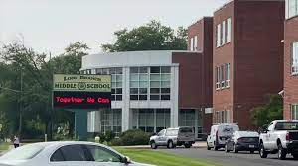
Multiplication Magicians
Understandings
Students know how to multiply; others struggle
Patience
Students with special needs in classroom
Teachers teaching students
Community
Long Branch, Monmouth
32,383 (population) (census.gov)
18.2% Poverty Rate (datause.io)
70.28 % U.S. Citizens, 12.74% not born in U.S. (point2home.com)
Majority white 68.1% (datausa.io)
Milana Shindelman
Monmouth University
Description of Students
8 males and 2 females
10 students
Students have IEPS
Impacts
Created Relationship with teacher and students
Explained to students' math in a simpler way
Overview of School
Long Branch Middle School
6-8th grade
1,121 students
11:1students: teacher ratio
53% male / 47% female students
58% Hispanic, 23% White (usnews.com)
Course & Project
EDS 330-02 Foundations of Special Education: Child
Project: Students to improve at multiplying numbers
Overview of Classroom
8th grade math classroom
10 students
Big Classroom
Big Ideas- Math
Layout Changes
Chromebooks
My Role
Create Do Now (Multiplication)
Provide support and assistance to individual students
Encourage students
Modeling Good Behavior
Future Goals
Apply knowledge that I learned towards my future classroom
Creating different lessons that will support all students

