Slide 1
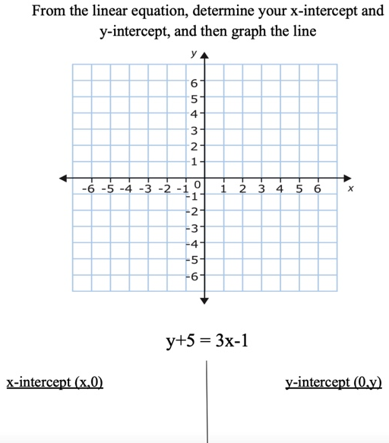
Rachel Vassallo Monmouth University EDS-330
Math Centers
Setting
Location: Long Branch Middle School
County: Monmouth County
Diversity: 47% female, 57% male; 58.3% Hispanic/Latino, 22.7% White, 15% African American (U.S. News, 2023)
Population: Student-to-teacher ratio is 11:1 (U.S. News)
Grade: 8th
Subject: Math
Students: 6 students with learning disabilities (5 male, 1 female)
Each student is at a different grade level of learning (Kindergarten-6th grade)
Classroom teacher and additional aide
Service Learning Project
Creating math centers that each focused on a specific skill
Work in small groups or independently
Help students improve in all areas of the class
Provide extra practice
Role
Aiding students in small group and independent work
Breaking down problems step-by-step
Make sure every student receives assistance
Helping students remain focused and encourage them while working
Observe during lectures and assist during do-nows, projects, and Chromebook work.
Impacts
Help cooperating teacher see which skills students needed more practice on
Understand which skills took the most/least time
Understand which skills students were most comfortable with
Eventually were able to perform skills on their own
Students were able to work together, and help those who needed extra assistance
Understandings
No two students or disabilities are exactly alike
Observe how culture impacts learning (i.e. different values impact learning styles)
Valuing working as a group or independently impacts learning
Observe different methods to help students with learning disabilities including peer-tutoring
Importance of repetition, patience and respect

