Slide 1




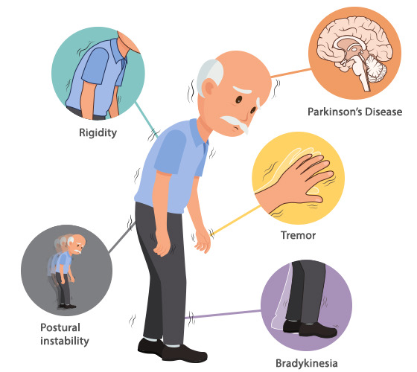
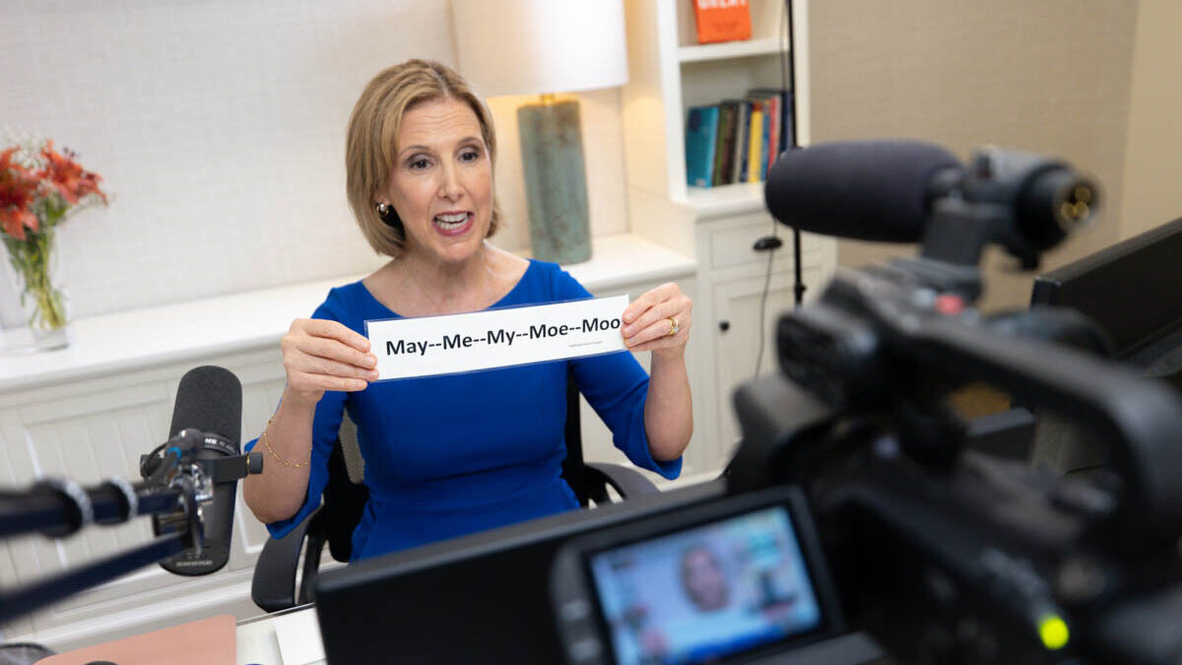

Lee Silverman Voice Treatment Versus SPEAK OUT! in an Individual with Parkinson’s Disease
Jessica Mancato, Ariana Renna, Isabella Sgroi, Brianna Trupiano
Monmouth University Graduate Students
School of Education
Background
Literature
Review
Findings
Proposed
Methodology
Proposed
Methodology
References
Participant:
The proposed study will include one 65-year-old female named Patricia who is diagnosed with idiopathic Parkinson’s disease (PD). This individual will have no other significant medical history, will not have undergone previous medical or therapeutic treatment (e.g., radiation for head and neck cancer, previous speech therapy), and will have average cognitive skills.
Procedure:
The individual participating in this single subject design will be taken as a sample of convenience. This study is an ABACA withdrawal design. The first A phase is initial baseline, B and C phases represent treatments, and the second and third A phases represent return to baseline. The dependent variable, mean intensity in decibels (dB) when reading one sentences from the Grandfather Passage, will be measured during all phases of the study. During all baseline phases, the client will read a random sentence from the Grandfather Passage without any cues or assistance. At least three baseline sessions will be administered until a stable baseline is reached. All sessions will be recorded for future analysis.
A certified speech-language pathologist (SLP) with five years’ experience will be administering the LSVT and SPEAK OUT! treatment. The SLP will be licensed and certified in LSVT and SPEAK OUT! Voice therapy. The SLP will be trained in the study’s baseline and treatment procedures via a training video. The SLP will be blind to the study’s hypothesis to avoid bias. During the study, videos of the treatment sessions will be watched by the investigators to ensure that baseline and treatment phases are being conducted according to study procedures. If necessary, feedback about procedures to adjust will be provided.
During the first treatment phase (Phase B), LSVT will be administered across 60-minute individual treatment sessions, 4 days a week for 4 consecutive weeks. Following this phase, another baseline measurement will be obtained. During the second treatment phase (Phase C), SPEAK OUT! will be administered across 60-minute individual treatment sessions, 4 days a week for 4 consecutive weeks. At the end of each session, the client will read a random sentence from the Grandfather passage, and intensity will be measured. Lastly, a final baseline measure will be obtained.
After all phases of the study are completed, two trained researchers who have no knowledge of the study hypothesis will watch the videos and take data on the dependent variable. Two weeks later, the researchers will swap data and rescore 20% of each other’s data to check for inter-rater reliability. The researchers will also rescore 20% of their own data to check for intra-rater reliability.
Behrman, A., Cody, J., Elandary, S., Flom, P., & Chitnis, S. (2020). The effect of SPEAK OUT! and The LOUD Crowd on dysarthria due to Parkinson's disease. American Journal of Speech-Language Pathology, 29(3), 1448-1465. https://doi.org/10.1044/2020_AJSLP-19-00024
Boutsen, G., Park, E., Dvorak, J., & Cid, C., (2018). Prosodic improvement in persons with Parkinson disease receiving SPEAK OUT! voice therapy. Speech, Language and Hearing, 70(2), 51-58. https://doi.org/ 10.1159/000488875
Bryans, L.A., Palmer, A.D., Anderson, S., Schindler, J., & Graville, D.J. (2021). The impact of Lee Silverman Voice Treatment (LSVT Loud ®) on voice, communication, and participation: Finding from a prospective, longitudinal study. Journal of Communication Disorders, 89, 106031. https://doi.org/10.1016/j.jcomdis.2020.106031
Sapir, S., Ramig, L. O., & Fox, C. M. (2011). Intensive voice treatment in Parkinson's disease: Lee Silverman Voice Treatment. Expert Review of Neurotherapeutics, 11(6), 815-30. https://doi.org/10.1586/ern.11.43
Parkinson’s disease (PD) is a progressive neurological disorder that negatively impacts the chemical dopamine, which plays a crucial role in movement. Therefore, while physical activities such as walking might be disrupted, the ability to speak and properly use the voice can also be interrupted. One of the main speech characteristics of individuals with PD is a low or weak voice. This makes a main goal of speech therapy to increase the loudness of an individual's voice.
In the article, “Prosodic Improvement in Persons with Parkinson disease Receiving SPEAK OUT! Voice Therapy,” (Boutsen et al., 2018) sixteen participants (11 male and 5 female) with different demographic backgrounds that had PD gave consent to participate in a study to evaluate the efficiency of the SPEAK OUT! program on people with Parkinson’s. Participants read the same passage each week and were given prompts that asked questions to encourage them to speak. Measurements were collected on the participants before and after therapy which included scores on the Voice Handicap Index and Voice Related Quality Life Questionnaire as well as audio recordings. Data collected after SPEAK OUT! showed that participants improved in multiple areas such as pitch range, speech rate and intensity, reading intelligibility and vocal quality. Improvement in prosody was also shown when the participants read louder and used extensive pitch ranges. In conclusion, this study has proven that these individuals with Parkinson’s disease can use SPEAK OUT! as an effective treatment because it improves speech intensity as well as prosodic features like intonation and pitch.
In the article, “Intensive voice treatment in Parkinson’s disease: Lee Silverman Voice Treatment,” Sapir et al. (2011) investigate the effectiveness of exercise-based treatment, specifically Lee Silverman Voice Treatment (LSVT), in the Parkinson’s disease (PD) population. The authors review characteristics and features of speech that occur within this population and the different treatment options (e.g., pharmacological and surgical treatment, LSVT) available. LSVT is demonstrated to be most effective as it is an intense treatment method that is utilized inside and outside of the therapy room where tasks focus on improving deficits of this progressive degenerative disease.
Bryans et al. (2021) assess the effectiveness of The Lee Silverman Voice Treatment (LSVT Loud) on those diagnosed with Parkinson’s disease (PD). Twenty-five individuals diagnosed with PD were chosen to receive LSVT for four weeks to treat communication deficits such as changes to their voice, rate of speech and cognitive impairments as a result of their diagnoses. Participants were required to participate in three self-reported studies, including The Voice Handicap Index, The Communicative Effectiveness Scale, and the Communicative Participation Item Bank, at baseline, immediately following treatment, 4-8 weeks after treatments, and 3-6 months after treatment. Partner-rated scores for The Communicative Effectiveness Scale were also taken from caregivers of participants at all points of treatment. Results of this study showed significant and consistent improvements of participant self-reported scales which showed a correlation to the partner-reported scale.
Behrman et al. (2020) assessed the impact of the SPEAK OUT! therapy program on those with PD, as well as those without communication impairments. To measure the effectiveness of the program, the researchers looked at measures of intensity, prosody (variation of intensity and frequency), cepstral peak prominence (CPP) as well as ratings on the Voice-Related Quality of Life (V-RQoL). Specifically, these measures were examined in both a reading task and a spontaneous monologue, as no prior research looked at prosody in both of these contexts. No significant changes occurred from baseline to post-therapy for the control group. For the PD group, significant changes were found from baseline to post-therapy for all measures except for variation in intensity in the reading context. While almost all changes were significant for the PD group, these post-therapy outcome measures were still lower than or equal to the control group.
Purpose
This study will investigate the different outcomes between Lee Silverman Voice Treatment (LSVT) and SPEAK OUT! in an individual with PD.
Research Question
Is LSVT a more effective treatment approach than SPEAK OUT! in increasing vocal loudness (i.e., intensity) in an individual with PD?
Notes:
1

