Slide 1
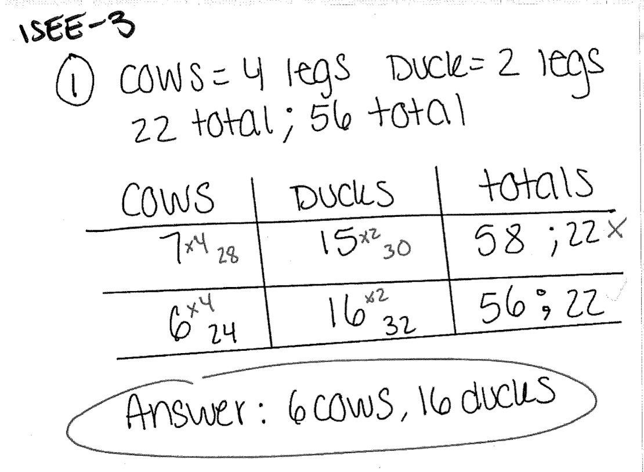
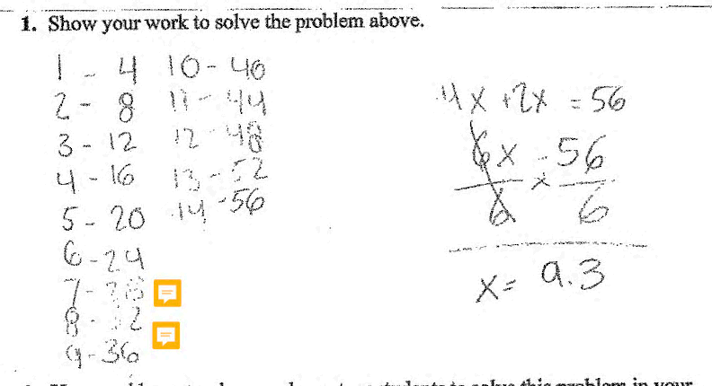
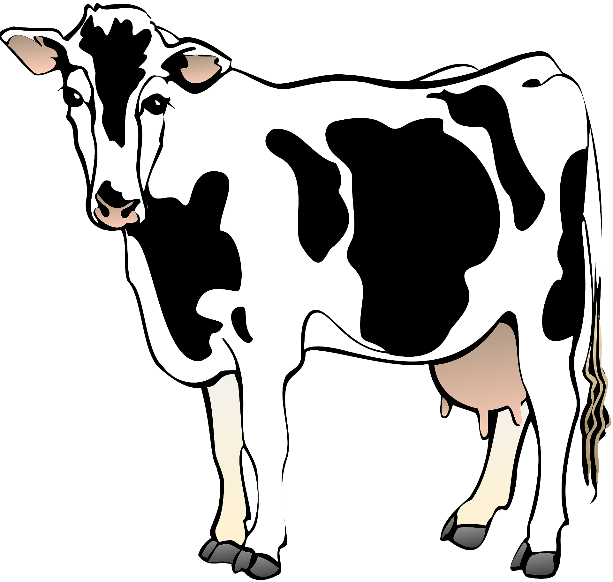
ISEE UNDER THE MICROSCOPE: A PRELIMINARY COMPARISON OF ELEMENTARY EDUCATION PROGRAMS IN SUPPORTING THE DEVELOPMENT OF MATHEMATICAL KNOWLEDGE FOR TEACHING
1. 2.
Brianne M. Brown Aja S. Perez Vecihi S. Zambak
Monmouth University
ABSTRACT
PURPOSE
PRELIMINARY FINDINGS (cont.)
DISCUSSION
We observed the mathematical problem-solving strategies of various Elementary Education programs at the Undergraduate and Graduate levels compared to those of the Interdisciplinary Studies for Elementary Educators (ISEE) program. The study examined the work of twelve students – 8 non-ISEE Majors and 4 ISEE Majors.
Each of the participants were given the same mathematics problem to solve and asked to explain how they would teach their elementary students to solve this problem in a classroom setting. Overall, the ISEE students were able to solve and effectively explain how to implement this strategy into their teaching methods in the classroom compared to the work of non-ISEE students.
It is important to study various teacher preparation programs at the Undergraduate and Graduate levels because teachers' background knowledge of mathematical problem-solving strategies will affect their usage and instruction in classrooms. It is common for elementary teacher candidates who do not have the strong mathematical knowledge to use the guess-and-check strategy to solve various mathematical problems. Not every mathematical problem can be solved using only algebra. There are over 15 solving strategies that are unique to problems taught in in the sequence of courses in the ISEE Program. Therefore, it is imperative to study how teacher preparation programs provide teacher candidates with opportunities to explore problem solving strategies and implement them.
Major | Problem Solving Strategy
ISEE - 1 | Guess and Check
ISEE - 2 | Guess and Check
ISEE - 3 | Guess and Check
ISEE - 4 | Guess and Check
Mathematics | Draw a Diagram
English | Algebra
History | Algebra
Anthropology | Algebra
M.A.T. – 1 | Guess and Check
M.A.T. – 2 | Algebra
M.A.T. – 3 | Guess and Check
M.A.T. – 4 | Guess and Check
Non-ISEE participants presented a great difficulty in expressing a singular strategy to implement for the given problem.
Based on preliminary findings, ISEE participants were able to utilize and show evidence to implement a singular strategy for a problem.
Mathematical knowledge and preparation from non-ISEE participants is limited and is reflected in work samples.
To move forward with effective mathematical instruction in the future, this mini-study shows that teacher candidates need to have exposure to more mathematics courses relevant for their professional preparation, which was not the case for non-ISEE participants.
If elementary education preparatory programs cannot support the development of mathematical knowledge for teacher candidates, their classroom instruction will in turn not be effective for students.
Table 2. Participants problem solving strategy used, identified by their sample work
RESEARCH QUESTION
METHODS
Do various teacher preparation programs at the Undergraduate and Graduate level impact a teacher candidates’ use of strategies to solve and instruct a mathematical problem?
Participants recruited from various teacher preparation programs, including the ISEE program, as well as content specific Education programs (UG or G students).
There were 12 participants who were given the same problem to solve and discuss both their understanding of the problem, as well as how they would teach students to solve this problem.
In our data analysis, we focused on identifying which problem-solving strategy was employed to complete the problem, if the correct answer was achieved, and how participants would teach an elementary student to solve the same problem.
We found that the ISEE participants were able to effectively solve, rationalize and generalize content from the problem for in-class use.
The other participants attempted to use algebra and guess-and-check to solve the problem. These participants did not effectively generalize the content or explain a method for instruction for a classroom setting.
ISEE participants had clear explanations of problem-solving strategies used.
Non-ISEE participants presented difficulty explaining and using a clear and concise strategy that guided their problem solution.
Whereas many of the answers are presented with algebraic solving strategies, the ISEE sequence courses prepare teacher candidates to use various approaches to mathematics problem solving.
BACKGROUND AND RATIONALE
Having meaningful learning opportunities during elementary grades is key in students' early cognitive and social development, and success in the later years (Bennett, 1986). Elementary teachers play a vital role in supporting students' foundational knowledge development and their motivation to learn (Campbell et al., 2014). Literature indicates that elementary teachers or teacher candidates have a limited amount of mathematics background knowledge to teach mathematical content in K-6 settings (Ball, 1990).
Image 3. ISEE student work sample, yielding the correct answer using guess and check
PRELIMINARY FINDINGS
Ben has only ducks and cows. He does not remember how many of each he has. He knows he has 22 animals because 22 is his age. He also knows that the animals have a total of 56 legs, because 56 is his father’s age. Assuming that each animal has all legs intact and no more, how many of each animal does Ben have? (Crossing the River with Dogs)
Major | # of Participants | Correct Answer Achieved (%)
ISEE | 4 | 4/4 - 100%
Mathematics | 1 | 0/1 - 0%
English | 1 | 1/1 - 100%
History | 1 | 0/1 - 0%
Anthropology | 1 | 0/1 - 0%
Masters of Arts in Teaching (M.A.T.) | 4 | 3/4 - 75%
REFERENCES
Ball, D. L. (1990). The mathematical understandings that prospective teachers bring to teacher education. The elementary school journal, 90(4), 449-466.
Bennett, W. J. (1986). First lessons: A report on elementary education in America. US Department of Education.
Campbell, P. F., Nishio, M., Smith, T. M., Clark, L. M., Conant, D. L., Rust, A. H., ... & Choi, Y. (2014). The relationship between teachers' mathematical content and pedagogical knowledge, teachers' perceptions, and student achievement. Journal for Research in Mathematics Education, 45(4), 419-459.
Johnson, K., Herr, T., & Kysh, J. (2018). Crossing the river with dogs: Problem solving for college students. John Wiley & Sons.
CONTACT
Brianne Brown: s1298562@monmouth.edu
Aja Perez: s1299264@monmouth.edu
Vecihi S. Zambak: vzambak@monmouth.edu
Image 1. Mathematic problem from Crossing the River with Dogs
Table 1. Participants grouped by major and the percentage of correct answers within the group
Image 2. History student work sample, yielding the incorrect answer using algebraic equations

