Slide 1
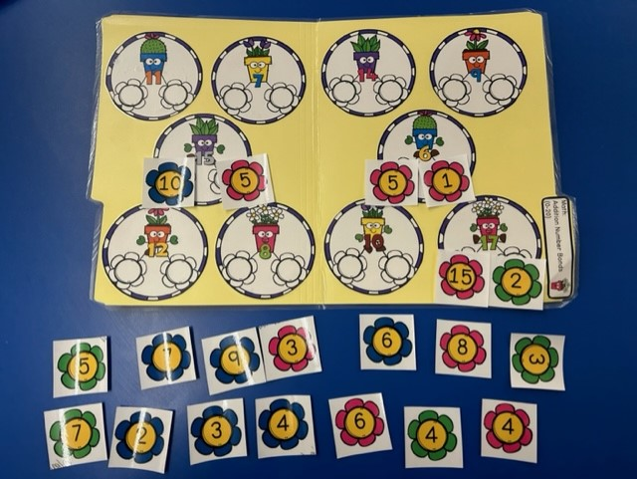
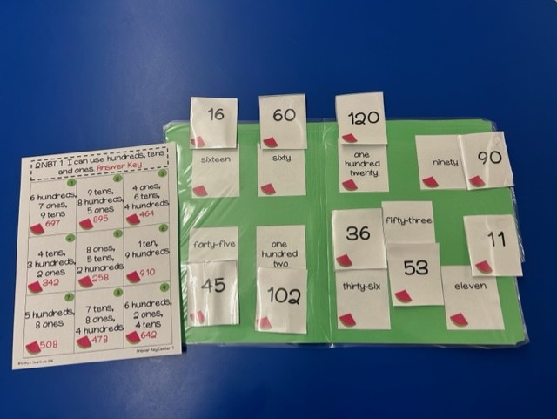
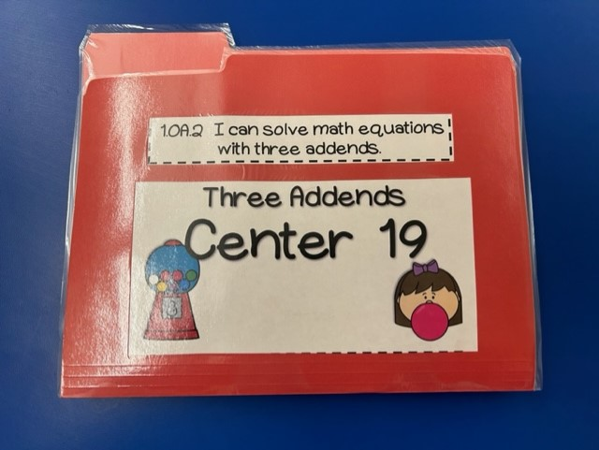
Fun With File Folder Math Games
By Emma Suleski
Introduction of Site
Meet My Students
Action Plan/ My Role
Amerigo A. Anastasia School
Long Branch Public Schools, NJ
First through Fifth Grade
Pull Out Resource for Math, Science & Social Studies
Visual and Performing Arts Magnet School
Curriculum is aligned with the Common Core State Standards
Treasures Reading Language Arts Literacy Program
Writers Workshop approach by Lucy Calkins
Everyday Mathematics, a comprehensive, research-based, mathematics program
Visual/performing arts experiences in the areas of art, dance, drama, instrumental music, and vocal music
Least restrictive environment for special needs students
Enrichment program
Students use technology in the classroom
“Solutions Team” infuses Character Education throughout the curriculum
Third grade students varying in math skill levels from beginning first to end of second grade
Pull-out resource room
6 students with one special education teacher and one paraprofessional
Resource room for math, science and social studies
Lessons are differentiated to meet their various levels
Teacher works with students in small groups and one-on-one
Students work independently, as well as, in partnerships while the teacher works with other students
Students need to also practice the learned math skills at home
Fun file folder math games used to reinforce common core math skills independently and in small groups
Games are differentiated to meet the various skill levels
Folders are colorful and have engaging themes
Folders are labeled with the math standards
Students can access them easily
The teacher can quickly assess a student’s ability by checking the answers
Students can use the answer keys as a self-check
Students can bring them home for a home-school connection to reinforce skills at home
What I Learned
New Ideas
Reflection:
Differentiating is so important to instruction in a resource room
Students find it easier to learn when you can make learning fun and engaging
Even I was having fun playing the file folders games with my students, so it can be enjoyable to the teacher or paraprofessional as well
Explain and model for the students before having them do it independently
Color coding the subjects or levels so the student knows exactly which ones to choose
Laminate so it can be used for years to come
It can be used for at home-school connection to reinforce skills and have fun with their family
File folders can also be used for other subjects:
In Language Arts, file folders can be used for high frequency words practice, vocabulary building, punctuation, and phonics practice
For Science, file folders can be used to practice the vocabulary of the new topic
For Social Studies, file folders can be used for new vocabulary, historical events, people in history, geography, and sequencing of a time period
My action plan impacted the site in several ways:
Helped with classroom management so when the teacher is working with a small group or an individual student, the other students can be completely the file folders independently
Students were able to master math skills through independent practice
Created a homeschool connection so the families can know what their children are working on and reinforce those skills
References
“First Grade Math Centers-Covers ALL First Grade Math Standards.” Thrifty in Third Grade, Cassie Smith.
Accessed February 22, 2023.
https://www.teacherspayteachers.com/Product/1st-Grade-Math-Centers-Covers-ALL-1st-Grade-Math-Standards-1964344
“Second Grade Math Centers-Covers ALL Second Grade Math Standards.” Thrifty in Third Grade, Cassie Smith.
Accessed February 22, 2023.
https://www.teacherspayteachers.com/Product/2nd-Grade-Math-Centers-Covers-ALL-2nd-Grade-Math-Standards-1682227

