Slide 1
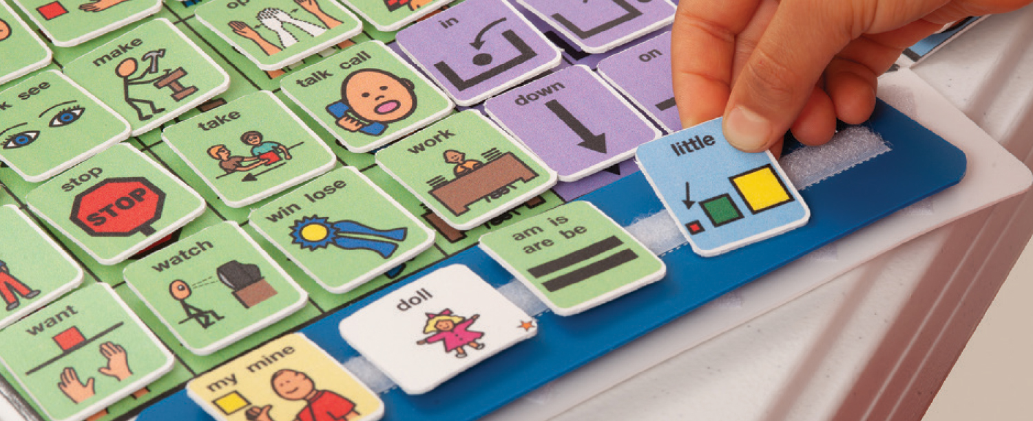
Exploring the Impact of High Tech Versus Low Tech AAC Devices to Improve communication of children with Autism Spectrum Disorder
Camarin Georges, Jackie Geardino, Cassidy Sullivan Monmouth University Graduate Students
School of Education
Augmentative and Alternative Communication (AAC)
Literature
Review
Findings
Proposed
Methodology
Proposed
Methodology
Proposed
Methodology
Participants: Our proposed participant is 9 years, 2 months old with Autism Spectrum Disorder. He has a below average IQ and attends a private school specializing in children with Autism. Our participant came to us after his teacher tried to implement break times into his schedule in class to help with fidgeting and focusing during lessons. He would frequently become upset when an activity he wasn’t interested in was chosen. The teacher would like to provide him with a sense of independence by allowing him to choose an activity of his preference. Using both a low and high tech AAC device will allow him to effectively communicate his interests with teachers.
Procedure: The SLP implementing the treatment currently works at a school specializing in children with multiple disabilities, specifically nonverbal. The SLP will have their CCC- SLP and have at least five years’ experience working with AAC devices. To avoid bias, the SLP will be blind to the study’s hypothesis. The SLP will watch training videos provided by the investigators to familiarize themself with the study’s procedures. The baseline and treatment sessions will be recorded for future analysis, and the investigators will watch the treatment to make sure it is aligned with the training videos. Feedback will be provided based on the treatment.
Dependent variables will be measured during all phases of the study. The participant will join in sessions where they have a choice of toys and activities. Twenty trials will be presented in 30 minutes. For each trial, the participant will be given a choice of two toys/activities. Percentage of trials where participant expresses a preference will be calculated.
To establish a stable baseline, the participant will participate in at least three sessions.
During Phase B, the participant will be provided with a low-tech Picture Exchange Communication System (PECS) board that has five different pictures of his typical preferred activities. Participants will participate in sessions where they have a choice of toys/activities. Twenty trials will be presented in 30 minutes. For each trial, the participant will be given a choice of two toys/activities. Percentage of trials where participant expresses a preference will be calculated. The same procedure will be repeated for Phase C, but with a high-tech tablet device. After completion of phases B and C, the study will withdraw treatment and return to baseline. Data Analysis: After all phases of the study are completed, two trained researchers who have no knowledge of the study hypothesis will watch the videos and take data on the dependent variable. Two weeks later, the researchers will swap data and rescore 20% of each other’s data to check for inter-rater reliability. The researchers will also rescore 20% of their own data to check for intra-rater reliability.
Augmentative and Alternative Communication, or AAC, is essentially a tool to allow people to communicate without using verbal expression. It can be used by people of all ages who may struggle with their speech or language skills. It may be used for a long or short period of time. Low tech options may include the use of gestures, facial expressions, writing, drawing, pointing to photos, pictures or written words. One low-tech device that is commonly used is the Picture Exchange Communication System (PECS). High-tech options may include using an online application on an iPad or tablet to communicate and using a computer with a generated voice (ASHA, 2023).
Alzrayer (2020) describes how the modified Picture Exchange Communication System (PECS) protocol can be used to transition from a low-tech AAC device to a high tech AAC device. The purpose of this study was to investigate the effects of transitioning from a low-tech AAC system to a high-tech AAC system and understanding the participants’ preferences between both AAC devices. Four children with ASD were taught to make requests through multiple symbol messages on a low-tech communication book and a high-tech modified PECS Phase IV app. After the participants mastered both the low-tech AAC device and the high-tech AAC device, the preferred method for the participants was assessed through comparing the response allocations. The article suggests that the modified PECS protocol can be used to transition from a low-tech to high-tech AAC device and participants preferred to use the high-tech Ipad AAC system over the low-tech AAC communication board (Alzrayer, 2020).
Donato et al. (2018) examined barriers and facilitators to the use of AAC devices by children diagnosed with ASD and their communication partners. The researchers obtained qualitative data through a broad range of 42 studies to identify the range of barriers and facilitators reported. The studies consisted of quasi-experimental, non-experimental, and qualitative study designs. In the studies the researchers thoroughly examined unaided, low-tech aided, and high-tech aided AAC systems. The critical synthesis isolated 5 areas to which barriers and facilitators are related: (a) Intervention Services and Service Providers, (b) AAC Systems and Technologies (c), Communication Partners of Children with ASD, (d) Parents of Children with ASD, and (e) Children with ASD. The results found that barriers and facilitators of AAC vary across individuals, AAC modalities, and environments. By identifying barriers and facilitators to the use of AAC experienced by children with ASD and their communication partners, service providers might be better equipped to support these children and their communication partners (Donato, Spencer, & Arthur-Kelly, 2018).
Holyfield et al. (2019) describe the importance of early communication, especially for children with disabilities. AAC devices allow us to build that bridge in that emergence of language to enhance opportunities for growth and learning. The purpose of this study was to investigate the effects of high-tech (visual scene displays) versus low-tech (isolated picture symbols) devices on engagement from students with numerous disabilities. Three children in elementary school participated in the study that measured their interest in each device by the amount of eye gaze they showed. Results revealed that participants showed a higher interest in the high-tech rather than the low-tech device. The article suggests for clinicians to measure engagement before introducing specific treatment approaches to clients. Future research should investigate the impact on communication and language the difference in AAC devices make (Holyfield, Brooks, & Schluterman, 2019).
References
Alzrayer, N. M. (2020). Transitioning from a low- to high-tech
Augmentative and Alternative Communication (AAC) system: effects on augmented and vocal requesting. AAC: Augmentative & Alternative Communication, 36(3), 155–165. https://doi.org/10.1080/07434618.2020.1813196
Donato, C., Spencer, E., & Arthur-Kelly, M. (2018). A critical synthesis of barriers and facilitators to the use of AAC by children with autism spectrum disorder and their communication partners. Augmentative and Alternative Communication, 34(3), 242-253. https://doi.org/10.1080/07434618.2018.1493141
Holyfield, C., Brooks, S., & Schluterman, A. (2019). Comparative effects of high-tech visual scene displays and low-tech isolated picture symbols on engagement from students with multiple disabilities. Language, Speech & Hearing Services in Schools (Online), 50(4), 693-702. doi:10.m44/2019_LSHSS-19- 0007
Purpose
The purpose of this proposed study is to find out whether high or low tech AAC devices are more effective in helping a child with Autism Spectrum Disorder (ASD) become a more effective communicator.
Research Question
Is a high-tech AAC device more effective than a low-tech in increasing communication of children with ASD to make choices.
Notes:
1

