Slide 1
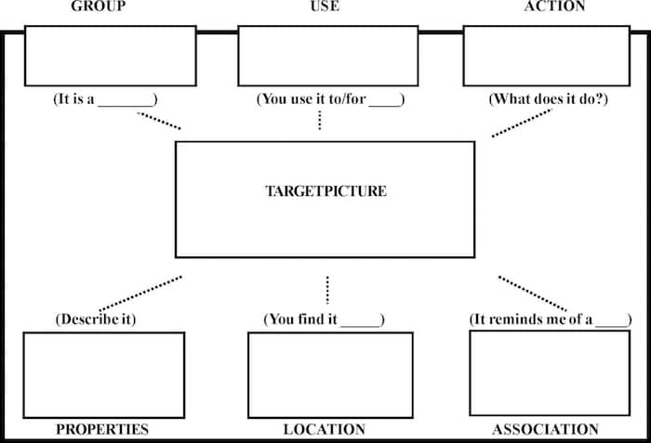
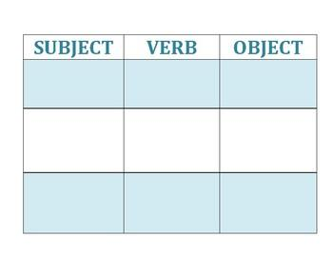
Exploring the effectiveness of Semantic Feature Analysis compared to Verb Network Strengthening Treatment in clients with Broca’s aphasia
Caryssa Guerra, Chelsea Oliveira Ramos, Gabriella Verzolini Monmouth University Graduate Students
School of Education
Aphasia, SFA, & VnEST
Literature
Review
Findings
Proposed
Methodology
Proposed
Methodology
Everyday Objects Included in Procedures:
Aphasia is a language disorder that occurs from brain damage, which results in an impairment in comprehension and/or formulation of language. Aphasia can affect both spoken and written language of an individual.
Semantic Feature Analysis (SFA) is a treatment that encourages a verbal approach to find a target word. The treatment of SFA was developed to treat aphasia and the related conditions of anomia (difficulty with word finding) SFA improves word retrieval by accessing features related to concepts that activate networks of the semantic system. SFA uses a step-by-step procedure.
Verb Network Strengthening Treatment (VnEST) is a semantic treatment approach that aims to improve lexical retrieval of content words in sentences by promoting systematic retrieval of verbs and their roles. In other words, it helps with word-finding in order to produce sentences. Those with aphasia struggle when creating complete sentences; therefore, VnEST is an effective tool to improve the effectiveness in communication and basic comprehension.
Participants: The study will include one participant who is a 50 year-old adult male who was diagnosed with Broca’s Aphasia and Anomia after a left-cerebral CVA. The participant’s cognitive abilities are within normal limits, he is right hand dominate. He presents with no previous medical history. Before his CVA he was working full time as an electrician, and lives with his wife and adult daughter.
Procedure: The participant will be recruited through a random selection from the local hospital, Monmouth Medical Center. The researchers will not participate in or administer the treatment to avoid bias. A Speech-Language Pathologist blind to the study’s hypothesis with at least 5 years’ experience treating aphasia will be trained through training videos to administer both treatments.
During all baseline and treatment phases of the study, the patient’s percent of correctly retrieved words in response to pictures of 20 everyday objects will be measured. The participant will be required to verbally retrieve everyday objects such as, toothbrush, cup, fork, and blanket, for baseline and treatment measures. During initial baseline sessions, the participant will not be provided with treatment. During each initial baseline session, participant will name pictures of 20 everyday objects. Initial baseline sessions measures will be conducted for at least three sessions until a stable baseline is obtained.
All treatment and return to baseline sessions will be 45 minutes 3 times a week for 4 weeks, totaling 12 sessions. During treatment phases, the participant will be administered Semantic Feature Analysis (SFA) from a trained SLP who is blind to the study’s hypothesis, after which a return to baseline phase will occur. The participant will then be administered Verb Network Strengthening Treatment (VnEST) from the same trained SLP who is blind to the hypothesis, after which a return to baseline phase will again occur. All baseline and treatment sessions will be recorded. In order to address treatment fidelity, partway through treatment, the investigators will watch recordings to monitor that the SLP is following study procedures. Feedback will be given to adjust treatment if needed.
After all baseline and treatment phases are complete, two trained researchers will each watch half of the recordings and determine the patient’s percentage of correctly retrieved words for each session. Two weeks after initial coding each researcher will re-code 20% of their original data and will calculate percentage of agreement vs. disagreement from first to second coding in order to obtain intra-rater reliability. To obtain inter-rater reliability, the researchers will re-code 20% of original data that they did NOT originally code and calculate percentage of agreement vs. disagreement from first to second coding.
Toothbrush Cup Fork Blanket
Gravier (2018) investigated the impact SFA has on word retrieval of those who have Aphasia. Individualized treatment for participants with chronic aphasia and semantically related probes were generated from items that participants were unable to name consistently during baseline data. The results of the study suggested that the number of features of the object the patients generated predicted how well they would do with SFA. The more features the client can initially name, the better outcome SFA will have. Research provides a methodology for determining the positive impact of SFA on individuals with Aphasia.
Edmonds, Mammino, and Ojeda (2014) conducted a study targeting the Verb Network Strengthening Treatment (VNeST) approach and its effectiveness of communication with people who has aphasia. The study demonstrated a group analysis evaluating the effect of VNeST. Researchers used 11 participants with aphasia to part take in this experience. Participants all had aphasia due to a stroke and were never treated using the VNeST approach prior. Overall, based on the results and findings, VNeST promoted specific and generalized lexical retrieval abilities and affected basic syntax production. This study demonstrates the benefits of the treatment approach and how it potentially can improve communication of those with aphasia.
Deepak (2020) investigated using a combination of Semantic Feature Analysis and Verb Network Strengthening Treatment, Semantic Cueing of Verbs and its Thematic role (SCVTr) to address retrieval in aphasia. The study consisted of 3 participants with a diagnosis of Aphasia from a CVA who were originally right-handed. Participants were treated with this combination of approaches and asked to retrieve verbs with semantic cues. Retrieval of verbs was assessed when reading aloud, when answering wh questions, when given semantic corrections, without or with promoting, and finally with no prompting. Data was collected for trained words that were familiar and untrained words that were not. Overall, there was a large improvement from trained words; however, limitations were stated for the untrained data collected. The results are relevant because the study demonstrates the effectiveness of the combination of popular treatment approaches for Aphasia.
References
Purpose
Edmonds, L. A., Mammino, K., & Ojeda, J. (2014). Effect of Verb Network Strengthening Treatment (VNeST) in persons with aphasia: extension and replication of previous findings. American Journal of Speech-language Pathology, 23(2), S312–S329. https://doi.org/10.1044/2014_AJSLP-13-0098
Deepak, P. (2020). Effectiveness of semantic-based treatment in persons with aphasia. Annals of Indian Academy of Neurology, 23, 123–129. https://doi.org/10.4103/aian.AIAN_558_20
Gravier, M. L., Dickey, M. W., Hula, W. D., Evans, W. S., Owens, R. L., Winans-Mitrik, R. L., & Doyle, P. J. (2018). What matters in semantic feature analysis: practice-related predictors of treatment response in aphasia. American Journal of Speech-language Pathology, 27(1S), 438–453. https://doi.org/10.1044/2017_AJSLP-16-0196
This single-subject study is designed to investigate the effectiveness of Semantic Feature Analysis (SFA) compared to Verb Network Strengthening Treatment (VNeST) in a 50-year-old adult diagnosed with Broca’s Aphasia and anomia after a left-cerebral vascular accident (CVA).
Research Question
Is SFA or VnEST more effective as a treatment method for anomia in an individual with Broca’s Aphasia after a left-cerebral vascular accident (CVA)?
Notes:
1

