Slide 1
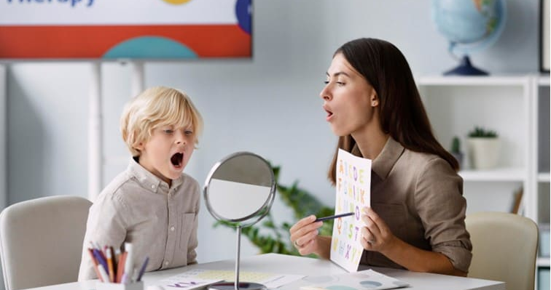
Exploring Motor and Linguistic-Based Treatment Approaches for Childhood Apraxia of Speech
Edina Cira, Hope D’Addesa, Amanda Russo, Aida Velic Monmouth University Graduate Students
School of Education
Childhood Apraxia of Speech (CAS)
Literature
Review
Findings
Proposed
Methodology
Selected References
Proposed
Methodology
Participants: The participants of the study will range between the ages 5;0 to 12;0 (40 males, 40 females). Each participant must have a diagnosis of Childhood Apraxia of Speech (CAS), as determined by the Diagnostic Evaluation of Articulation and Phonology (DEAP). Participants will have no history of hearing, learning, psychiatric or behavioral disorders. This will be a sample of convenience. Qualifying participants will be randomly assigned to one of four treatment groups.
Pre-testing and post-testing will assess the accuracy of phoneme production in 20 single words. No treatment will be administered during pre or post testing. During treatment, the following approaches for CAS will be utilized: ReST, NDP3, IAPI, and PROMPT. Participants will undergo treatment over the course of 4 weeks with 3 sessions per week, for 30 minutes each session. All sessions will be recorded for future analysis.
The treating SLPs will be selected based on experience with CAS. The treating SLPs will be trained by the researchers on the four treatment approaches. The four treating SLPs will have their CCC-SLP and at least 5 years of experience with the four treatment approaches. The investigators will train the treating SLPs on the specific treatment procedures for this study. The treating SLP will be blinded to the researcher’s hypothesis. The treating SLPs will watch a video to learn study procedures. In order to assess treatment fidelity, the investigators will watch recordings of treatment and provide feedback as needed. After all phases of the study are completed, two trained researchers who have no knowledge of the study hypothesis will watch the videos and take data on the dependent variable. Two weeks later, the researchers will swap data and rescore 20% of each other’s data to check for inter-rater reliability. The researchers will also rescore 20% of their own data to check for intra-rater reliability.
Dale, P. S., & Hayden, D. A. (2013). Treating Speech Subsystems in Childhood Apraxia of Speech With Tactual Input: The PROMPT Approach. American Journal of Speech - Language Pathology, 22(4), 644–661. https://doi.org/10.1044/1058-0360(2013/12-0055)
McNeill, B. C., Gillon, G. T., & Dodd, B. (2010). The longer term effects of an integrated phonological awareness intervention for children with childhood apraxia of speech. Asia Pacific Journal of Speech, Language and Hearing, 13(3), 145–161. https://doi.org/10.1179/136132810805335074
Moriarty, B. C., & Gillon, G. T. (2006). Phonological awareness intervention for children with childhood apraxia of speech. International Journal of Language & Communication Disorders, 41(6), 713–734. https://doi.org/10.1080/13682820600623960
Murray, E., McCabe, P., & Ballard, K. J. (2015). A Randomized Controlled Trial for Children With Childhood Apraxia of Speech Comparing Rapid Syllable Transition Treatment and the Nuffield Dyspraxia Programme-Third Edition. Journal of speech, language, and hearing research : JSLHR, 58(3), 669–686. https://doi.org/10.1044/2015_JSLHR-S-13- 0179
Childhood apraxia of speech (CAS) is disruption in the relaying of messages from the brain to the muscles needed for motor planning and overall articulation of various speech sounds. CAS was estimated to occur in 1 to 2 children per 1,000 (0.1%–0.2%; Shriberg et al., 1997). The deficits in CAS are not a result of muscle atrophy, but inability to coordinate movements controlled by neurological functioning. Primary mechanisms involved in the formation of speech that are often impacted by CAS include lips, jaw, and tongue. Three main speech features present in individuals with CAS include inappropriate prosody, inconsistent errors on consonants and vowels in repeated productions of syllables or words, and lengthened and disrupted coarticulatory transitions between sounds and syllables. Children with CAS were reported to have a higher likelihood of concomitant language, reading, and/or spelling disorders (Lewis et al., 2004; Lewis & Ekelman, 2007).
Murray et al., (2015) compared the treatment efficacy of Rapid Syllable Transition (ReST) treatment to the Nuffield Dyspraxia Program-Third Edition (NDP3) in twenty-six children with CAS. This is the first peer-review study to analyze the treatment effects of NDP3. Both treatment approaches yielded positive results and have support for clinical use.
In the article “Phonological awareness intervention for children with childhood apraxia of speech”, Moriarty et al. (2006) describe the effectiveness of integrated phonological awareness intervention (IPAI) for children with childhood apraxia of speech (CAS). The purpose of this study was to determine if children with CAS would benefit by receiving IPAI. Three children with CAS received this form of treatment and their performance was recorded throughout the sessions. Results revealed that two out of the three participants improved their target speech, phonological awareness, and decoding skills. This article suggests that for children with CAS, IPAI is an effective treatment method.
Phonological awareness interventions have been created to improve the development of spoken and written language. In the article, “The Longer Term Effects of an Integrated Phonological Awareness Intervention for Children With Childhood Apraxia of Speech'' McNeill et al. (2010) analyzed the long-term effects of participants who participated in an 18-hour integrated phonological awareness intervention. This study reassessed twelve children, ages 4-7, with CAS that have participated in an integrated phonological awareness intervention 6 months prior to this reassessment. The purpose of this study was to see whether the intervention had any long-term effects on the participants. The results revealed that the participants maintained improvements post intervention, although the authors suggested that children with CAS should receive ongoing services and support even after the 18-hour intervention.
Dale et al. (2013) observed the efficacy of PROMPT training with and without TKP (tactile-kinesthetic- proprioceptive) cues when treating Childhood Apraxia of Speech (CAS). Four children, ages 3;6 to 4;8, were divided into two groups, the first group being that of FP (Full Prompt) treatment (8 consecutive weeks) while the other underwent 4 weeks of Prompt Without Tactile Cueing (PWT) and 4 FP. Frequency of treatment was consistent amongst both the control and experimental groups, consisting of twice a week. Results revealed that PROMPT was efficacious in its entirety considering all four participants showed significant improvement in multiple motor-based areas impacted by CAS. However, researchers concluded that the implementation of tactile-kinesthetic-proprioceptive cueing amplified the benefits of PROMPT training.
Purpose
This review investigates the use of motor and linguistic treatment approaches in CAS.
The purpose of this proposed study is to see whether the intervention had any long-term effects on the participants.
Research Question
Are motor or linguistic-based approaches most efficacious for treating individuals with Childhood Apraxia of Speech?
Notes:
Talking Points:
-AAC: apps have increased from 3 apps in 2009 to over 110 in 2011. That is 6 years ago so we can infer that the amount of apps has only increased since then.

