Slide 1
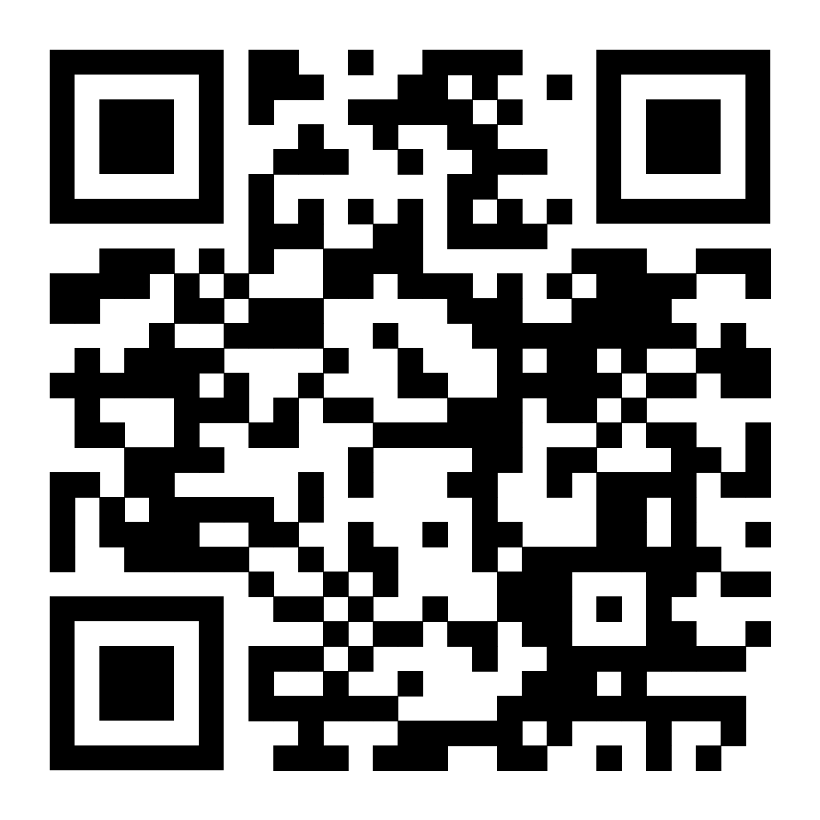
Effective Behavioral Interventions for Secondary Students with Emotional Behavioral Disorders
Christina Ratajczak
Monmouth University
Background
Emotional Behavioral Disorders (EBD) are conditions that affect a student's education, social skills, and behavior
Higher rates of disruptive and off task behavior, chronically absent, failing grades, low GPA, high dropout rate
Educated in residential or other alternative school placements (Collins et al., 2017)
Schools are struggling with these students
Wide range of school-based-interventions have been researched and implemented
Behavioral Intervention trainings for teachers, parents, and students
Findings: Themes
Classroom Engagement
Trouble with engaging in appropriate behaviors
Good Behavior Game and Behavior Bingo
Encourages peer mediation (Collins et al., 2017)
Peer Reinforcement/Tutoring
Promotes social interaction and builds relationships
Peer mediators vs. teachers
Makes students reflect on their own behaviors (Smith et al., 2015)
Video Modeling
Watch desired behavior-→demonstrate desired behavior
Most effective: Video Self Modeling
Students generalized skills in other class settings and maintained skills after intervention withdrawal (Chu et al., 2015)
Autonomy
Build Self-Determination, Self-Advocacy, and Self Regulation Skills
Create goals, develop action plan, execute strategies (Kelly et al., 2014)
Poor self regulation leads to failure, dropout, substance abuse, and arrests
Self-monitoring
Social Skills
Lack of interpersonal relationships due to deficiencies in communication skills (Morgan et al., 2016)
Video Self Modeling to Generate Social Skills
Purpose
What are effective behavioral interventions for secondary students with Emotional Behavioral Disorders?
Discussion
Cross-Age Tutoring and Video Modeling most effective interventions
Step by step intervention implementation for teachers
Lack of generalization and maintenance data
Effective Behavioral Interventions for Secondary Students with Emotional Behavioral Disorders can minimize problem behaviors, motivate students to use replacement behaviors, and improve academic engagement in a classroom setting
Paper
Methods
Searched WorldCat and HawkFind articles from the last 10 years
Search terms: “behavioral interventions”, “emotional behavioral disorder”, “behavior”, “special education”, “secondary education”, “high school”, and “strategies”
Empirical, quantitative or qualitative reports in either peer-reviewed journals, books, or dissertations
Receive Special Education Services
Targeted Behaviors
Implications
Feasible, economical, and instrumental interventions
Further research in multiple classroom settings
Further research with larger sample sizes
Greater emphasis on implementation at the high school level
Limitations
Small sample sizes
Few studies done at high school level
Limited research on generalization and maintenance after intervention was implemented

