Slide 1
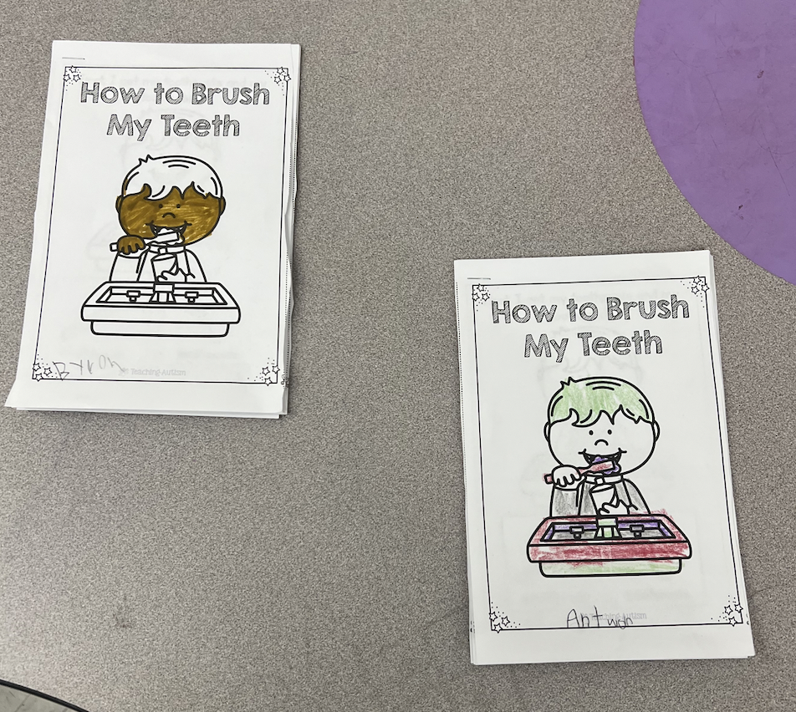
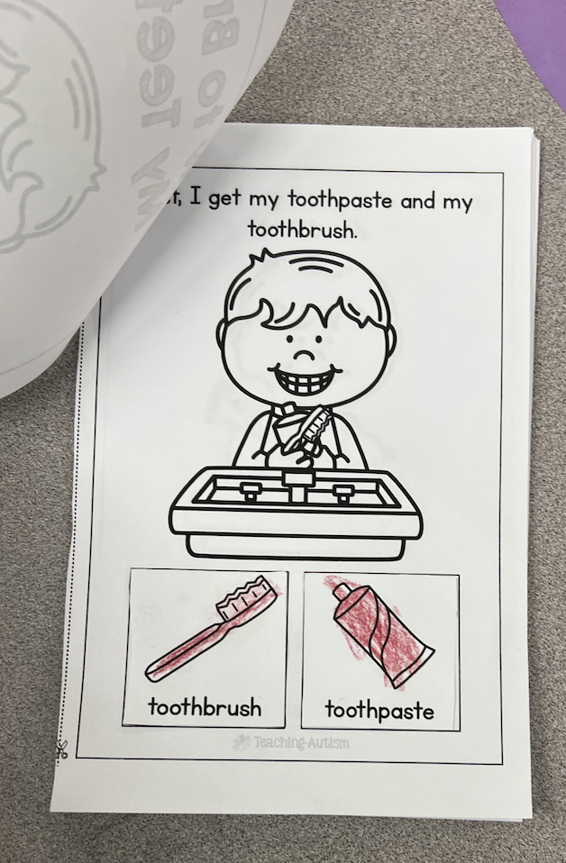
Daily Life Skills
Samantha Favaloro
Monmouth University
Understandings
Setting
During this experience, I have been able to first- handedly see different characteristics of several disabilities and strategies, as teachers, to provide a positive learning environment for all students
This connects with my coursework because I have been learning about several disabilities, the specific cognitive, social, emotional and behavioral characteristics, and different interventions and supports
This connects to research in the field because I have been able to see the wide range of the spectrum and several accommodations
Overview of Community
Long Branch, New Jersey
Monmouth County
Population: 31,667
Poverty rate: 22.31%
US Citizenship: 81.5%
Race/Ethnicity: Largest groups are White (56.8%), Hispanic (23.3%) and Black (12.0%)
Description of Students
6 male students, 0 female students
All students have disabilities
Autism and ADHD
Impacts
Course & Project
Course: EDS 330-01 Foundations of Special Education
SL Project: My project consisted of introducing a new life skill each week
While students have already been exposed to life skills, I would start with an introduction video and then complete a worksheet
All worksheets I created were cut & glue activities
I impacted my field site by:
Being an extra help to my teacher
Offering trust and friendship to the students
Improving life skills that students will need in their everyday life
Overview of School
Amerigo A. Anastasia School
K-5
562 students
Student-teacher ratio of 10 to 1
47% female students and 53% male students
Minority Enrollment: 69.8%
Role
Future Goals
I worked with students, in centers, with my cooperating teacher and on my own
I helped with students during assemblies and was an extra set of hands
Based on my learning, I plan to continue to grow by thinking in a more creative mindset and focusing on how I can make my future classroom the best it could possibly be
Specific areas that I want to continue working towards are becoming more comfortable leading a lesson on my own and thinking outside of the box with activities.
Overview of Classroom
K-2 Autism
Students sit at paired desks, round tables in back for centers
Large rug area in back with toys
Classroom library
Bins with sensory activities
Notes:
First, I would show a video to introduce the topic
Next, I would walk through a worksheet with students based on the steps included in completing this life skill
Worksheets consisted of cut and glue activities to practice fine motor skills
During an assembly, one of the students was having a tough day and couldn’t deal with the noise. Therefore, I ran to the classroom and brought headphones back.
Students have come to me with problems regarding their personal friendships or personal home life.
Each week I introduced and worked through the steps of life skills every person needs in their life

