Slide 1
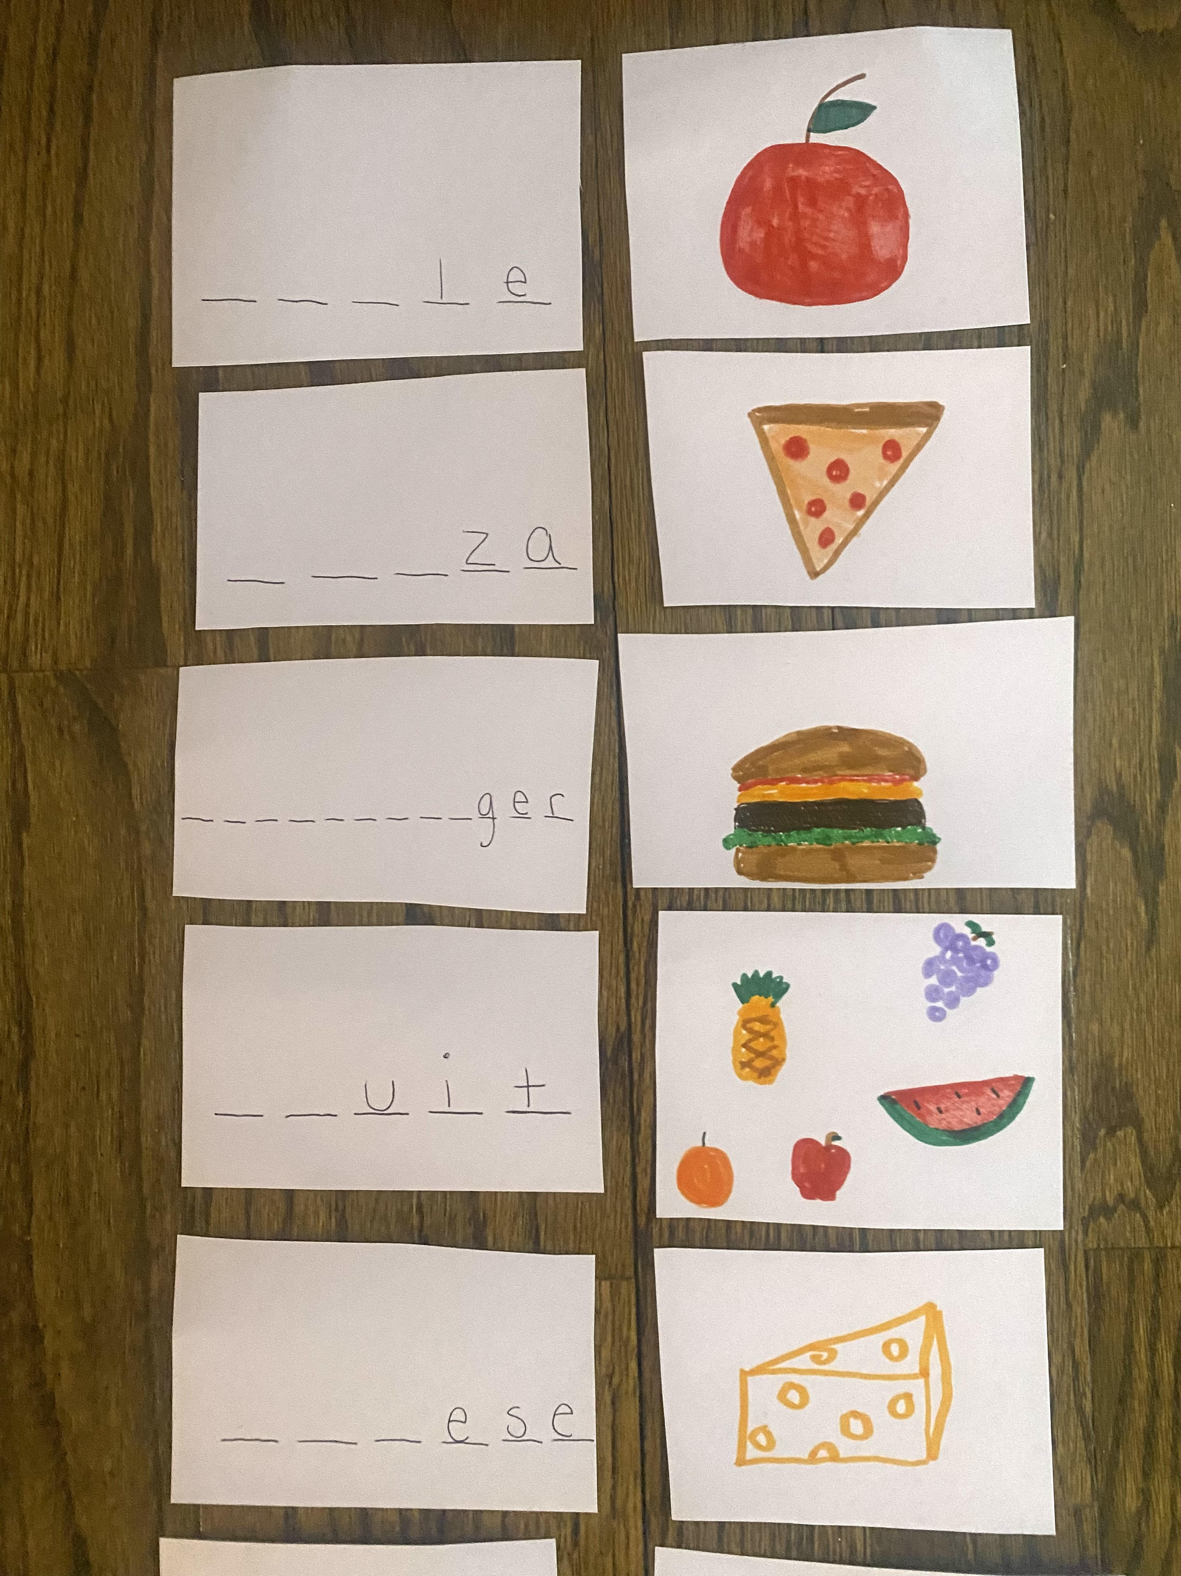
Jessica Brehm Monmouth University
Amerigo A. Anastasia
Elementary school 2023
Creative and engaging learning
Understandings
I learned that its important to be patient and understanding.
Allow students to have fun but also stay focused to learn academically
This relates to the course because it was emphasized how each student learns differently and it is important to provide activities to accommodate students learning.
Impacts
I provided guidance to students when needed and students worked on the activity in small groups of 2 -3. I encouraged students to talk and work with each other as a team through the activity.
Students can apply these skills outside the classroom when speaking, reading and writing Future Goals
I plan to use strategies that I learned in my future placements and classroom such as communication and understanding students.
I would like to work on organization and planning to provide students with a great learning environment.
Setting
Overview of Community
Long Branch
Monmouth County
31,952 total population
22.31% poverty rate
83% citizens, 13% non-citizens
68.1% white,
13.66% African American
(World population review, 2023)
Overview of School
Amerigo A. Anastasia Elementary school
Kindergarten to 5th grade
562 student’s total
Student/ Teacher ratio: 10:1
53% male students 47% female
- 296 males and 266 females
55% students are Hispanic, 30% White, 10% African American
(Public school review, 2023)
Overview of Classroom
4th grade classroom
10 students
ELA class
12 desks
Flexible seating through the room
Technology: laptops, projector
- ClassDojo, Seesaw
Description of Students
4 girls and 6 boys
One teacher and an aid for guidance
Modifications for each student
Self contained learning disabilities (SCLD)
Course & Project
EDS 330 01- Foundations of Special Education
Matching game where students use clues of missing letters to match to the picture
Worksheet following where students write and draw a picture on the same topic.
Focused on spelling, writing, and sounding out words.
Allowed students to be creative
Role
Observe the teacher’s strategies and activities
Assist students with reading comprehension and spelling
Work with small groups on the activity I brought during centers
Favorite food matching activity:

