Slide 1
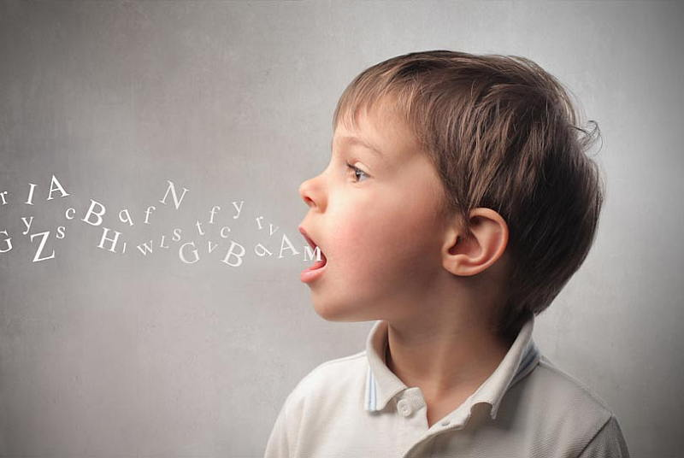
A Comparison of Treatment Approaches in Childhood Apraxia of Speech
Christina Blumstein, Kristen Eckert, Lauren Esposito Monmouth University Graduate Students, School of Education
Childhood Apraxia of Speech (CAS) & Treatment Methods
Literature Review Findings (cont.)
Proposed
Methodology: Procedure
Dynamic Temporal and Tactile Cueing (DTTC) treatment for CAS was used. Motor learning principles were the rationale for treatment. Implementation of treatment was provided and data showed response to treatment. Three participants showed significant improvement following treatment across all utterances. The authors concluded that frequent treatment while incorporating motor learning principles facilitates improvement in these participants with CAS. Murray et al. (2012) proposed a study comparing Rapid Syllable Transition Treatment (ReST) and Nuffield Dyspraxia Programme - Third Edition (NDP3). The planned study is a parallel group, fixed size, randomized control trial. It is meant to target English speaking children, ages 4-12 with a suspected diagnosis of CAS. After a diagnostic assessment and baseline assessment probe, twenty children will be chosen to participate and will randomly be given one of the two treatments. Licensed speech-language pathologists will administer either ReST or NDP3 to each child four times a week for one hour. These two treatments will be conducted in parallel over the span of three weeks. This study was proposed, but never performed, and therefore does not include results. However, outcome assessments and measures were taken into consideration, as it was determined that those participating in the study would follow up with post-treatment assessments one week, one month, and four months after treatment. Dale et al. (2013) describe the treatment approach, Prompts for Restructuring Oral Muscular Phonetic Targets (PROMPT), and how it aims to improve speech sound disorders in children. PROMPT is commonly used for children with Childhood Apraxia of Speech (CAS) and utilizes tactile-kinesthetic-proprioceptive (TKP) cues to support and shape the movement of the articulators for speech. The purpose of this study was to evaluate the efficacy of PROMPT for children with CAS. Four children with CAS, ages 3:6 to 4:8, were treated using PROMPT for 8 weeks, two times per week. Treatment included full PROMPT, PROMPT with TKP cues, and treatment of PROMPT without TPK cues. This design permitted both between-subjects and within-subjects comparisons to evaluate the effect of TKP cues. All 4 children made significant gains during treatment, and the researchers found that PROMPT as a whole is effective for treating children with CAS. The researchers suggest that the inclusion of TKP cues with PROMPT seems to have a greater effect on improving speech sound disorders in children with apraxia of speech.
Childhood Apraxia of Speech (CAS) is a neurological condition in which the precision and consistency of movements underlying speech are impaired in the absence of neuromuscular deficits. The core impairment of CAS is planning and programming the movement sequences to produce speech sounds. Dynamic Temporal and Tactile Cueing (DTTC) and Prompts for Restructuring Oral Muscular Phonetic Targets (PROMPT) are both treatment approaches for CAS.
This study will utilize a sample of convenience. This child will be selected specifically for this study because she has Childhood Apraxia of Speech (CAS). The study will utilize a ABACA design, representing the following phases: initial baseline (initial Phase A), Dynamic Temporal and Tactile Cueing (DTTC) (Phase B) and Prompts for Restructuring Oral Muscular Phonetic Targets (PROMPT) treatments (Phase C) and two return to baseline phases (one A Phase following each treatment). During the study, the child will not receive her normal speech therapy services outside of the study, and her mother will not cue her at home. This will be done in order to avoid confounding variables. The percentage of sounds produced correctly within 20 random age-appropriate words (dependent variable) will be measured and compared during all phases of the study. During the baseline phases, the client will be asked to produce the 20 random words without using specific therapy techniques and without help. No treatment or cueing will be given for the baseline phases. To establish a stable baseline for the first baseline session, the child will be asked to produce the 20 words and the accuracy of production of speech sounds in the words will be measured. Baseline sessions will continue until a stable baseline is reached over at least 3 consecutive sessions. During the treatment phases, the child will participate in DTTC or PROMPT therapy depending on whether it is the B or C phase. The child will be asked to produce the 20 random words while receiving the treatment. Treatment will be two sessions per week for one hour per session . There will be 5 sessions in the B phase, 5 sessions in the C phase, and 5 sessions in the return to baseline phases. The licensed, certified treating SLP, who will be blind to the study’s hypothesis, will be trained and certified in PROMPT and DTTC, and have at least 5 years’ experience using these approaches. To ensure treatment fidelity, the sessions will be recorded, and the investigators will watch the recorded sessions to make sure the SLP is conducting the treatment as expected. Feedback will be given to adjust treatment as needed. For reliability purposes, all baseline and treatment sessions will be recorded. After all phases of the study are completed, trained researchers who have no knowledge of the study hypothesis will watch the videos and take data on the dependent variable. Two weeks later, the researchers will swap data and rescore 20% of each other’s data to check for inter-rater reliability. The researchers will also rescore 20% of their own data to check for intra-rater reliability.
Proposed
Methodology: Participants
The proposed study will include a 7:8 female child as the participant. The child will be diagnosed with Childhood Apraxia of Speech (CAS). The child does not present with any coexisting diagnoses. She is enrolled in public elementary school and receives
30-minute sessions of speech therapy during school twice a week. At home, her mother tries to practice speech sounds and correct productions when she can. She has difficulty with transitions between sounds, and struggles especially with words containing /s/, /r/, and “th” sounds.
Purpose
This study will seek to compare the effectiveness of DTTC and PROMPT treatments on the accuracy of sound production at the word level in CAS.
Research Question
Are PROMPT and DTTC effective treatments for sound production at the word level in Childhood Apraxia of Speech?
References
Literature Review Findings
Dale, P. S., & Hayden, D. A. (2013). Treating speech subsystems in childhood apraxia of speech with tactual input: The PROMPT approach. American Journal of Speech-Language Pathology, 22(4),644-66. https://doi.org/10.1044/1058-0360(2013/12-0055).
Murray, E., McCabe, P., & Ballard, K. J. (2012). A comparison of two treatments for childhood apraxia of speech: methods and treatment protocol for a parallel group randomised control trial. BMC pediatrics, 12, 112. https://doi.org/10.1186/1471-2431-12-112
Strand, E. A., Stoeckel, R., & Baas, B. (2006). Treatment of severe childhood apraxia of speech: a treatment efficacy study. Journal of Medical Speech - Language Pathology, 14(4), 297.
Strand et al. (2006) report data regarding the efficacy of treatment for four young, male children with severe Childhood Apraxia of Speech (CAS). At the beginning of treatment, all participants were essentially nonverbal. A multiple baseline, single-subject design across behaviors was utilized for both independent and dependent variables to determine an experimental control. Procedures were replicated for all of the four participants. Data for baseline, maintenance, and probe phases was collected throughout the study
Notes:
1
Talking Points:
-AAC: apps have increased from 3 apps in 2009 to over 110 in 2011. That is 6 years ago so we can infer that the amount of apps has only increased since then.

