Slide 1
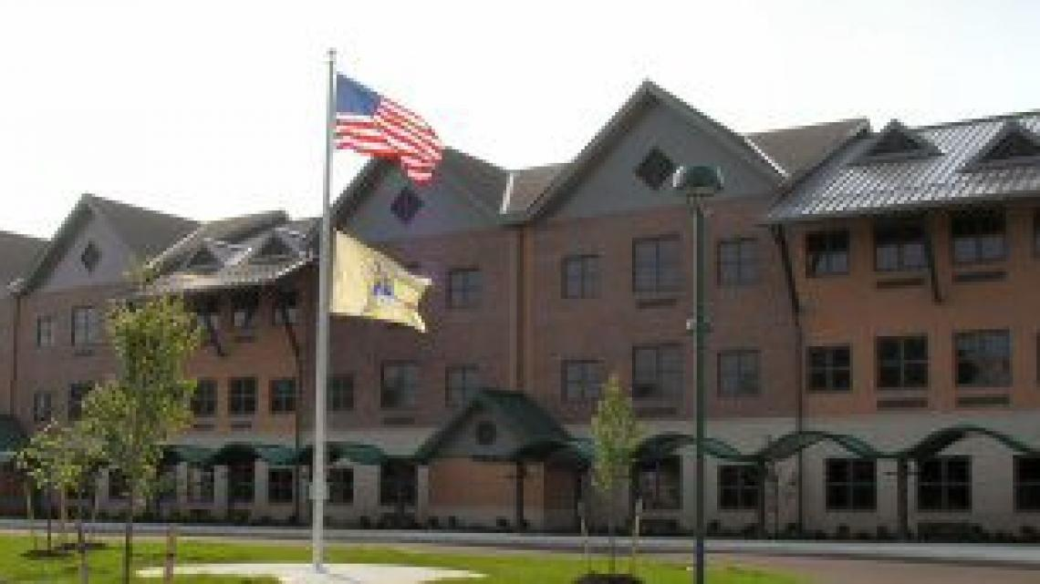
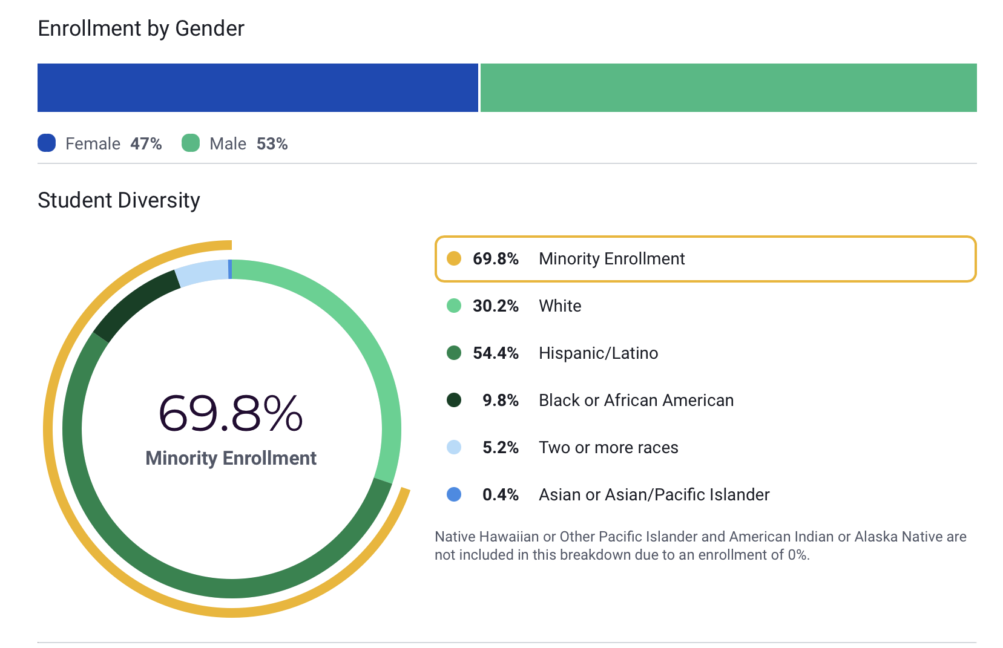
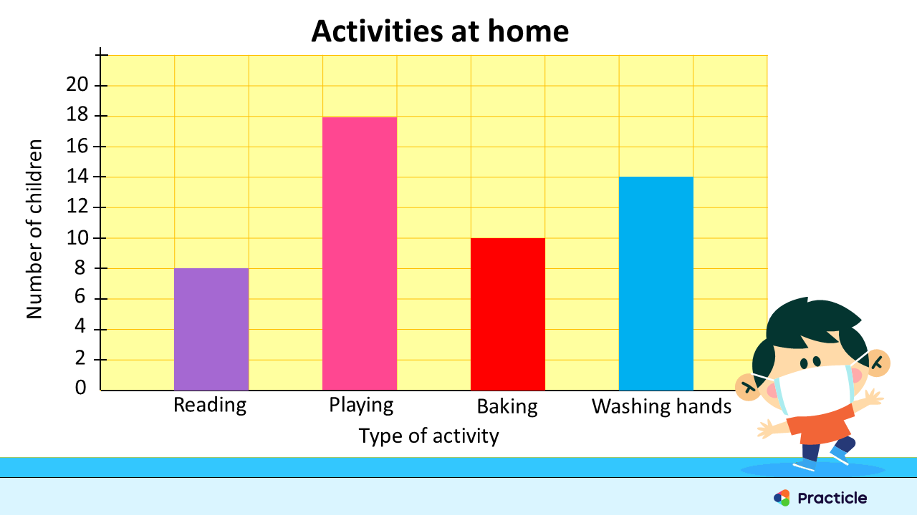
EDS 330 Service Learning Project
About the Setting
During my field placement I was placed in Amerigo Anastasia Elementary school. It is located in Monmouth County. The population of West Long Branch consists of 8700 people. The poverty rate is almost 7 percent. The race and ethnic breakdown is White: 89%, African American 6%, 2 or more races: 2%, other: 1.8%. https://worldpopulationreview.com/us-cities/west-long-branch-nj-population
Lea Cupo
Monmouth University
About the Project:
For my project I helped the students create and utilize a graph. At the beginning of my lesson the students took a plain piece of paper and created their own, unique graph template. I showed them samples online and they were able to choose which layout they liked best. The next time I went, I brought in dry erase covers for them to put over their graphs. Then, each time I went, we picked a topic and the students filled in the numbers on their dry erase covers. This helped them with their graphing skills. This also was something that they could bring home at the end of the school year and use whenever they want to.
About the School:
Anastasia Elementary school is for students from Kindergarten to 5th grade. There are 562 students and 59 full time teachers. The ratio of teachers to students is 10 to 1. There are 264 female students and 298 male students. The student diversity breakdown is White: 30%, Hispanic/Latino: 54%, African American: 9%, 2 or more races: 5%.
https://www.usnews.com/education/k12/new-jersey/a-a-anastasia-elementary-school-239255
About my Role:
During my time at the field site, I observed, participated, and taught. The first couple times I went, I sat and took notes on the classroom and how the teacher was conducting the lesson. When the students went to centers, I would walk around and talk with them. Then, I taught them how to create a graph.
About my Impacts:
The teacher was able to focus on the student she was working with because I helped the other students if they had any questions. I furthered their understanding of graphs and how they can be used.
About the Class:
I was placed in a 4th grade special needs classroom. There were 9 students, 5 of them were boys, 4 of them were girls. I was there during their math lessons. The teacher utilized the smartboard to show visuals, then the students would work on activities from their workbook. After this, they would go to math centers. All the students were below grade level. A couple of them showed signs of being very low on the autism spectrum.
About my Understanding and Goals:
During this experience I had the chance to work with a 4th grade class, which I've never done before. I was able to see how a special needs class works. My understanding of students with special needs has changed and I now know you can't make assumptions. In my course we discussed the different types of special needs and how each student is different. This relates to what I saw in the class because each student needed different things. Some students were able to do the work by themselves and others needed a lot of help. My goals are to continue to learn about special needs students and get a job helping all types of students. I want to work with students who have a wide range of disabilities, so that I'm as prepared as I can be for when I graduate and start my career.
About the Course:
The course was "Foundations of Special Education: Child & Adolescent Devlopment and Transition to Adulthood".

