Slide 1

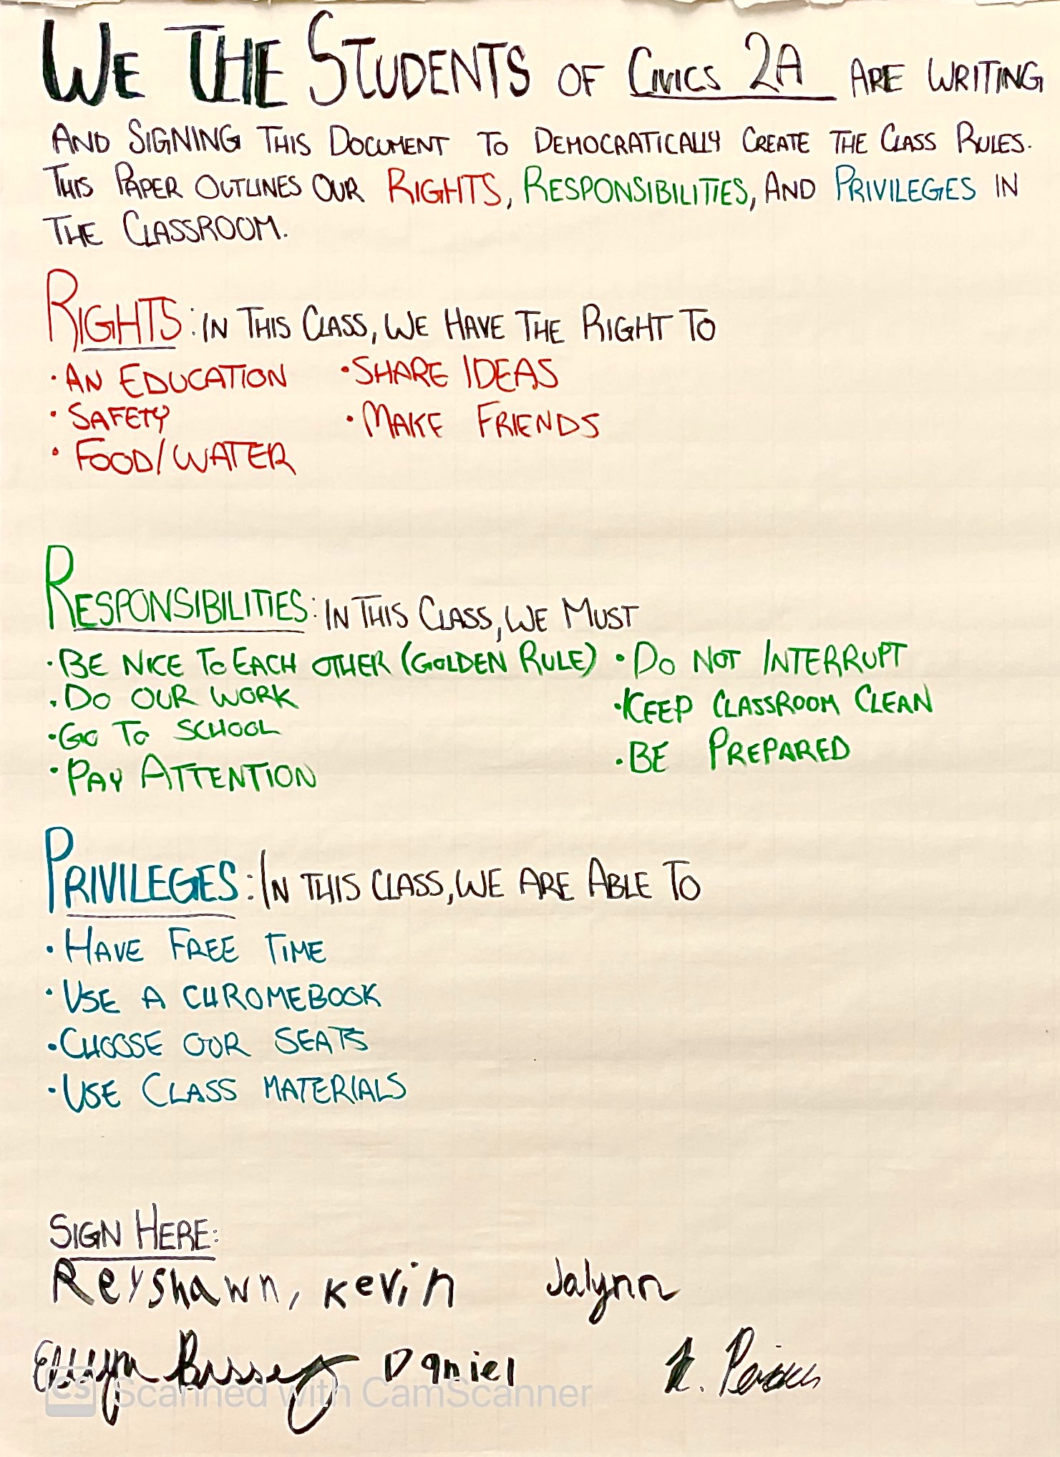

Special Education Action Plan Project
LINCOLN PEREIRA | MONMOUTH UNIVERSITY
Setting
Description of Students
Impacts
Community: Long Branch
Monmouth County
Population: 32,383 (2021)
18.2% poverty rate
(census.gov)
81.5% citizenship rate
Race/ethnicity breakdown:
White (Non-Hispanic) 55.7%
White (Hispanic) 12.4%
Black 11.6%
Other (Hispanic) 10.3%
(datausa.io)
School: Long Branch Middle School
Grades 6-8
1,121 students
Student/Teacher Ratio: 11:1
47% Female | 53% Male
77.3% Minority Enrollment *
(usnews.com)
School: Civics
7th Grade
4-6 Students per class
Newsela used for reading
5 Pairs of desks facing towards one whiteboard, teacher’s desk, and help desk
Projector used by the teacher, Ms. Bissey
Chromebooks used by students
Class 1A: 5 Boys | 1 Girl
Class 2A: 3 Boys | 1 Girl
Classroom for students with emotional/behavioral disorders
No intellectual disabilities
Learning disabilities common
Reading performance below typical
Each class now has specific rules that the students signed
Teacher can hold them directly accountable
Students created a constitution based on prior lessons on civil rights and the Enlightenment era
* Ethnic Demographics:
58.3% Hispanic/Latino
22% White
15% Black
3.4 % Two or more races
0.6% AAPI/Native
Course & Project
Future Goals
EDS-330-50: Foundations of Special Education
Students listed their rights, responsibilities, and privileges in the classroom, which was made into a Classroom Constitution.
My role in the class:
Observing students’ interactions with each other and Ms. Bissey
Leading discussion of self-advocacy using the classroom constitution.
This project helped me reflect on my classroom management skills
Keeping students on-task without cutting off their train of thought
I want to implement this project in every classroom
Have students write directly on the constitution or board
Understandings
I learned how to
Direct a classroom
Coordinate with other staff
I got the chance to observe small-group instruction
Differentiated learning through audiobooks and other text-to-speech resources also used
Class 2A’s Constitution

