Slide 1
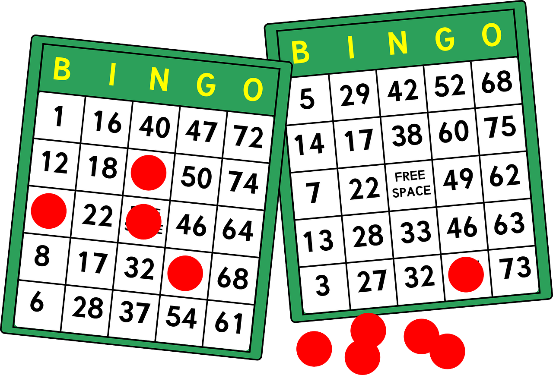
Catherine Forsyth Monmouth University
Single Addition BINGO
Setting
Overview of Community
Long Branch, New Jersey
Monmouth County
Population: 32,383
Poverty rate: 18.24%
Citizenship: 81.5%
White: 68.1%, African American: 13.66%, Other: 11.19%, Two or More: 5.19%
https://worldpopulationreview.com/us-cities/long-branch-nj-population
Overview of School
Amerigo A. Anastasia School
K-5
562 students
10 to 1 student-teacher ratio
296 male/266 female students
Hispanic: 54.4%, White: 30.2%, African American: 9.8%, Two or More: 5.2%, Asian: 0.4%
https://www.niche.com/k12/amerigo-a-anastasia-school-long-branch-nj/
Overview of Classroom
1st and 2nd Grade, Mrs. Gregory
9 students
Desks on one half of classroom, rug/open space on the other half of classroom
Laptops
Description of Students
1 female & 8 male students
All 9 students have disabilities
Self-contained Learning Disabilities Classroom
Active group of eager learners
Course & Project
EDS330 Foundations of Special Education: Development Across the Lifespan
Created BINGO game that includes numbers up to 50 as well as single digit addition sentences
Role
I observed the class during math and special
Gave guidance and corrections when appropriate
Gave positive reinforcement to all students
Understandings
Learned how to interact with students in classroom setting, adjust to any and all distractions or set-backs that could happen throughout the day
Understanding the disabilities discussed in the coursework gave an opportunity to act on my knowledge in the field
Impacts
I was an extra set of hands in the classroom, which gave the students another person to go to if they needed assistance
I helped one student figure out how to work out single addition math sentences in a new way that they understood better than previous ways taught to them
Future Goals
I plan to continue to grow with giving students positive reinforcements for their achievements rather than negative criticism for what they are doing incorrectly
I want to continue to gain more knowledge on different approaches to teaching that is inclusive for all students
This Photo by Unknown Author is licensed under CC BY

