Slide 1
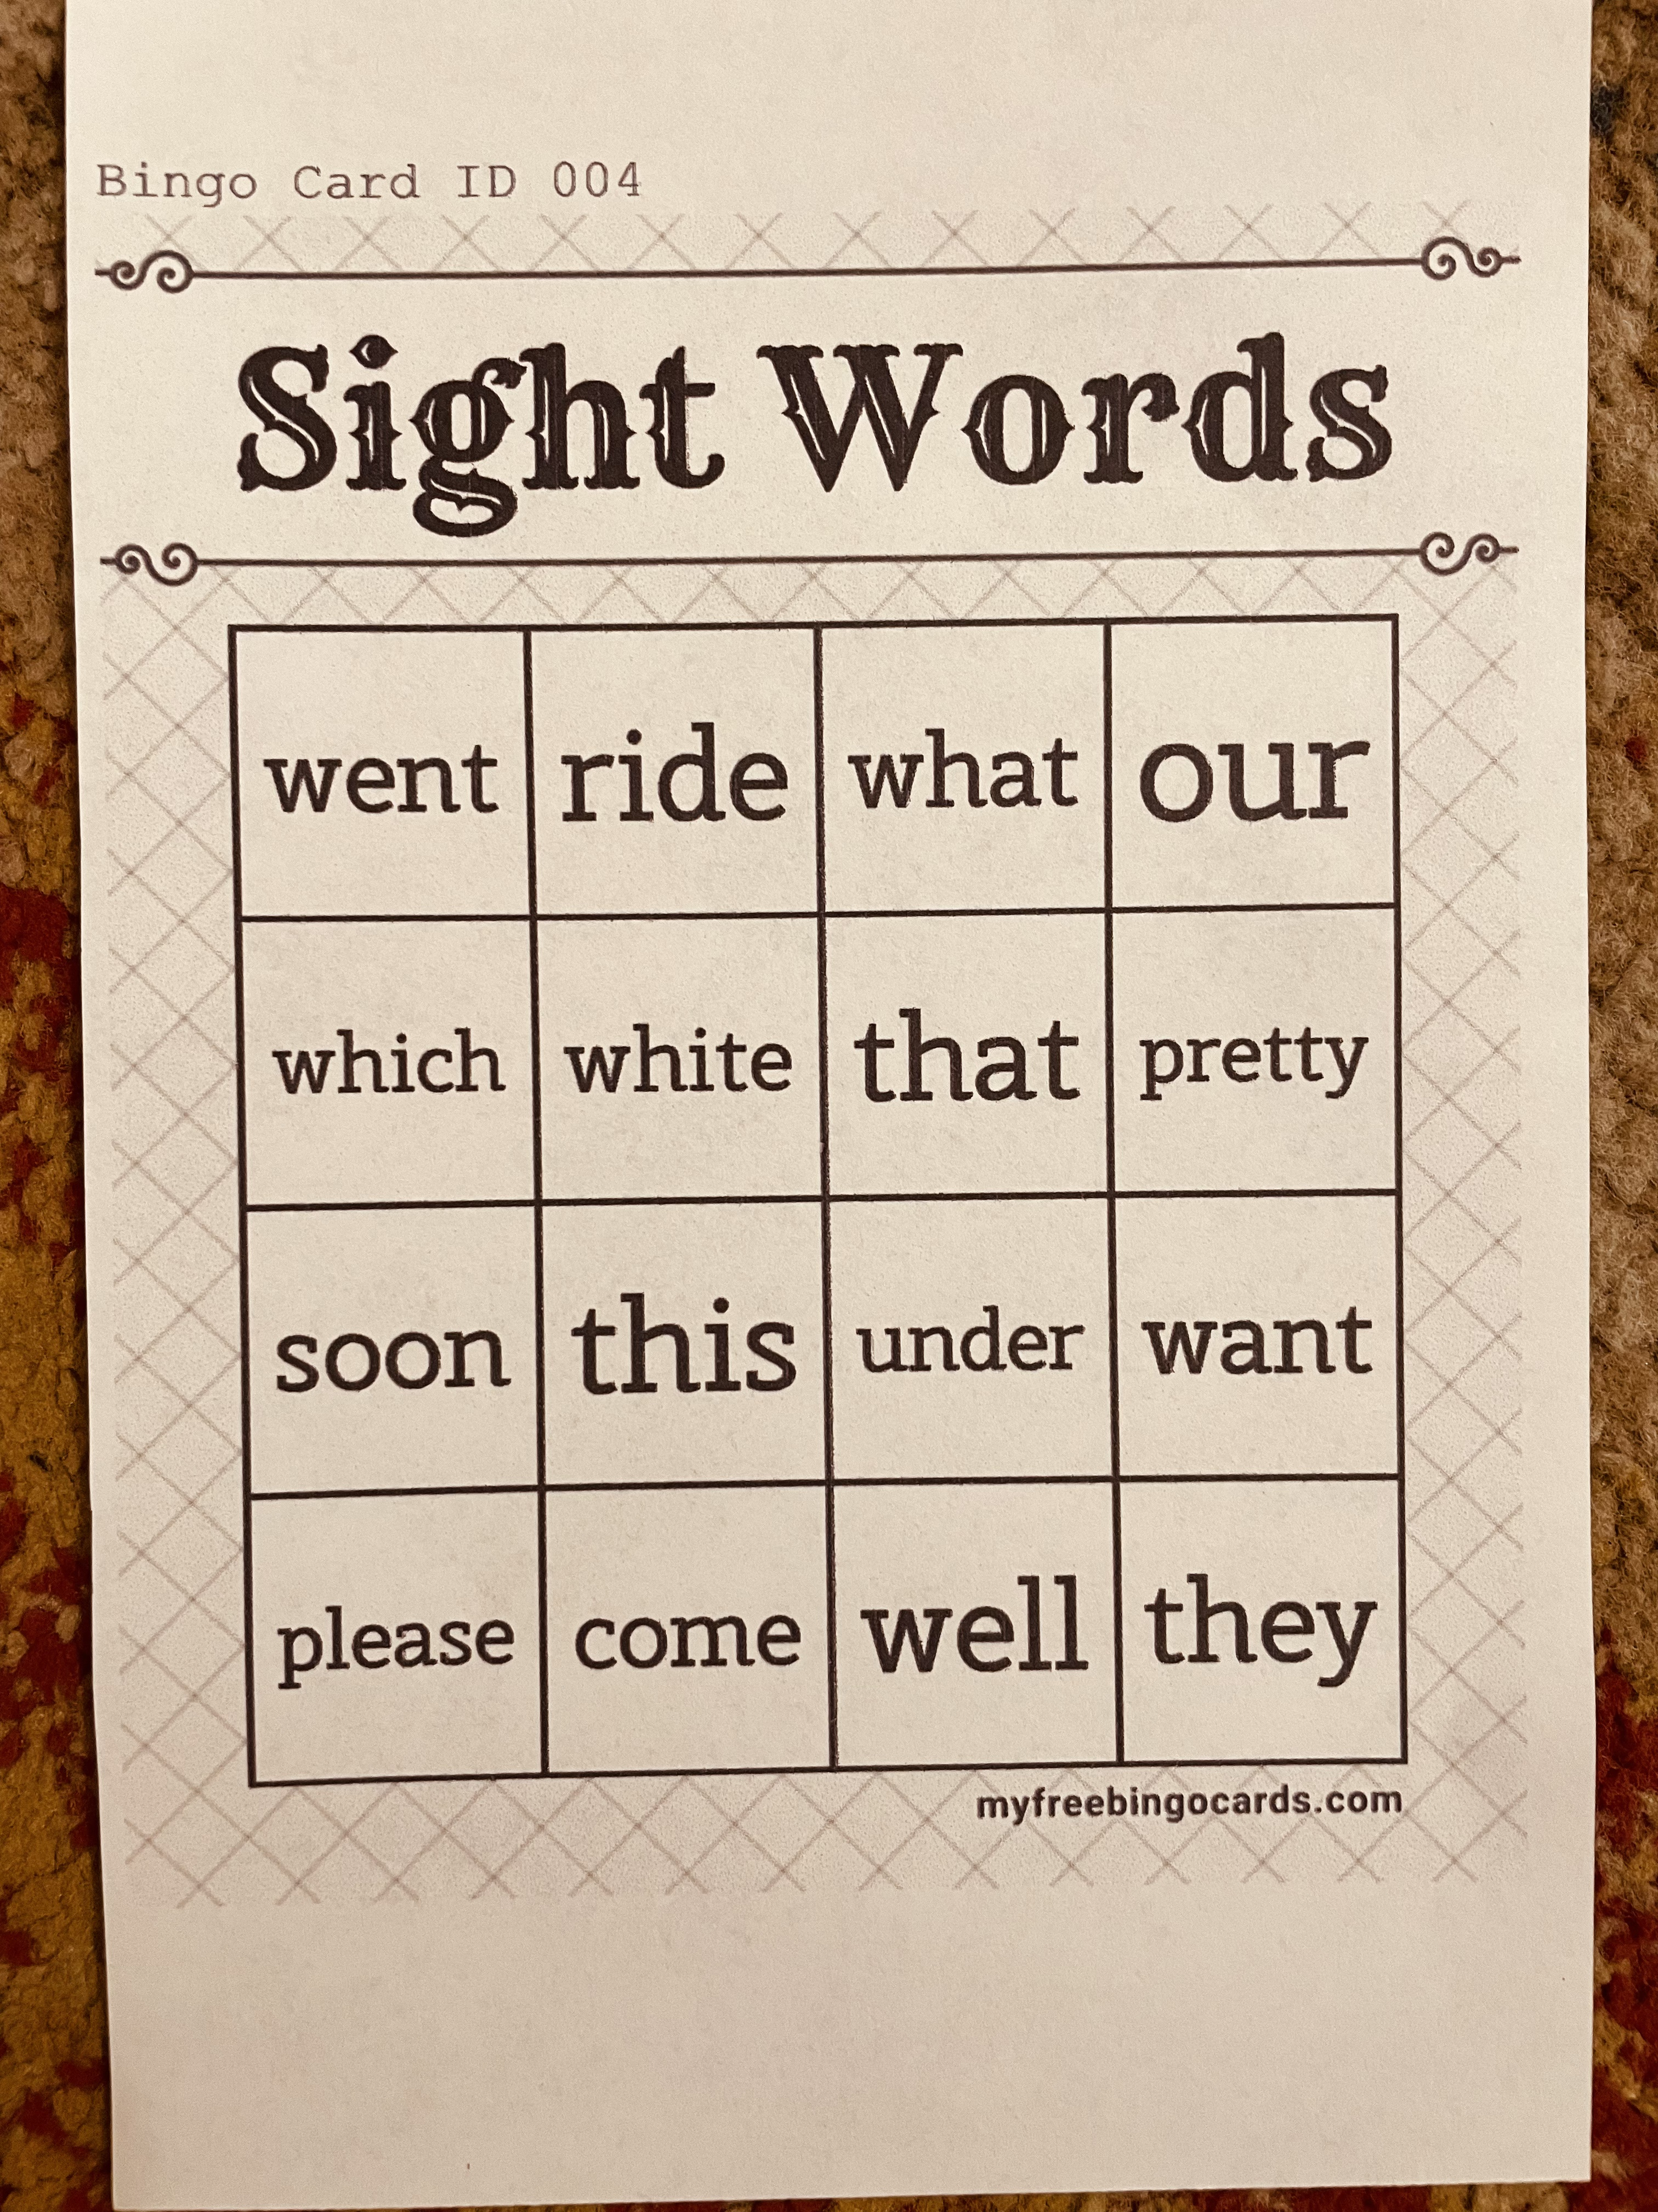
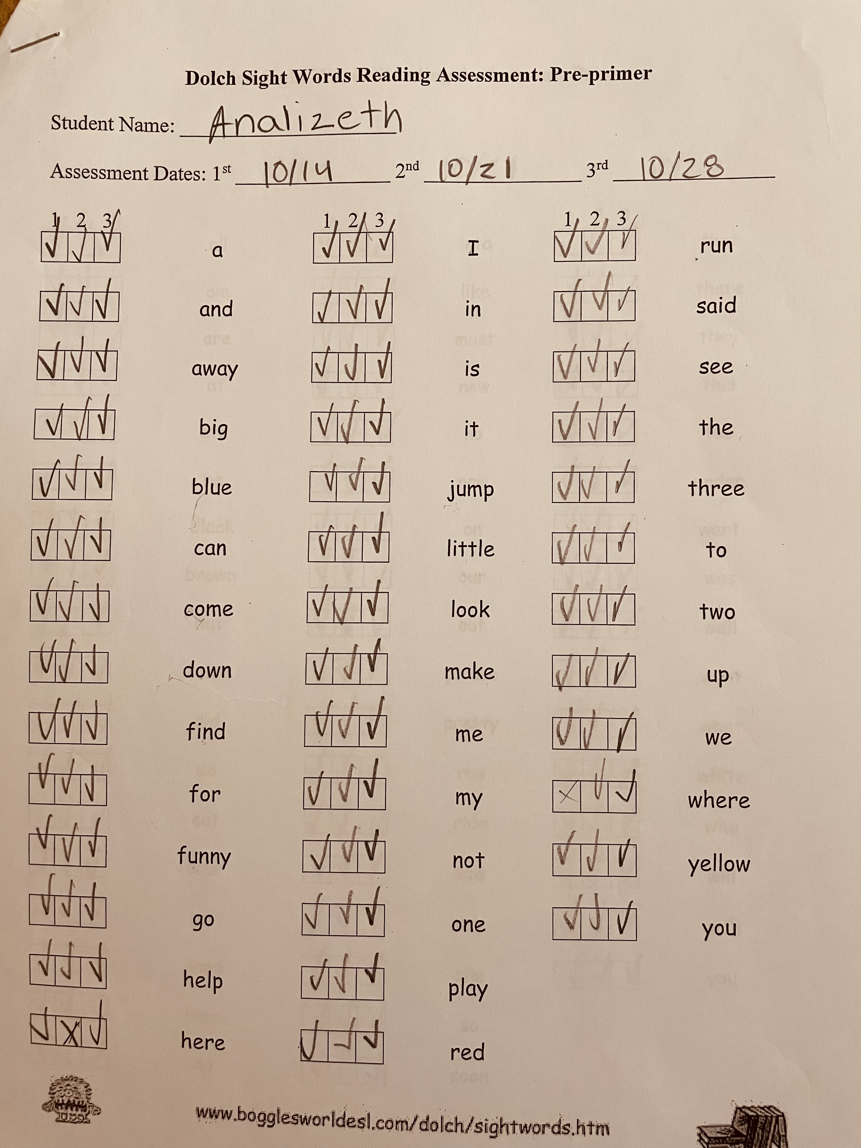
Role
Observer
Sight word practice
UNDERSTANDINGS
IMPORTANCE OF INCLUSION CLASSROOMS
THE LEAST RESTRICTIVE ENVIORNMENT
TEACHER AIDS AND PARAPROFESSIONALS
IMPACTS
PROVIDED STUDENTS WITH THE NECESSARY SIGHT WORD PRACTICE
ENCOURAGED STUDENTS TO MEMORIZE
IMPLEMENTED PATIENCE FOR STRUGGLING STUDENTS
FUTURE GOALS
DEVELOP MORE KNOWLEDGE
IMPLEMENT SKILLS LEARNED
IMPROVE UPON PATIENCE, UNDERSTANDING, &EMPATHY
SETTING LONG BRANCH
MONMOUTH COUNTY
POPULATION: 31,857
27.93% POVERTY
49.36% BORN IN LB
68.10%WHITE 13.66% BLACK 11.19% OTHER RACE
LONG BRANCH, NEW JERSEY P
OPULATION 2022, HTTPS://WORL POPULATIONREVIEW.COM/US-CITIE
/LONG-BRANCH-NJ-POPULATION.
OVERVIEW OF SCHOOL
A.A ANASTASIA ELEMENTARY SCHOOL
GRADES: K-5
STUDENTS: 562
STUDENT/TEACHER RATIO: 10:1
53% MALE STUDENTS
47%FEMALE
70% MINORITIES HISPANIC, BRAZILIAN, BLACK
A A ANASTASIA ELEMENTARY SCHOOL (2022-23 RANKING) - LONG BRANCH, NJ.” PUBLIC SCHOOLREVIEW, HTTPS://WWW.PUBLICSCHOOLREVIEW.COM/A-A-ANASTASIA-ELEMENTARY-SCHOOL-PROFILE.
OVERVIEW OF CLASSROOM & students
Fifth Grade
10 students, 4 girls, 6 boys, 3 disabilities
Iready, math xl
Chromebooks
Sight Words
Selene Ramirez
Course & project
5th grade math and reading
Sight word practice
Sight word bingo

