Slide 1
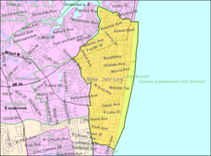
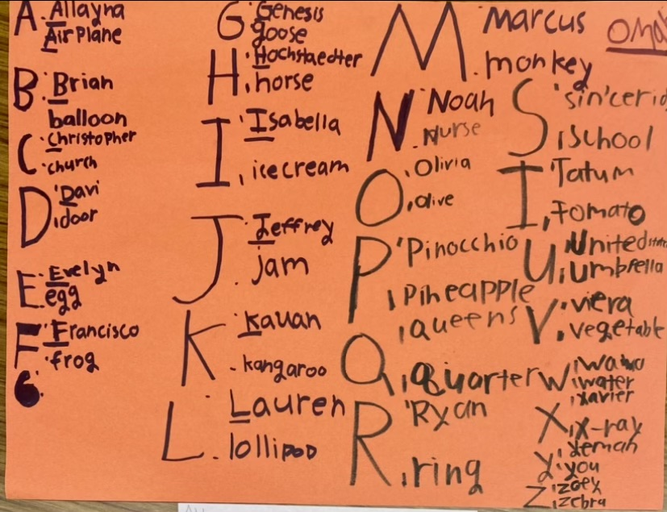
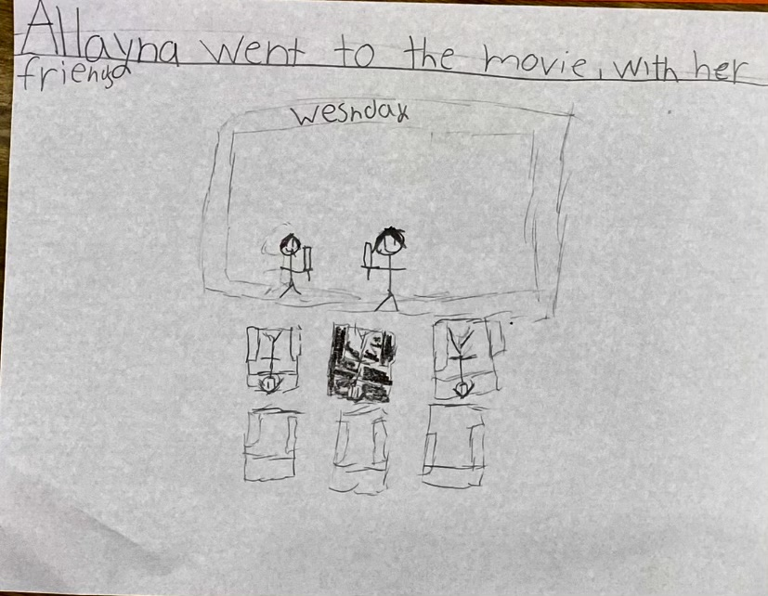
Service-Learning Presentation
Andrew Vera Monmouth University
Setting:
Overview of Community:
Long Branch population: 32,383
Monmouth county population: 645,354
Poverty Rate: 18.2%
Citizenship: 81.5%
Race/Ethnicity:
White: 68.1%, Black: 13.7%,
Hispanic/Latino: 27.7%
Understandings:
What was learned? I learned how to work with students that work at different paces. I also learned how to adjust my plan on the fly.
How did this connect to my coursework? This connected to my course work because we are constantly talking about individualizing teaching for each student based on the way they learn. We are being taught to do differentiated instruction to meet individual learning needs.
Description of students:
Males to Female- 4:3
Students with disabilities- All students
Types of disabilities:
Communication impairment, OHI (ADHD), Autism
Other Details- Students struggle with spelling and sounding out words but are eager to learn and get better.
Impacts:
Impact at the field site: I impacted the field site by giving advice and tips from another perspective other then a person who is already a teacher. I also impacted these students by providing them with practice and support with there noun identification and confidence with spelling.
Overview of School
School: Amerigo A Anastasia school K-5
Students: 562 students
student to teacher ratio- 8.3:1
Sex Ratio: 47% female and 53% male
Race/ethnicity:
Hispanic: 54.4%, White: 30.2%, Black: 9.8%
Course & Project:
Course: EDS 330 51
SL Project: Students will create a poster that helps students practice identifying and spelling nouns. In centers I lead groups of 4 students with the project. They went through every letter of the alphabet and produced a common and proper noun for each letter as a group. Then they each created their own sentence using one of the nouns that they produced. Then they drew and colored a picture that goes with it.
Overview of Classrooms
Grade: 4th
# of students: 7
Reading programs: Read180 and System44
Classroom Layout:
Do now
Class Lesson
Reading centers
Independent reading, teaching table and software
Technology
Chromebooks for software in centers
Seesaw
Role:
I observed how the teacher taught and handled all kinds of situations.
I would make sure students were staying on task
I would check students' classwork so that they can move on to the next task.
During the independent reading center if a student was having trouble, then I would help talk them through the worksheet.
Future Goals:
Make connections with students
Learn different methods of teaching different groups of students
Continue to improve on my classroom management skills by being more patient and understanding

