Slide 1
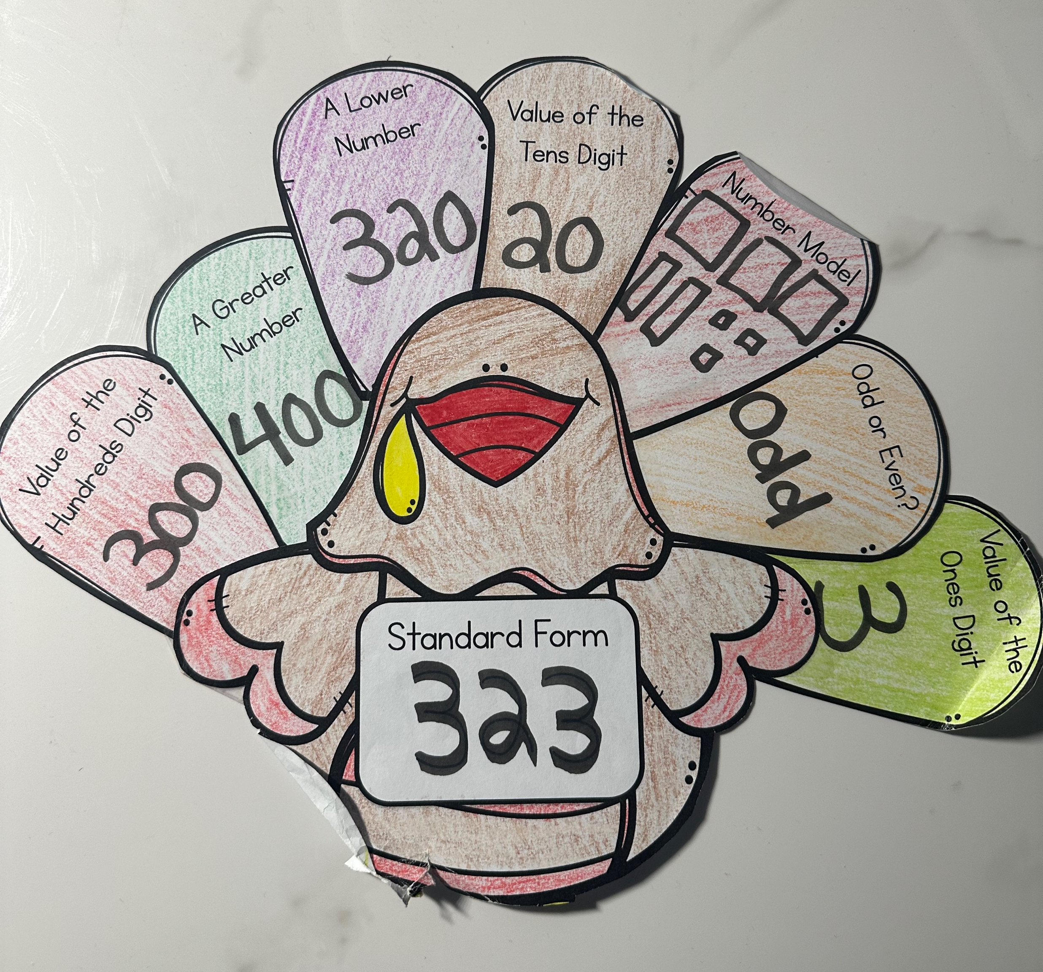
Bianca Hunsinger Monmouth University
Service-Learning Experience at Anastasia Elementary School
Understandings
I learned that while working alongside these special needs students, it takes a lot of patience and preparation to fully create proper environment for these students to learn. I learned the importance of making accommodations and modifications to fit each students needs.
This connected to my coursework because in class we talked about following a procedure on how to help students with special needs and have an understanding that each student learns differently and needs extra support and modifications to learn to the best of their ability, so I was able to take what I learned in class and apply it to what I observed in the classroom.
Impacts
I was able to use my skills to help the students on their learning path. I noticed that certain students needed additional help during their lesson, so I was able to provide one-on-one help to students while my cooperating teacher was still able to conduct the lesson to the rest of the class without taking time away. This allowed certain students to catch up to the rest of the class and all be on the same page.
Future Goals
I plan to use what I learned being in the classroom and expand on it while I continue the path of service learning. Each new placement that I get the pleasure of working in, I will use what I know and apply it to the new group of students and adapt to new strategies.
I would like to work towards:
Adaptability
Innovation
Organization
Setting
Overview of Community
Long Branch
Monmouth County
32,383 people
Poverty rate: 18.2%
Citizenship: 70.62%
Race/ethnicity
White: 68.10%
African American: 13.66%
“Search for Public School Districts - District Detail for Long Branch Public School District.” National Center for Education Statistics (NCES) Home Page, a Part of the U.S. Department of Education, 2022, https://nces.ed.gov/ccd/districtsearch/district_detail.asp?Search=2&details=1&ID2=3408940&DistrictID=3408940.
Overview of School
Amerigo A. Anastasia Elementary School
Grade Ranges: K-5
562 Total Students
Student/Teacher Ratio: 9.53
296 Male Student
266 Female Students
Race/Ethnicity:
Hispanic 54.4%
White: 30.2%
African American: 9.8%
“Search for Public Schools - School Detail for a a Anastasia Elementary School.” National Center for Education Statistics (NCES) Home Page, a Part of the U.S. Department of Education, 2022, https://nces.ed.gov/ccd/schoolsearch/school_detail.asp?Search=1&DistrictID=3408940&ID=340894003908.
Overview of Classroom
4th Grade
8 Total Students
Everyday Math/Connect ED
iReady and ST math
3 separate groups of desks, 2 in which have 3 desk and one group with 2 desks
Chromebooks
Description of Students
4 Male students and 4 Female students
All 8 students have a disability
Autism, ADHD, Hear Impaired and communication impaired.
Course & Project
EDS 330 50 – Foundations of Special Education
Turkey Place Value Worksheet
This assignment was targeting their knowledge on place value. They were asked different questions that related to place value.
Questions on the turkey included finding value of the ones digit, value of the tens digit, finding a greater number and a lower number, standard form and creating a number model.
Once completed they were able to color and cut out the turkey and put in up in their classroom.
Role
Observed
Took note on accommodations and modifications needed for the students.
Took part in aiding in lessons
Created my own lesson in which I conducted in the classroom.
Participated in one-on-one pairing to help students that were struggling.

