Slide 1
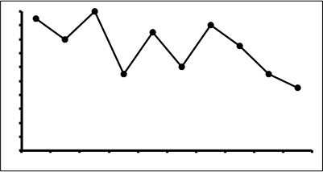
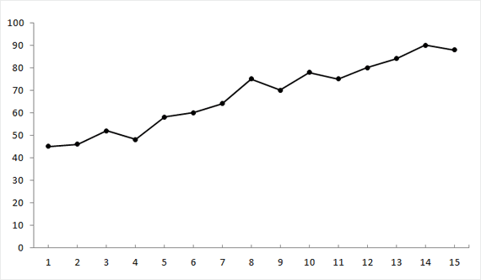
Whitney Lott Monmouth University
Effects of Differential Reinforcement
Background
DR is a versatile method which is utilized to increase or decrease behavior, teach new skills, and can be paired with procedures to increase effectiveness.
Methods
EBSCO, ProQuest
Key Terms: Differential Reinforcement (DR), Effects, Autism, Integrity, Behavior
Purpose
The Effects of Differential Reinforcement (DR) on Students with Autism
Findings:
Behavior Reduction with DR
Reduction on maladaptive (unwanted) behaviors, which may impede on future learning (Butler, 2020) and Pica reduction using DR to pair edibles in lieu of nonedibles (Slocum, 2017)
Skill Acquisition with DR
On-task behavior increased (Jessel, 2017) and (Karsten, 2009) increased unprompted responses with DR
Maintenance and Generalization
Using DR in a variety of settings to promote generalization (Slocum, 2017) (Butler, 2020)
Limitations
Limited research in current/previous years
Discussion
Potential for negative side effects, resurgence (Briggs, 2017)
Lack of fidelity should pursue need within upcoming research (Weston, 2017)
Treatment outcome integrity is questioned (Lanovaz, 2010)
Implications
Due to effectiveness, it is a highly sought-after intervention method
Next steps: research on magnitude, investigation in integrity of treatment, alignment with CEC standards

