Slide 1
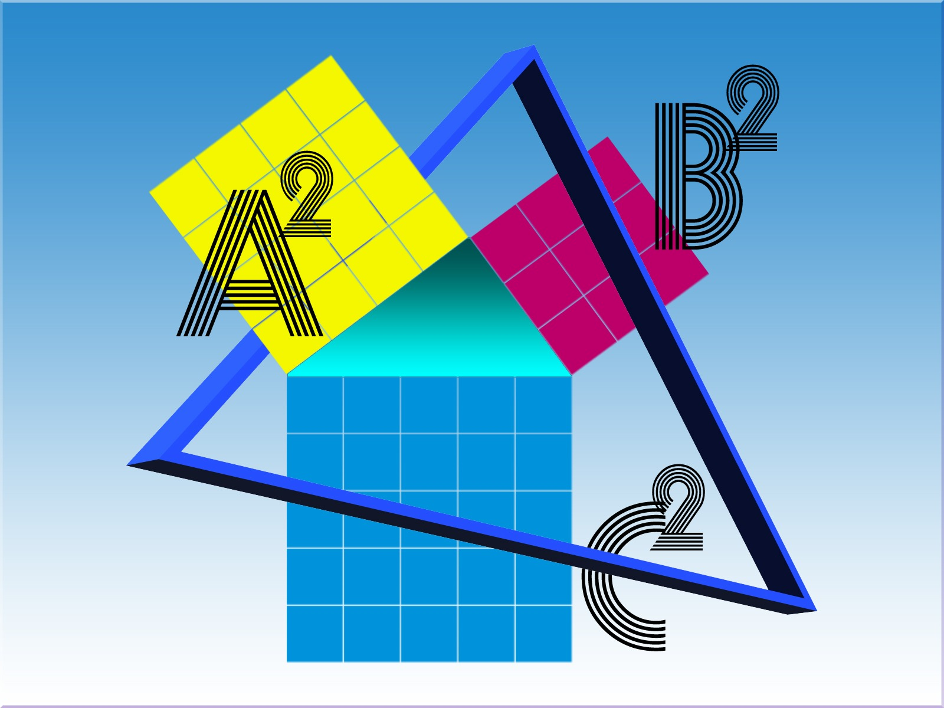
Emily Malool Monmouth University
Benefits of Explicit Instruction in Mathematics
Background
Explicit Instruction is an evidence-based practice (Agrawal & Morin, 2016)
Teach content, model examples, students practice independently with feedback (Yuwono et al., 2021)
Findings: Themes
Increased Mathematical Accuracy
Improved computational skills
(Namkung & Bricko, 2020)
Gained mathematics vocabulary
(Hinton et al., 2015)
Enhanced working memory
(Swanson et al., 2013)
Aided in conceptual
and procedural
knowledge
(DeCaro & Rittle-Johnson, 2012)
Guided Real World Applications
Problem solving skills in real stimuli (Root et al., 2018)
Aids in transitions from concrete to abstract concepts
(Strickland & Maccini, 2012)
Provides meaningful context
(Chapman et al., 2019)
Increased Self Reliance
Gain practice working independently
(Al-Salahat, 2022)
Increased self confidence
(Doabler et al., 2021)
Improved critical thinking skills
(Purpura et al., 2016)
Limitations
Most research conducted in elementary schools
Does not take diversity of students into consideration including race, gender and socioeconomic status
Purpose
To identify benefits of explicit instruction for students with disabilities in mathematics classrooms
Discussion
Consensus that there are many benefits to explicit instruction
However, not specific to grade level or disabilities
Methods
Researched three education databases
Reviewed 20 peer reviewed studies about explicit instruction
Key Words: Explicit Instruction, Math Education, Special Education, Mathematics Learning Disabilities
Implications
Supports that explicit instruction benefits students with disabilities
Research should be conducted specifically in high schools
Further research to support that explicit instruction benefits all students with disabilities

