Slide 1
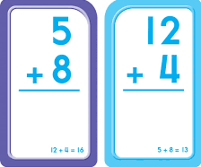
Aimee Hirst Monmouth University
Experiential Learning
Math Scavenger Hunt
Role
Teacher candidate
Observed a classroom setting
Collaborate with CT
Assist students in their work
Overview of School
Anastasia A. Amerigo Elementary School
Grades K-5
Long Branch, Monmouth County
School population: 581
85% reduced lunch
Racial Breakdown
52.2% Hispanic
31% White
12.6% African American
Overview of Classroom
Grade 4
Special Education Class
6 Students- 3 boys, 3 girls
Project pertains to math portion of class
Students have trouble with basic math skills
Course & Project
EDS 330 Foundations of Special Education Across the Lifespan
Addition and subtraction scavenger hunt
With the use of index cards, students solved addition and subtraction problems
Students then looked for the index card matching the correct answer of said problem.
Gave students the opportunity to engage intellectually, socially, and emotionally.
What I learned
Classroom management skills
Time management Skills
How to create and perform an action plan in a classroom
I was able to see an increase in the student's math skills and motivation!
Results
Basic addition and subtraction skills slightly improved in 3/6 students
Students became more enthusiastic in developing their math skills
Future Goals
I plan on continuing to grow and develop, enhancing my teaching abilities.
I want to continue working on my self-reflection and analysis.

