Slide 1
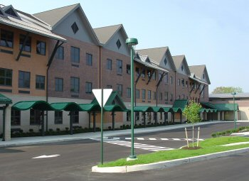
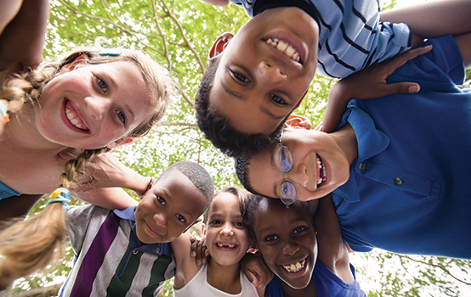
Literacy Enhancing Clinical Project
School of Education Exhibition
Laura Thomas
Site
Anastasia Elementary School located in West Long Branch, NJ. The total population is 567, 52.2% of which are Hispanic, 31% white, 12.6% African American.
My Mission in the Classroom
Impact
In taking the Foundations of Special Education Across the Lifespan course, I created a literacy-based project that focuses on word recognition and rhyming. I created bingo boards and bingo tokens, each with a separate set of words. Students matched each token with the word that rhymed on the bingo board. Pictures were given to boost students’ ability to recall words and rewards were given at the end.
Improvement with rhyming and phonics skills. Students were able to complete the assignment however, some needed more help. In later weeks I would adjust the project towards students developing skill sets, improving the ability to efficiently complete the assignment.
Students
Five first grade students. Four have Autism, one has Attention Deficit Disorder. I observe during reading time, most need extra support and resources.
Takeaways
I observed students thinking processes, assisted, and worked with my cooperating teacher to ensure the activity would fit individual skill levels of each student.
Students were engaged and determined. In the future, it’s important to support students in any way necessary. Each thrives in different ways and are all capable of succeeding!

