Slide 1

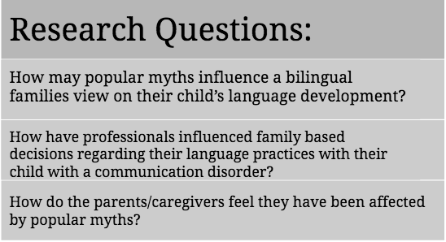

Popular Myths and the Potential Influence on Bilingual Families Care-Based Decisions
Kristen Kerrigan, Molly Smith, Madison Somple | Monmouth University Speech Language Pathology
Introduction
Investigating the Gap in the Literature
Due to the gap in the literature, families raising a bilingual child with a communication disorder are at a disadvantage when trying to find educational resources. This could affect how the parents will raise the child, and because there is less information, the parents are more likely to unknowingly allow myths to influence their decisions. Furthermore, even when a person goes to a professional, the gap in the research is so vast that a professional may guide the parents in a negative direction.
The population of bilingual families in the world is continuing to rise, yet there is still very limited research available for bilingual children with communication disorders. In turn, this lack of information creates a need for further exploration to prevent families from falling victim to common myths about bilingual children with a communication disorder. Two common myths that often influence the care of a child with a communication disorder in a bilingual family include the following:
1) The child’s language development is delayed when raised in a bilingual environment
2) Learning two languages simultaneously creates an “added burden for their child’s already limited cognitive resources” (Hampton et al., 2017, p. 441)
These myths have been found to negatively impact the child’s language development, as well as the family's culture. The goal of this study is to examine how common myths are influencing how bilingual families care for a child with a communication disorder.
Hypothesis
Myths in Professional Practice
It is hypothesized that families may believe certain popular myths related to their child’s language learning and overall communication. Therefore, these myths might cause them to change their parenting style in a way they do not agree with, but will still do because they do not want to hinder their child's development. This study will allow for more insight on how these myths directly affect parents and influence their parenting style, and it will show the need for why professionals need to have more information on the bilingual population that have communication disorders.
In a study done by Hampton et al. (2017), out of 11 families who were raising a child with autism spectrum disorder (ASD), eight families reported in a survey that they reduced the exposure of the minority language. The rationale for this shift to monolingualism was due to the myth that bilingualism will be a disadvantage to the child’s capacity to learn language. Subsequently, these shifts to the majority language affected the socio-cultural aspect of the family. Families reported that after “sacrificing the minority language” they felt disappointed for not speaking the language in their culture (Hampton et al., 2017, p. 436).
Proposed Methodology
Myth Driven Parenting Styles
Purpose
Participants
The study will be made up of at least 100 families that are multilingual, and their family unit includes a child who has a communication disorder. Participants will be recruited via email by the principal investigator. Participants will be given informed consent, and the research data will remain confidential.
Procedure
Parents will receive a 13 question survey with both true or false questions and open ended questions. The survey questions include questions about the families demographics (parental age, race, gender, nationality, native language) as well as questions about the experience of raising a multilingual child with a communication disorder. Both qualitative and quantitative data will be collected and analyzed by a group of graduate students.
In a study done by Kay‐Raining Bird et al. (2012) 49 caregivers of bilingual children with ASD were interviewed on their experience of being caregivers. Out of the 49 parents, 75% of the parents reported that they were raising their child in a multilingual home. The families stated that professionals recommended that they shifted to a monolingual home, yet they went against the recommendation. When they chose to remain bilingual, they explained that there was a significant lack of services for the bilingual child with ASD.
Using previous literature and parent interviews it is crucial to fill the gap in research involving multilingual families that have a child with a communication disorder. Parents and families are being misled in multiple ways due to the popular myths presented in this study. It is imperative to research these myths and their influences on bilingual families because this research will allow professionals to see which myths are still being prescribed to by parents of multilingual children with communication disorders. Once the research is complete, clinicians will be able to dispel these myths.
References
Hampton, S., Rabagliati, H., Sorace, A., & Fletcher-Watson, S. (2017). Autism and bilingualism: A qualitative interview study of parents' perspectives and experiences. Journal of Speech, Language, and Hearing Research, 60(2), 435-446
Kay‐Raining Bird, E., Lamond, E., & Holden, J. (2012). Survey of bilingualism in autism spectrum disorders. International Journal of Language & Communication Disorders, 47(1), 52-64.
.
Notes:
Using previous literature and parent interviews it is crucial to fill the gap in research about multilingual families that have a child with a communication disorder. Parents and families are being misled in multiple ways due to the popular myths presented in this study. It is imperative to research these myths and their influences on bilingual families because this research will allow professionals to see which myths are still being prescribed to by parents of multilingual children with communication disorders. Once the research is complete, clinicians will be able to dispel these myths.

