Slide 1
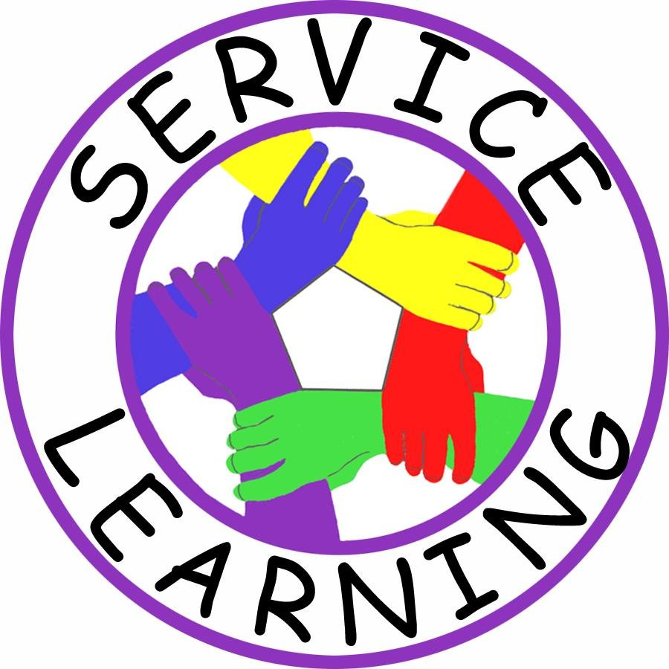
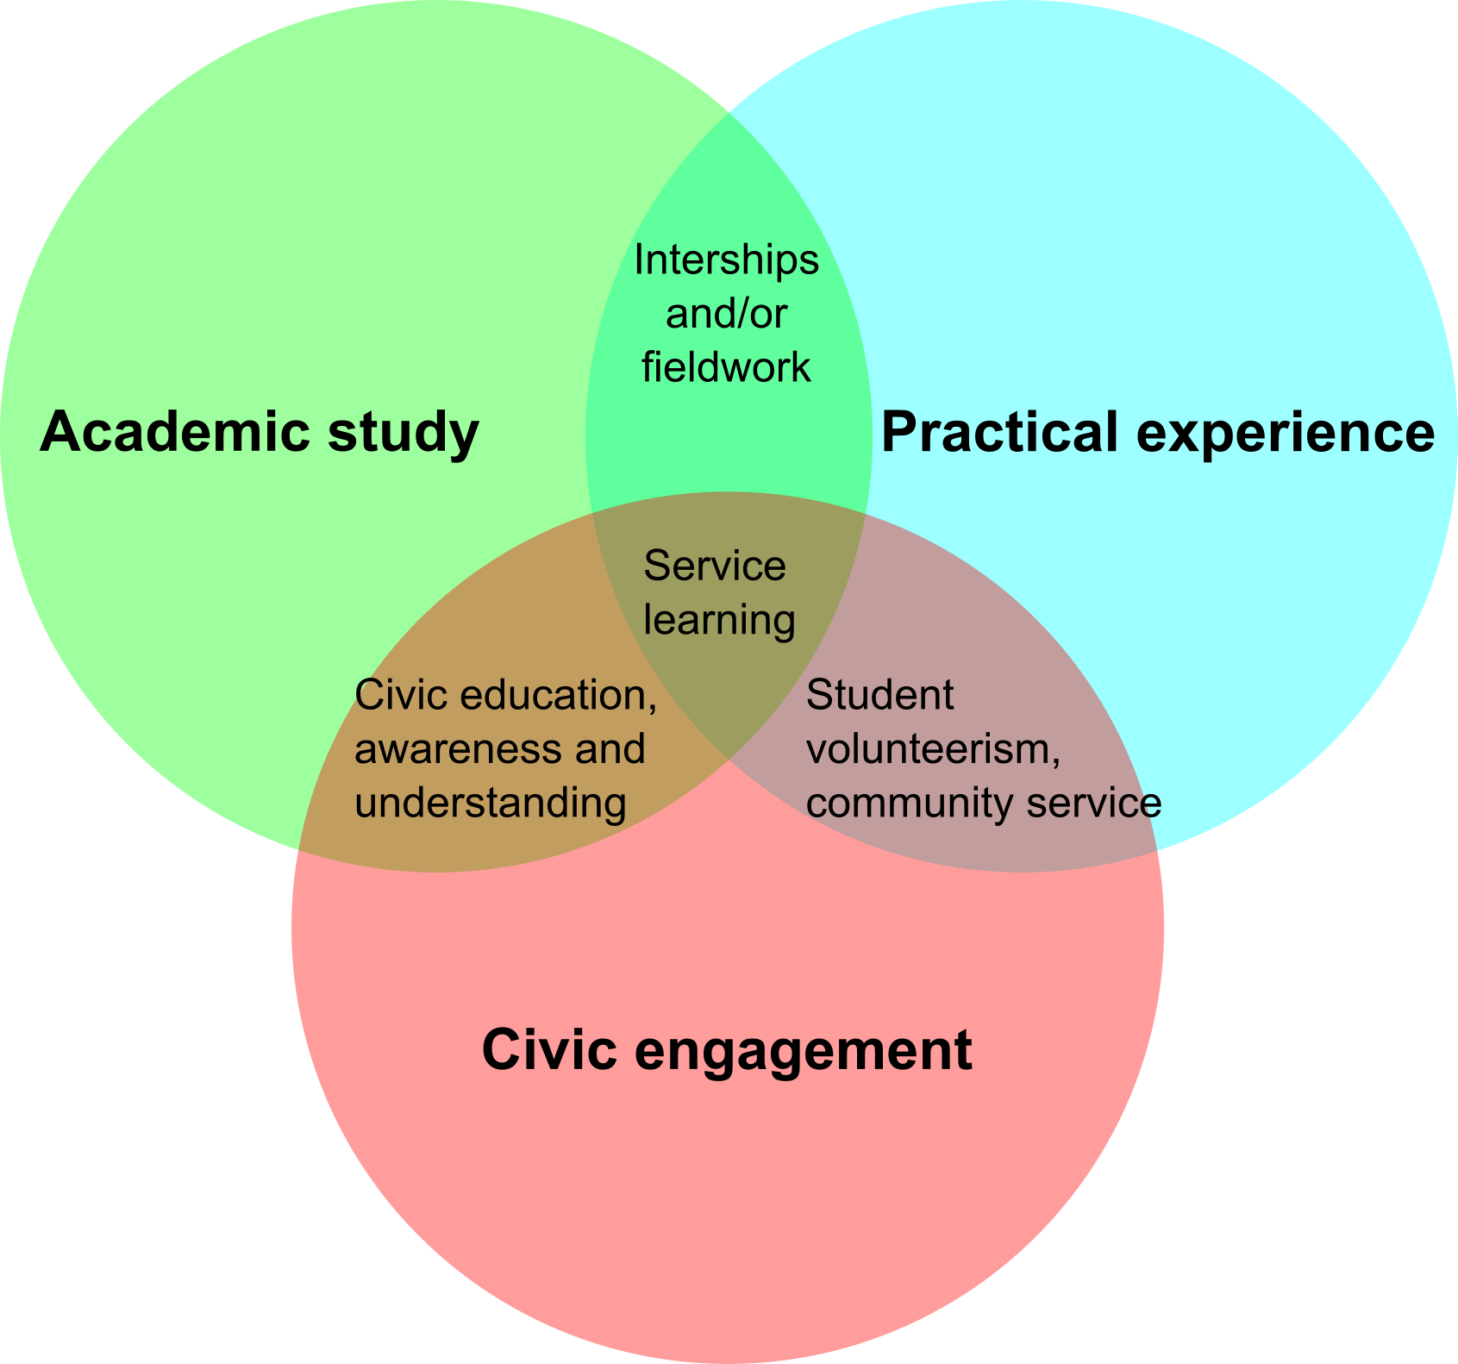
Making a Positive Impact on students As Future Elementary Educators
Samantha DiMaggio
Monmouth University
Students: For my service-learning experience, I am working with 4th graders in a math class. There are a total of 8 students and all of them have some type of Learning disability. Most of them have hearing impairment and one student has turrets. However, behavior wise, the students are well behaved. 4 of the students are in person and 2 are on Zoom. This class uses SeeSaw which is a technology-based program for students to complete assignments. Some things they struggle with is showing up to class, participating and completing the work.
Project: For EDS-330 at Monmouth University, I was assigned to a class of elementary students to complete 15 hours of experience. My action plan consists of meeting with students on Zoom in breakout rooms and going over material for more practice, or playing games with them that will encourage student engagement.
Role: My role in the classroom is to guide the students during lessons and be another role model to them. As the semester progressed, I felt more like an assistant teacher as I connected with the students more and more each week.
Understandings: During this experience, I learned that every student is at their own individual pace, with their own strengths and weaknesses. As the teacher, it is important to make a connection with your students and determine their learning style. Make students want to learn. Help them and support them on their journey of success. Help them learn from their mistakes and think positively. Be a role model.
Impacts: Working one on one helped the students be more interactive and communitive with the lesson. As a group, the class was able to answer more questions correctly. Students who often did not pay attention in the beginning of the semester became much more involved in class. I am proud of the students’ growth and my own growth because I have a better understanding of special education which will benefit my future and the community.
Future goals: This experience helped me grow as an individual and future educator. I hope to take the skills that I learned and use them in my own classroom one day. There may be students in my own class with a learning disorder and being able to not only observe but also interact with children with a LD has prepared me for the future. I have gained leadership skills, communication skills and a wonderful experience.
Setting:
Long Branch, New Jersey
Population: 30,611 people
Poverty rate: 19.1%
Citizenship%: 80.4% are U.S citizens
Race/ethnicity: 51.4% are White/Non-Hispanic, 15.6% are white/Hispanic, 12.9% are Black or African American, 2.54% are Asian
School:
Amerigo Anastasia Elementary School in Long Branch, New Jersey
It has 541 students in grades K-5 with a student-teacher ratio of 10:1.
43% female students, 57% male students
There are 49.5% of Hispanic students, 31.4% White and 13.9% African American

