Slide 1
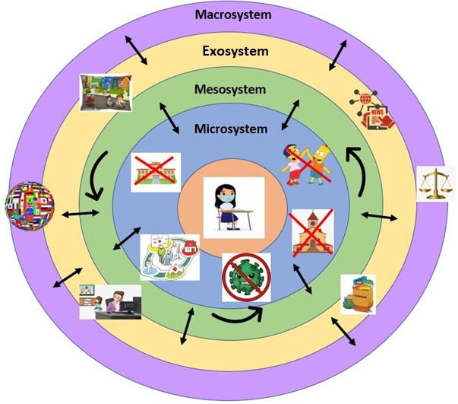
Is there a difference in suicide ideation among K-12 students before the
COVID-19 pandemic compared to after the COVID-19 pandemic?
Caitlin Santaniello
Faculty Advisors: Dr. Kathryn Lubniewski and Dr. Ai Kamei
Special Education Department
Monmouth University
Background
The COVID-19 pandemic increased stress and anxiety.
New Jersey schools were forced to change the way they administered services.
Lack of research on the impact of COVID-19 on K-12 students.
Educators have a responsibility to their students, including mental health.
Research will lead to better and more informed interventions for students.
Purpose
Determine the impact of the COVID-19 pandemic on the mental health of K-12 students attending public schools in New Jersey.
Inform schools and educators on how to best serve their students.
Methods
Collect suicidal ideation reports from New Jersey public school districts from January 2017 to January 2021.
Use secondary data analysis to compare collection of data.
Literature Review
Short term vs. long term effects of the COVID-19 pandemic
Lack of research on the connection between COVID-19 and mental health in the United States
Results inform interventions
Teachers, counselors and school administrators are mandated reporters
Figure 1: Urie Bronfenbrenner’s Theory of Ecological Systems can help illustrate the impact that COVID-19 has had on K-12 students.

