Slide 1
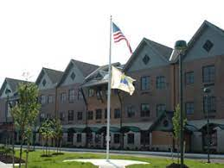
EXPERIENTIAL EDUCATION & CLINICAL PRACTICE- SCHOOL OF EDUCATION-GABRIELA ABBAZIA
Overview:
•Long Branch
•Monmouth County
•Citizenship: 80.4%
Students:
•6 males and 6 females
•12 students
•ADHD and ADD
•Communication impaired and cognitively impaired.
Impact:
•Students were inspired to be great when I came to class.
•They felt encouraged when I gave them praise for getting a question right!
•I’m always happy to participate and make sure students feel comfortable!
Overview of School/Classroom:
•Amerigo A. Anastasia Elementary School
•K-5
•581 students
•10:1 Student to teacher ratio
•3rd grade.
•System 44 Reading Program/ SeeSaw
•Some students online/ some in person
Course & Project
•EDS 330-field experience
•15 hours
•Service-Learning Project
•Word Ladders
•Phonics project that will help students with guessing words from clues.
Understandings;
•I learned to be patient and to encourage always.
•The observation hours helped to show us how it is to interact with students with disabilities and what strategies to use.

