Slide 1


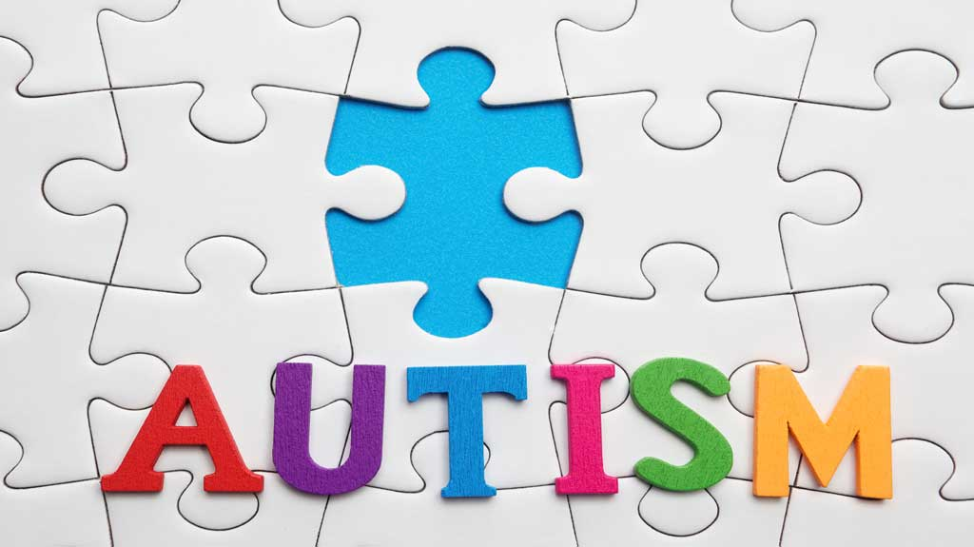



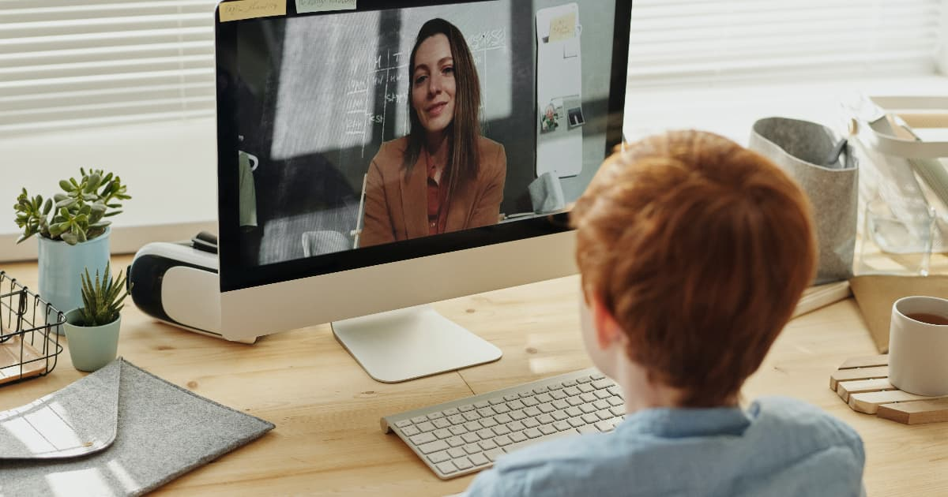

Benefits of Teletherapy for school-aged kids with Autism
Andrea Beyer, Danielle Lippiello, Leyla Marquez, and Mercedes Taglioni
Monmouth University Graduate Students
School of Education
Background
Purpose of study
Survey Questions
At the start of the Covid-19 Pandemic when the worldwide quarantine began, speech services were halted due to the need for face-to-face communication between SLPs and their clients. Given the need for continued therapy sessions to treat communication disorders in children with Autism Spectrum Disorder (ASD), speech services couldn’t simply stop and continue when the pandemic was over. During the Pandemic, speech services transitioned from in-person to online therapy, more commonly known as “teletherapy.” Teletherapy has allowed all individuals to continue speech therapy amidst a global pandemic while still managing to have fun, improve their speech, and stay safe. The American Speech-Language-Hearing Association (ASHA) has assured that “the assessment and treatment process in speech and language pathology can be done through telepractice” (Tohidastet al., 2020, para. 1) with great potential for positive outcomes.
Due to Covid-19 and public health restrictions, it has become very difficult to see clients in person for speech therapy. The need for teletherapy has increased and has become a pivotal aspect in helping children with autism receive speech therapy during a pandemic. Therapy must be consistent or else the client will begin to regress. It is helpful to learn how this form of therapy will affect speech therapy in the future especially for those clients and families who have found this new area of therapy to be more favorable than in-person. As the prevalence of ASD continues to rise, so does the number of families in need of speech services. It may begin to be challenging to find in-person services with the number of people in need of services increasing. Families may need to be more open-minded to online options for speech therapy especially if this is the only option for services.
The goal of this study is to gain the perspectives of caregivers and SLPs regarding their opinions, concerns, and thoughts about the effectiveness of teletherapy for children with autism. Gaining more knowledge and insight on the matter will help future parents and clinicians determine if teletherapy is an effective option for children with ASD if they are unable to return to in-person services.
How many sessions of teletherapy is your child/client involved in every week?
How many sessions of in-person therapy was your child/client involved in every week prior to Covid-19?
If you were given both options, in-person vs online therapy which would you prefer for your child/client?
What benefits or disadvantages does teletherapy provide for your child/client?
What benefits or disadvantages does in-person therapy provide for your child/client?
Likert scale
1 strongly disagree
2 disagree
3 neutral
4 agree
5 strongly agree
Teletherapy has negatively affected the progress of the child/client.
Teletherapy has positively affected the progress of the child/ client.
I think teletherapy is beneficial.
My child/client engages when doing teletherapy
My child/client engages when doing in-person therapy
My child/client speech has improved since engaging in teletherapy
Selected References
Amichai-Hamburger, Y., Klomek, A., Friedman, D.,
Zuckerman, O., & Shani-Sherman, T. (2014, October 24). The future of online therapy. Computers in Human Behavior,
41, 288-294.
https://doi.org/10.1016/j.chb.2014.09.016
Garcia J, M. Lawrence S., Brazendale K., Leahy N., &
Fukuda D. (2020, October 30). Brief report: The impact of the
COVID-19 pandemic on health behaviors in adolescents with autism spectrum disorder. Disability and Health Journal, 101021. DOI: 10.1016/j.dhjo.2020.101021
Hao, Y., Franco, J. H., Sundarrajan, M., & Chen, Y.
(2020). A Pilot Study Comparing Tele- therapy and In-Person Therapy: Perspectives from Parent-Mediated Intervention for Children with Autism Spectrum Disorders. Journal of Autism and Developmental Disorders, 51(1), 129–143. https://doi.org/10.1007/s10803-020-04439-x
Mumbardó-Adam, C., Barnet-López, S., & Balboni, G.
(2021). How have youth with Autism Spectrum Disorder managed quarantine derived from COVID-19 pandemic? An approach to families perspectives, Research in Developmental Disabilities, 110, https://doi.org/10.1016/j.ridd.2021.103860
Simacek, J., Dimian, A. F., & McComas, J. J. (2017).
Communication Intervention for Young Children with Severe Neurodevelopmental Disabilities Via Telehealth. Journal of Autism and Developmental Disorders, 47(3), 744–767. https://doi.org/10.1007/s10803-016-3006-z
Sutherland, R., Trembath, D., Hodge, M. A., Rose, V., &
Roberts, J. (2019). Telehealth and autism: Are telehealth language assessments reliable and feasible for children with autism? International Journal of Language & Communication Disorders, 54(2), 281-291. doi:http://dx.doi.org.ezproxy.monmouth.edu/10.1111/1460-6984.12440
Tohidast, S. A., Mansuri, B., Bagheri, R., & Azimi, H.
(2020). Provision of speech-language Pathology services for the treatment of speech and language disorders in children during the Covid-19 pandemic: Problems, concerns, and solutions. International Journal of Pediatric Otorhinolaryngology, 138, 110262. DOI: 10.1016/j.ijporl.2020.110262
Methods
Approximately 50 people, SLPs who treat and caregivers of children with ASD, will complete an online survey. They will be directed to a letter of consent. Once consent is given, the participant will be directed to continue to the online survey. The survey will contain 11 questions, both open-ended and Likert scale opinion-based questions. The participants may skip any question at any time during the survey by selecting the continue button on the bottom of the screen. Once the survey is completed and submitted, the participant will be redirected to a new screen containing a thank you message for participating in the study and will be prompted with an exit button to close the browser.
Notes:
1

