Slide 1
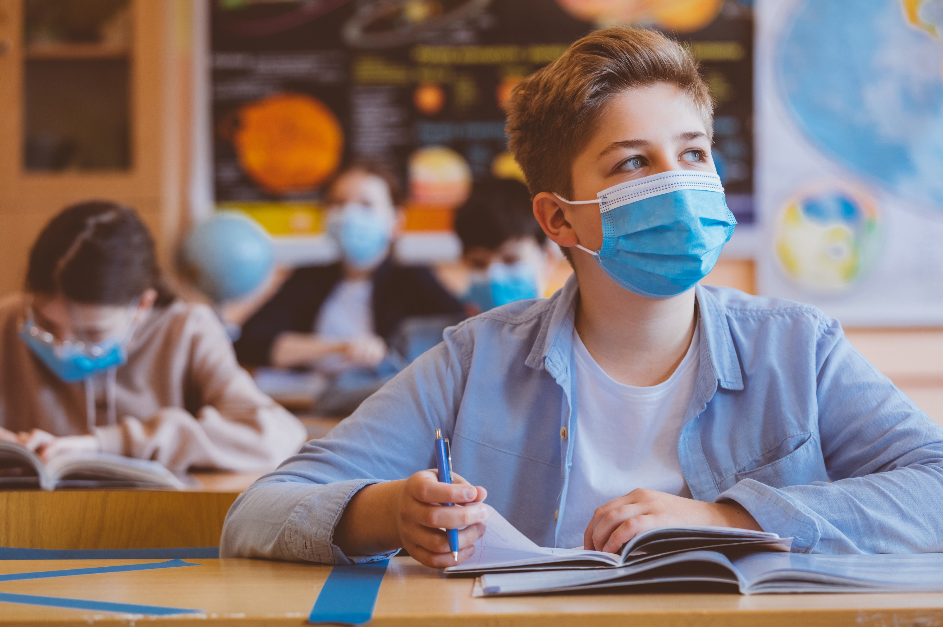
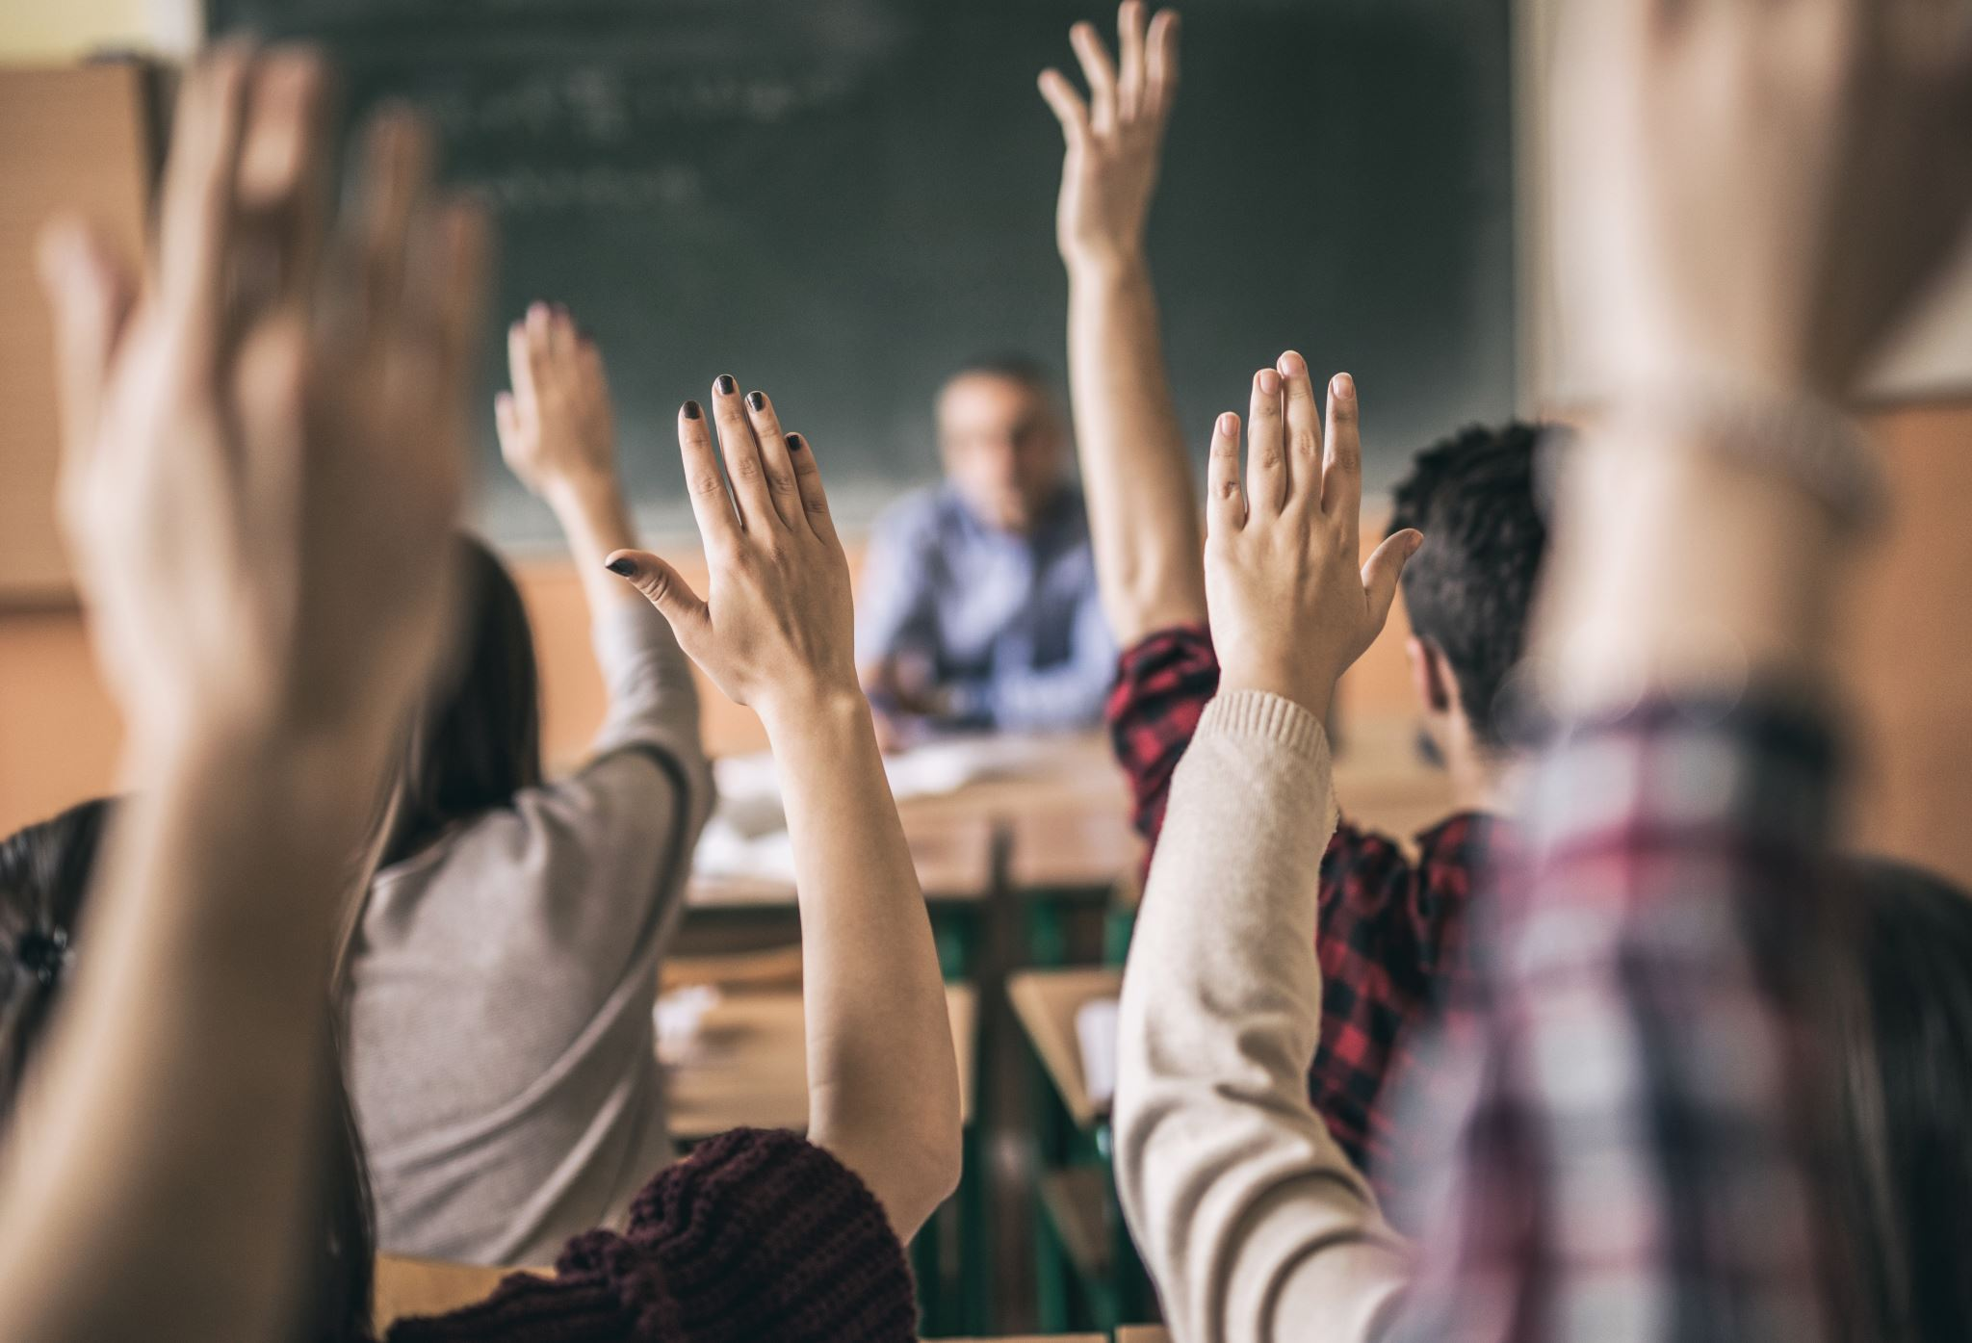
Olivia Rosario Monmouth University
Anastasia Elementary School Clinal Experience Reflection
Setting
Overview of Community
West Long Branch
Ocean County
Overview of School
A A Anastasia Elementary School
Grades K-5
567 students
Student to teacher ratio is 8:1
53% male and 47% female students
71% of the students are Hispanic, while the rest are a mix of white, African American, Asian
https://www.publicschoolreview.com/a-a-anastasia-elementary-school-profile
Overview of Classroom
5th grade students
8 students in the classroom
Students use see saw and online math programs for their homework assignments
Students are on a joint zoom call at all times whether they are in person or at home
Understandings
During this experience, it really opened my eyes to how different everyone is
Learning about different kinds of disabilities in class made it easier for me to work with the students
Knowing that everyone is different is extremely important in this field
Impacts
In my service learning, I tried to be positive and show the students they can always feel comfortable asking questions and participating during the lesson
Future Goals
In the future, I hope that I can make all of the students in my classroom comfortable when asking questions during a lesson, and asking for help when they need it
I want to continue working towards a positive classroom environment where my students can grow and flourish
Description of Students
3 females and 5 males in the class
All students have some form of reading and comprehending disability
Course & Project
In the class ED 330, students were required to attend 15 hours of service learning in a classroom, and help not only the students but the teachers as well all while gaining knowledge and experience about becoming a teacher
Role
As a Monmouth student, I did everything I could to help my participating teacher, and make class easier for her. I helped students with their homework in breakout rooms and even prepared educational games for them to help them work on their math skills.
Notes:
Hello, My name is Olivia Rosario. I am a sophomore health and physical education major. This year, for my ED 330 class, we were required to complete 15 hours of on site clinical experience, in an actual classroom. We were assigned to the Amerigo Anastasia elementary school, in west long branch, Nj. I myself was put in a special education classroom to not only observe the class, but help out in any way I could. All students in my class of 8, had some kind of reading or processing disability. The Anastasia elementary school Is extremely diverse, with 71% of the students being of Hispanic ethnicity, while the other 29% of the students in the school were made up of white, African American, and Asian decent. Anastasia elementary school is in a low socioeconomic area, which means that not all kids may have access to computers which is especially hard in this time where a lot of students are doing school from home. Besides all of that, my goal was to make students comfortable in this class. I wanted them to feel okay with raising their hand and asking a question about something they don’t understand. I tried my best to make the students feel comfortable around me. I helped them with their math homework's in breakout rooms as well as setting up an educational game for them to retain their knowledge about decimals. I hope I was able to help this class, and I want to thank my participating teacher for letting me do so in her classroom. In the future, I hope to create a positive learning environment where mt students can feel comfortable to learn and flourish, and mostly, have fun. This experience opened my eyes, and I got to see how different every student it. Learning about different kinds of disabilities in my ED 330 class made it a lot easier to work with the students in my class.

