Slide 1
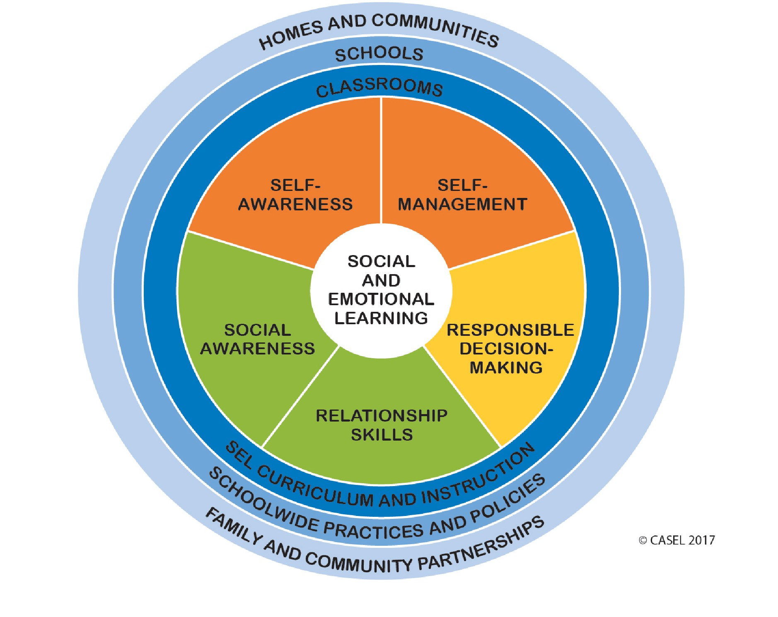
Culturally and Linguistically Diverse learners: how implementing social and emotional learning strategies will help close the academic achievement gap
s1211196@monmouth.edu
Monmouth University School of Education
Introduction
Findings
Data from George L. Catrambone School in Long Branch, NJ retrieved from the New Jersey Department of Education website helps understand more about its community and efforts being made in order to improve students’ scores.
Long Branch serves a large community of Culturally and Linguistically Diverse (CLD) students where some are also part of the underachievement group. The report helps us understand which areas need focus and more research in order to help those students and what is already being done and showing improvement.
One of the biggest challenges in American schools is how to address culturally and linguistically diverse (CLD) students’ needs. Those students usually present a lack of social and emotional skills, becoming less connected with the school setting, which is usually a result of an environment that does not exactly understand or respect those students' cultural background. Such aspects tend to end up in low academic achievement, behavioral issues, and health problems, especially mental health (Durlack, Dimnicki, Taylor, Weissberg & Schellinger, 2011)
Numerous schools have been implementing SEL programs - especially schools in low-income areas. SEL programs are based on developing “cognitive, emotional and behavioral skills regarded as foundational for academic performance” (McCormick, Capella, O’Connor and McClowry, 2015). These programs focus on students’ positive relationships, responsible decision making through the development of critical thinking and the ability to “handle interpersonal situations” (Zins & Elias, 2006 in McCormick et al, 2015).
“Relationships and emotional processes affect how and what we learn” (Durlack et al, 2011, p. 405). However, it is the school’s responsibility to address those aspects, making sure students are being set to succeed in their academic life.
Teacher-student interaction quality can be grouped into three domains: emotional support, classroom organization, and instructional support. Altogether, they have been linked to children’s positive outcomes. Positive emotional support has proved to be essential to allow positive academic achievement (Abry, Rimm-Kaufman & Kurby, 2016).
“Identifying best practices for serving the needs of at-risk CLD students has become a priority for school-based mental health care providers” (Castro-Olivo, 2014, p. 568). CLD students, especially ELLs, are usually the ones with lower feelings of school belonging and higher levels of social and emotional problems. “Very few interventions have been developed and validated to support the multiple needs of these students” (Castro-Olivo, 2014, p. 568)
As per literature and research, I strongly believe that incorporating social and emotional learning skills to the curriculum is one of the most important strategies to help Culturally and Linguistically Diverse - CLD (Allen 2017) students to lower their affective level, help them adjust to a new culture and language, feel safe and, consequently, ready to learn and succeed, helping close the academic achievement gap between CLD students and the mainstream ones.
Research Question
Throughout almost ten years of my life dedicated to the field of education, I have noticed that, when applying social and emotional learning (SEL) strategies in the classroom, teachers have been able to help their students improve their test scores and, most importantly, set them ready for learning. “SEL programs focus on developing social-emotional competence in the context of a safe, caring, and well-managed school and classroom environment” (Panayiotou et al., 2019). That is why this research’s attempt is to analyze if adding social and emotional learning programs to the curriculum will help close the academic achievement gap of the Culturally and Linguistically Diverse students who attend GLC school.
References
Allen, J. K. (2017). Exploring the Role Teacher Perceptions Play in the Underrepresentation of Culturally and Linguistically Diverse Students in Gifted Programming, Gifted Child Today. 40. DOI: 10.1177/10766217517690188
Abry, T., Rimm-Kaufman, S.E., Curby, T. W. (2016) Are all program elements created equal? Relations between specific social and emotional learning components and teacher-student classroom interaction quality. Crossmark. 18. 193-203. DOI: 10.1007/s11121-016-0743-3
Castro-Olivo, S.M. (2014) Promoting social-emotional learning in adolescent latino ELLs: A study of the culturally adapted strong teens program, School Psychology Quarterly. 29. 567-577. DOI: 10.1037/spq0000055
Durlack, J.A., Dymnicki, A.B., Taylor, R.D., Weissberg, R.P., Schellinger, K.B. (2011) The impact of enhancing students’ social and emotional learning: a meta-analysis of school-based universal interventions. Child Development. 82, 405-432
McCormick, M. P., Capella, E., O’Connor, E.E., McGlowry, S.G. (2015) Social-Emotional Learning and Academic Achievement: Using Casual Methods to Explore Classroom-Level Mechanisms. AERA Open, 1. 1-26. Doi: 10.1177/2332858415603959
National Center for Education Statistics retrieved from
https://nces.ed.gov/ccd/districtsearch/district_detail.asp?Search=2&details=1&ID2=3408940&DistrictID=3408940
NJ School Performance Report retrieved from
https://rc.doe.state.nj.us/SearchForSchool.aspx
Panayiotou, M., Humphrey, N., Wigelsworth, M. (2019) An empirical basis for linking social and emotional learning to academic achievement. Contemporary Educational Psychology, 56. 193-204
Methodology
This research consists of an analysis of George L. Catrambone School’s report available on the New Jersey Department of Education website, aligned with a review of the literature that includes the use of social and emotional learning strategies as a tool for closing the academic achievement gap of Culturally and Linguistically Diverse students.

